Slide 1
Hale COLLAGE (CU ASTR-7500)
“Topics in Solar Observation Techniques”
Spring 2016, Part 1 of 3: Off-limb coronagraphy & spectroscopy
Lecturer: Prof. Steven R. Cranmer
APS Dept., CU Boulder
steven.cranmer@colorado.edu
http://lasp.colorado.edu/~cranmer/
Lecture 10:
Scattering lines: diagnostics & results

Slide 2
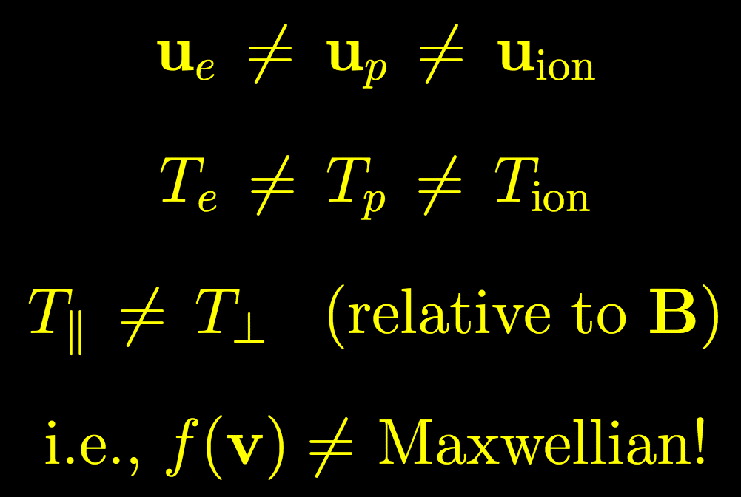
Brief overview
Goals of Lecture 10:
Understand lines dominated by radiative/scattering processes.
Discuss line profile shapes: sensitive to motions along line of sight.
In the low-density outer corona…

Slide 3
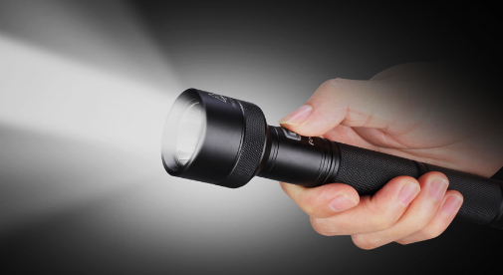
Emission line formation
In the ~high density inner corona, collisional lines have:
However, for some strong resonance lines formed on the solar disk, the disk photons “shine” on atoms in the extended corona & excite the line via scattering:
Because the detailed balance no longer depends on the C₁₂ rate, line intensity ends up being proportional to n₁ , not n₁n_{e}

Slide 4
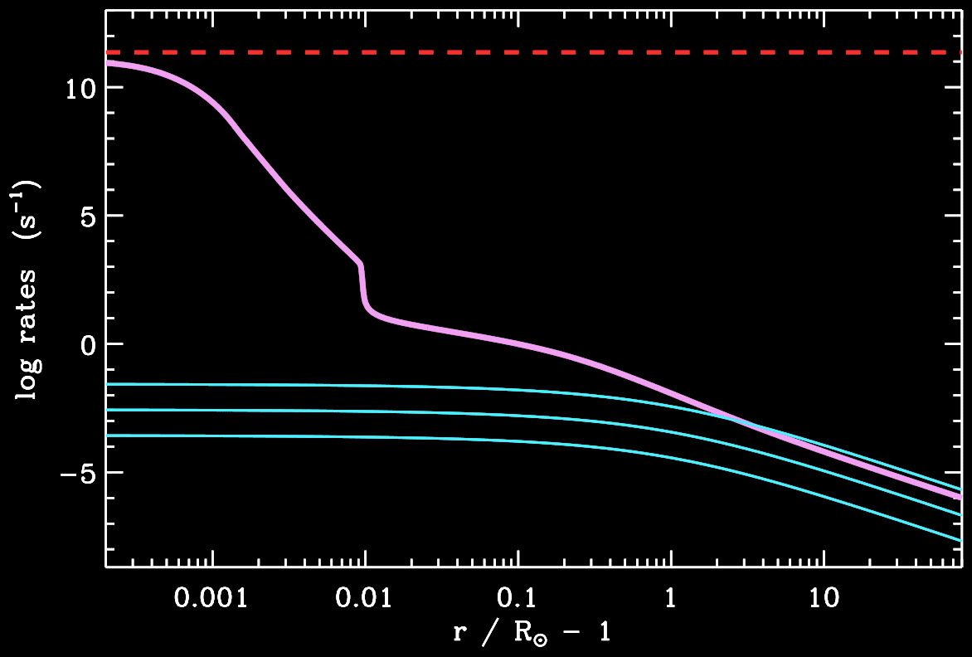
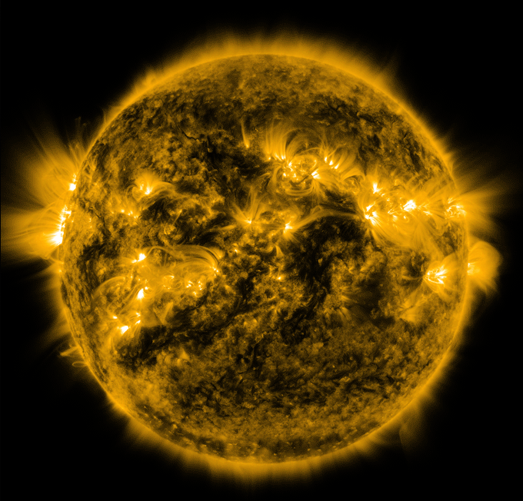
Example: Fe IX 17.1 nm
A₂₁
C₂₁
B₂₁ J

Slide 5
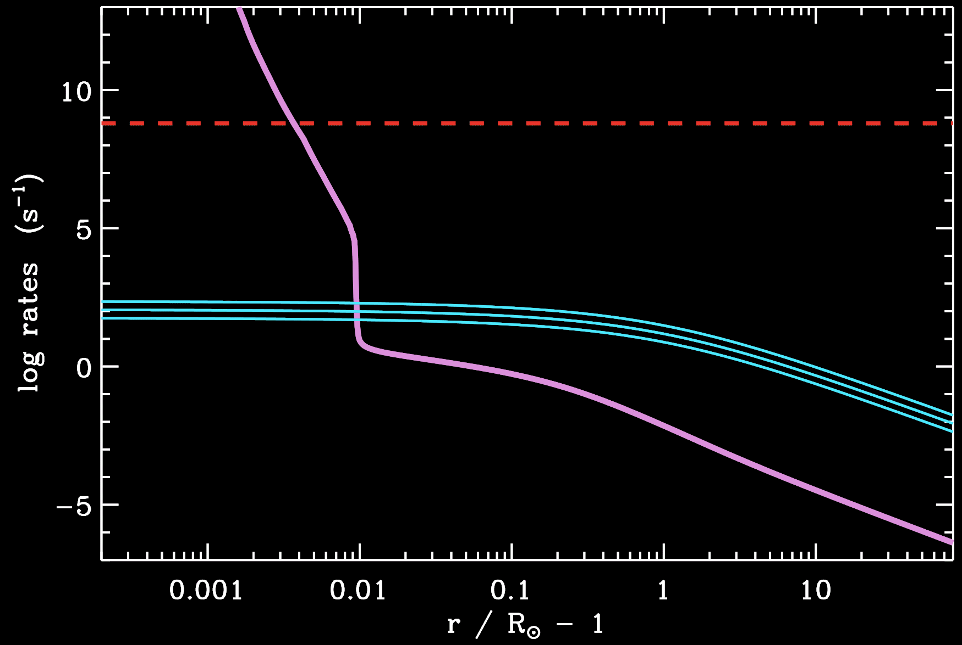
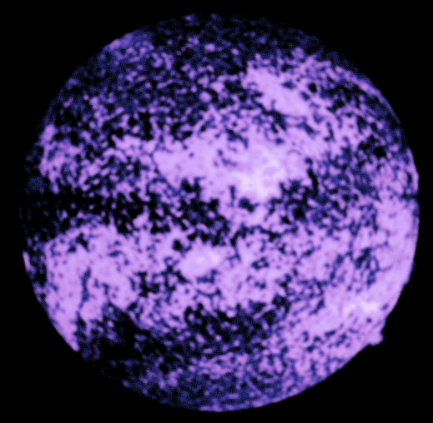
Example: H I Lyman α 121.6 nm
A₂₁
B₂₁ J
C₂₁

Slide 6
Scattering line formation
Recall…
For scattering lines, a_{ν} ≈ 1, but coherent isotropic scattering is too simple…
redistribution function

Slide 7
Down the redistribution rabbit-hole
Write frequencies in atom’s rest frame as ξ′ (absorbed) and ξ (re-emitted).
Assume probabilities of absorption & re-emission are independent, and also assume the frequency & angle dependences are independent of one another:
transition is ideally “sharp”
atom doesn’t care where photon came from
scattering is coherent (in atom’s frame!)
Hummer’s Case I:
isotropic
Thomson or Rayleigh
other orbitals (n=4, 8, 12)

Slide 8
Down the redistribution rabbit-hole
Write frequencies in atom’s rest frame as ξ′ (absorbed) and ξ (re-emitted).
Assume probabilities of absorption & re-emission are independent, and also assume the frequency & angle dependences are independent of one another:
transition is ideally “sharp”
atom doesn’t care where photon came from
scattering is coherent (in atom’s frame!)
Hummer’s Case I:
isotropic
Thomson or Rayleigh
other orbitals (n=4, 8, 12)

Slide 9
Down the redistribution rabbit-hole
Write frequencies in atom’s rest frame as ξ′ (absorbed) and ξ (re-emitted).
Assume probabilities of absorption & re-emission are independent, and also assume the frequency & angle dependences are independent of one another:
transition is ideally “sharp”
atom doesn’t care where photon came from
scattering is coherent (in atom’s frame!)
Hummer’s Case I:
isotropic
Thomson or Rayleigh
other orbitals (n=4, 8, 12)

Slide 10
Down the redistribution rabbit-hole
Write frequencies in atom’s rest frame as ξ′ (absorbed) and ξ (re-emitted).
Assume probabilities of absorption & re-emission are independent, and also assume the frequency & angle dependences are independent of one another:
transition is ideally “sharp”
atom doesn’t care where photon came from
scattering is coherent (in atom’s frame!)
Hummer’s Case I:
isotropic
Thomson or Rayleigh
other orbitals (n=4, 8, 12)

Slide 11
Redistribution in observer’s frame
The corona is a collection of atoms moving randomly… assume a Maxwellian velocity distribution f (v), drifting at bulk velocity u.
What we see is a weighted average over f…
Turn the crank…

Slide 12
Redistribution in observer’s frame
For simple case of u = 0 (no solar wind), and θ = 90º (“plane of sky”):
(our earlier assumptions of coherent & isotropic scattering were ~OK)
However, for the real corona…
I_{ν′} is also in the integrand… “flashlight” is a line, not continuum!
Integral over dΩ′ isn’t simple because <R_{I}> depends on θ
u ≠ 0
There’s a mismatch between:
the centroid of the line (flashlight), and
the centroid of the coronal f(v)

Slide 13
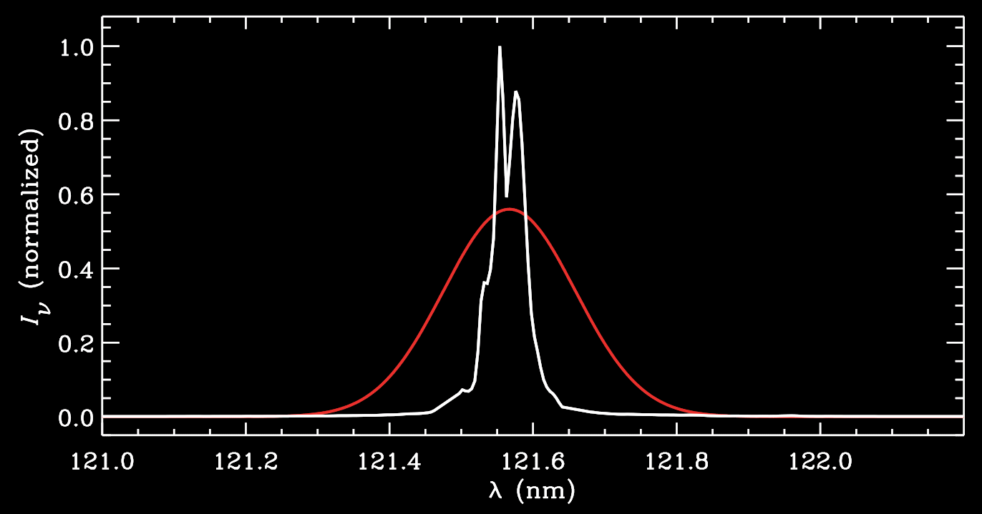
“Simple” coronal redistribution
Let’s keep assuming θ = 90º
Also, solar disk line is “sharp” with no limb darkening…
Example: H I Lyman alpha
Disk line is formed in upper chromosphere / lower TR
Coronal line is broader (with local T in Δν_{D}) and “Doppler dimmed”

Slide 14
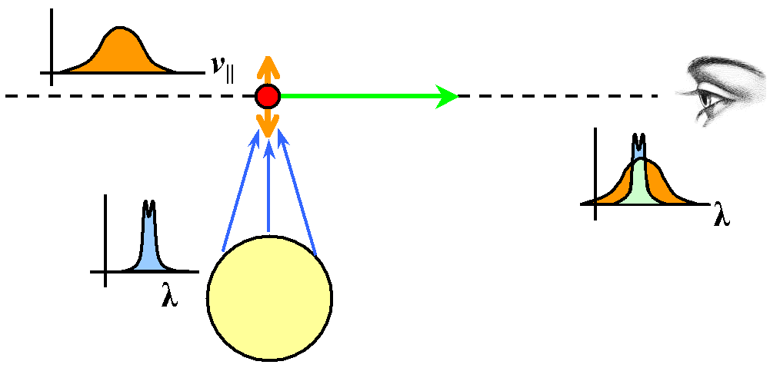
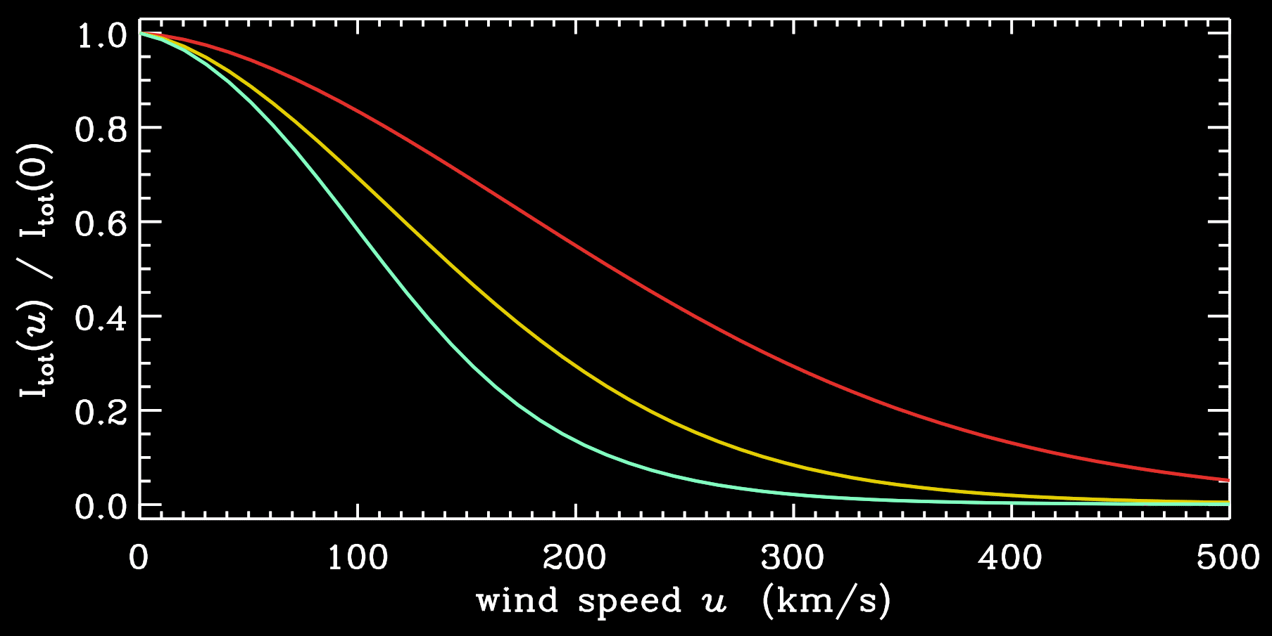
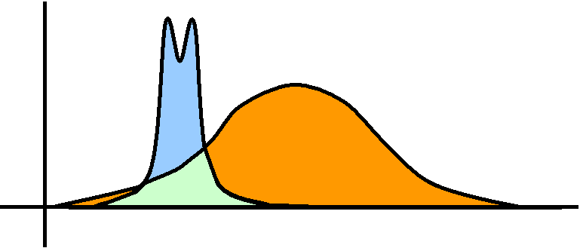
Doppler dimming
–(u/v_{th})²
It’s kind of amazing that the e factor is the result of a Doppler shift, but for velocities not parallel to the line of sight!
For scattering lines, the total number of photons scattered depends on how well the radial velocity distribution lines up with the narrow source of photons.
T_{H} = 0.3, 1, 3 MK
larger u

Slide 15
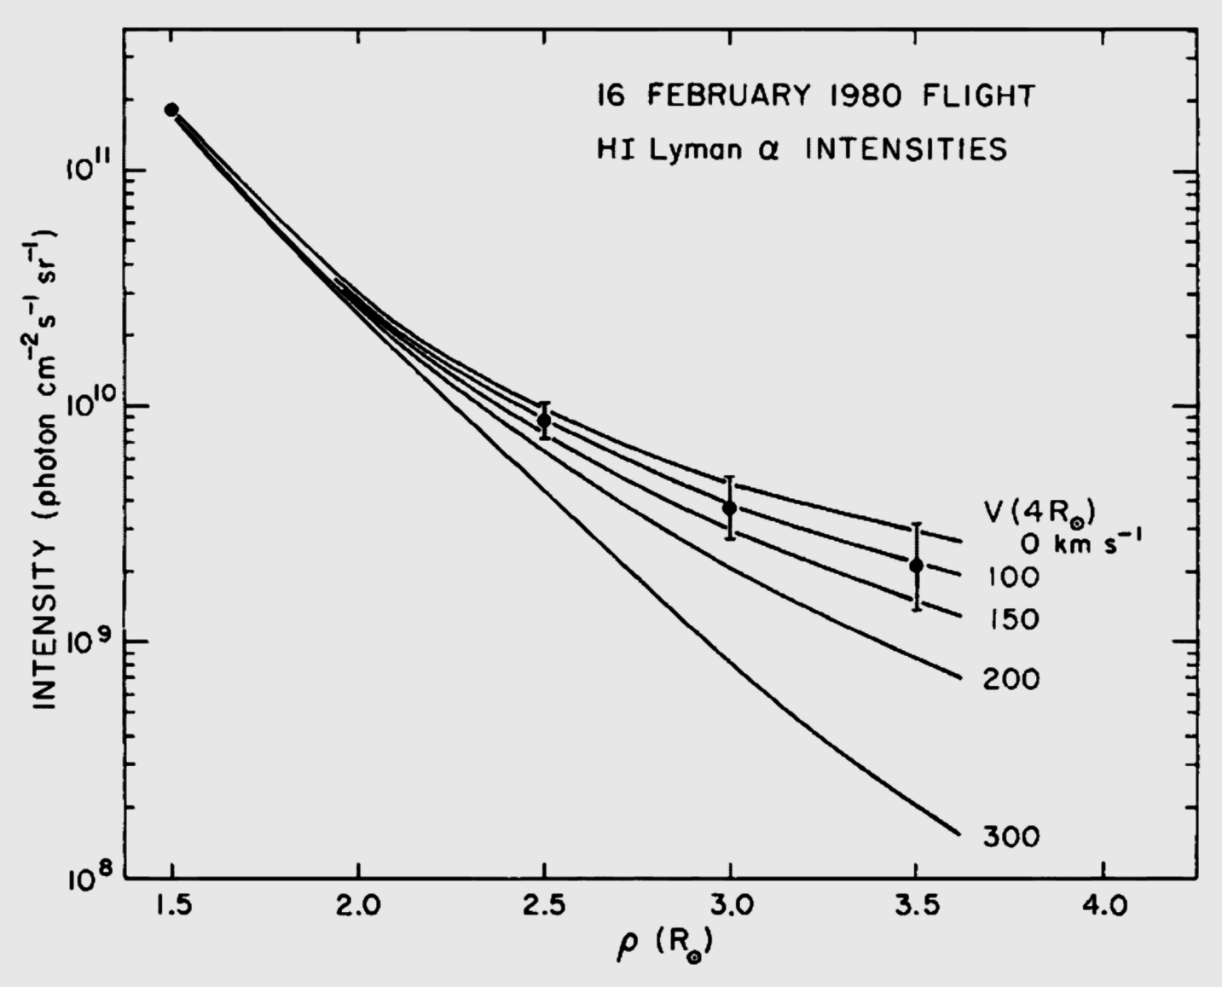
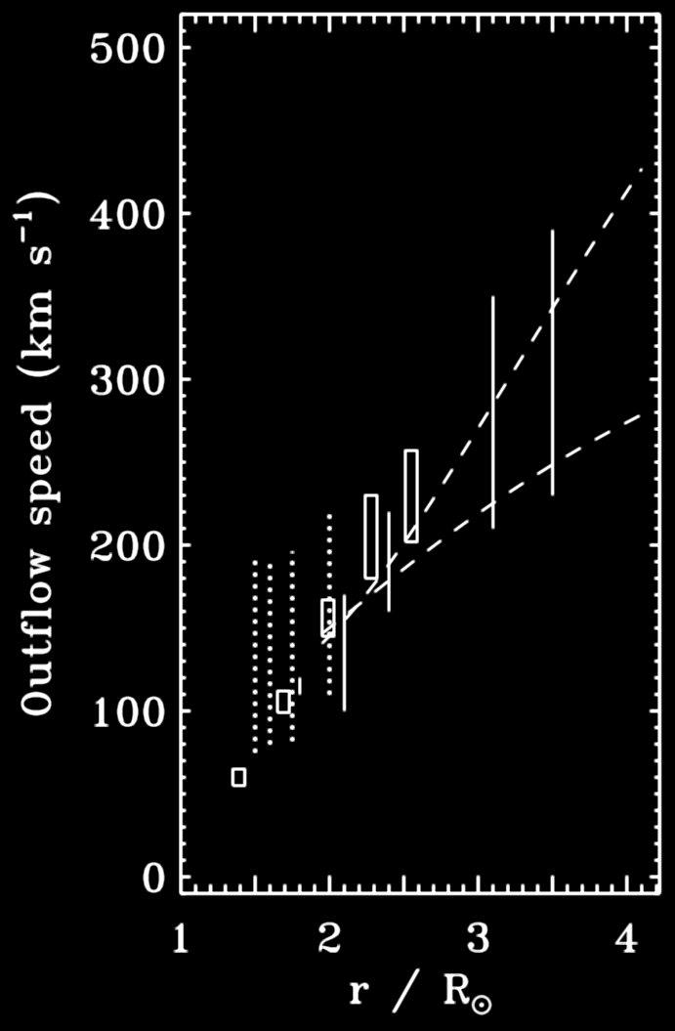
Doppler dimming
Hints of H I Lyα Doppler dimming were first seen in data from 1980 rocket flight of a UV coronagraph spectrometer (Kohl, Withbroe, et al.)
UVCS / SOHO
(1996–2006)

Slide 16
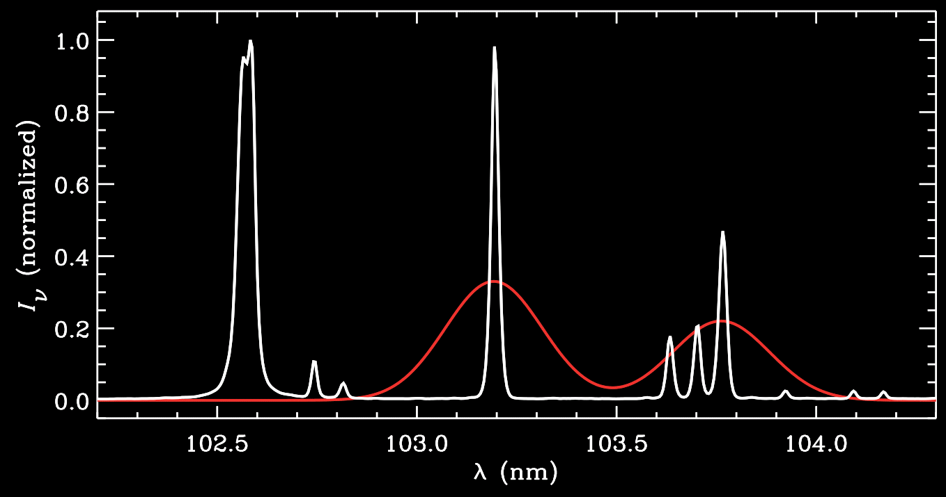
Doppler dimming… and “pumping”
What if there are several nearby lines in the solar disk spectrum?
The coronal profile can get shifted out of “its own” line… and into the “flashlight beam” of these other lines.
H I Lyβ
O VI
O VI
C II

Slide 17
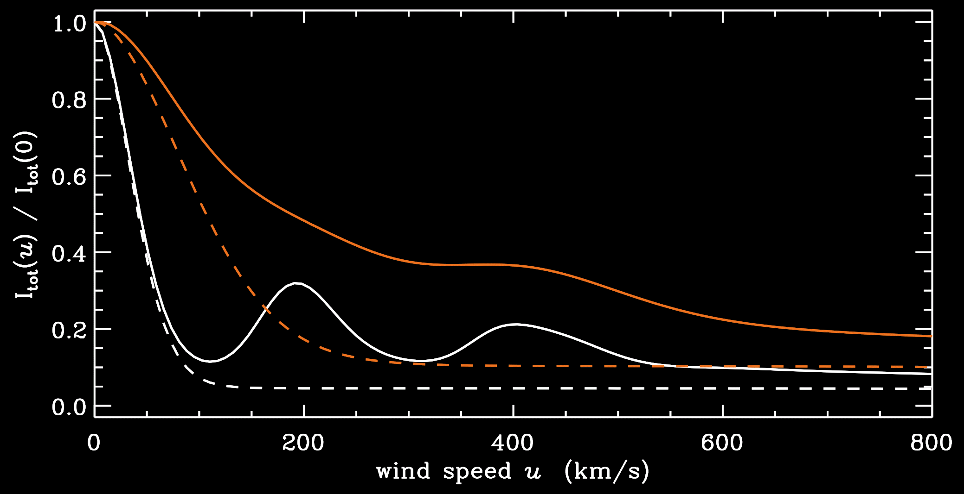
Doppler dimming… and “pumping”
What if there are several nearby lines in the solar disk spectrum?
The coronal profile can get shifted out of “its own” line… and into the “flashlight beam” of these other lines.
T_{O+5} = 1, 10 MK
O VI 103.2
O VI 103.7 (with pumping)

Slide 18
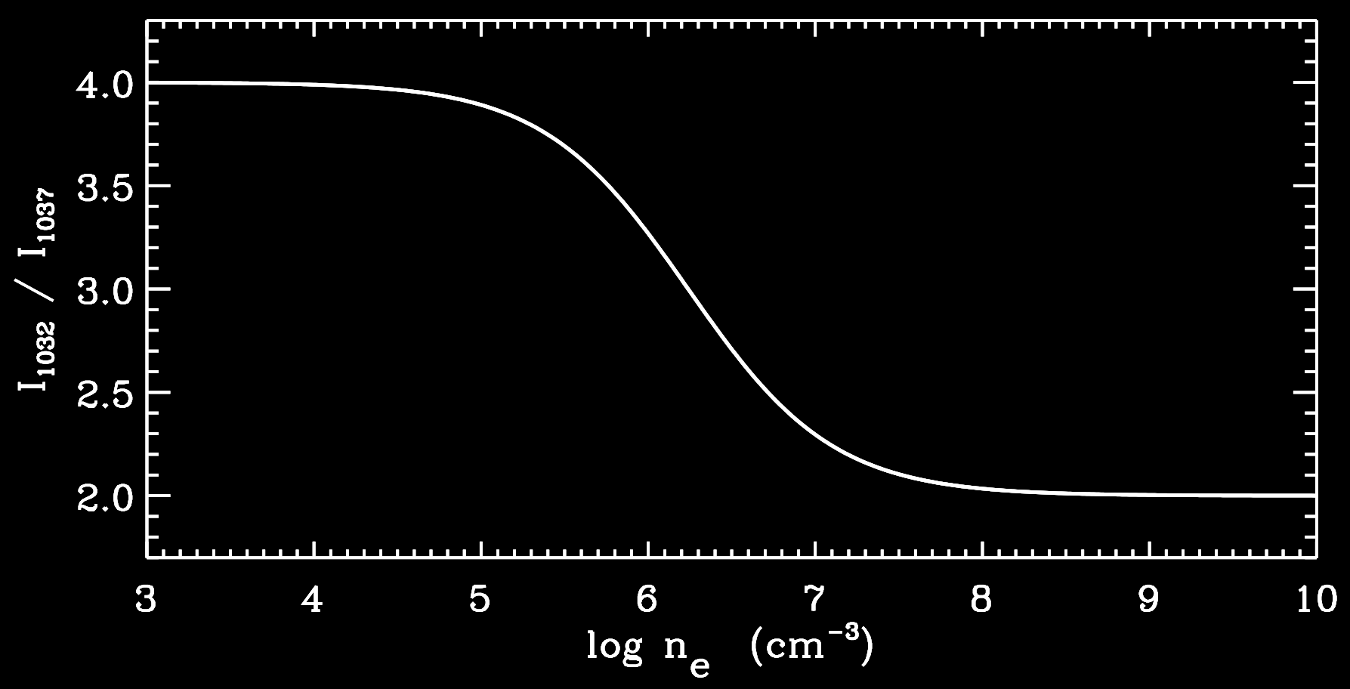
The O VI 103.2, 103.7 nm doublet
Even without Doppler dimming/pumping, these lines are useful as n_{e} diagnostics…
Collision-dominated (high n_{e})
Scattering-dominated (low n_{e})
limited to 2 ↔ 4 when u = 0

Slide 19
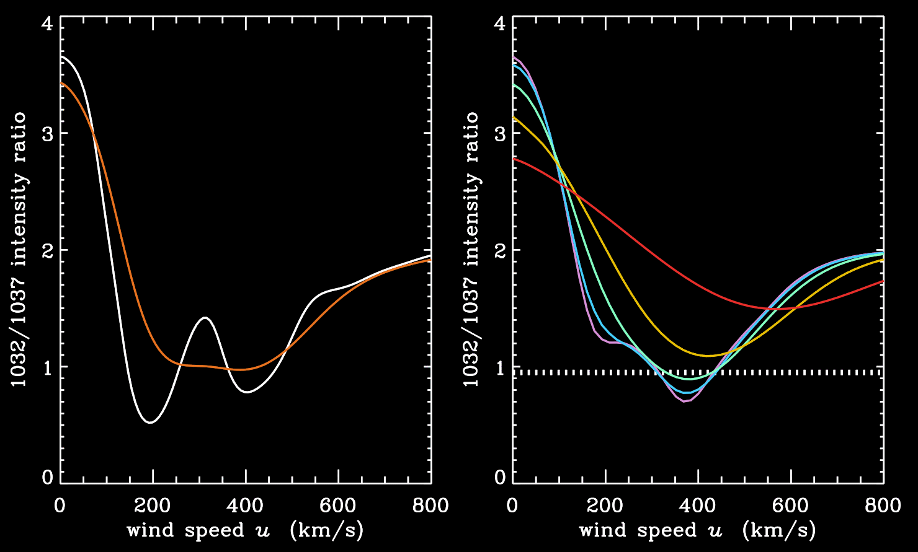
The O VI 103.2, 103.7 nm doublet
Ratios below 2 indicate pumping from the 103.7 line … and thus u ≠ 0
T_{O+5} = 1, 10 MK
(std. coronal n_{e})

Slide 20
Anisotropic temperatures?
UVCS/SOHO observations indicate that the above analysis may not have been general enough…

Slide 21
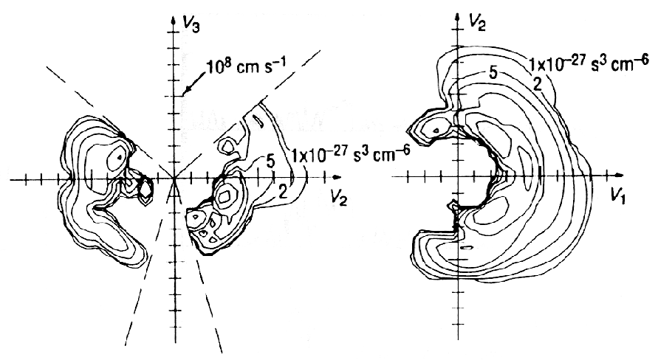
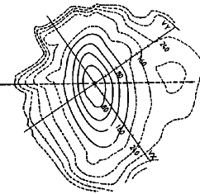
Anisotropic temperatures?
UVCS/SOHO observations indicate that the above analysis may not have been general enough…
In {laboratory, magnetospheric, heliospheric} plasmas, the velocity distribution is often not Maxwellian….
fast solar wind
Helios @ 0.3–1 AU
(Marsch 1991)
Venus bow shock, Galileo (Russell et al. 1995)
B

Slide 22
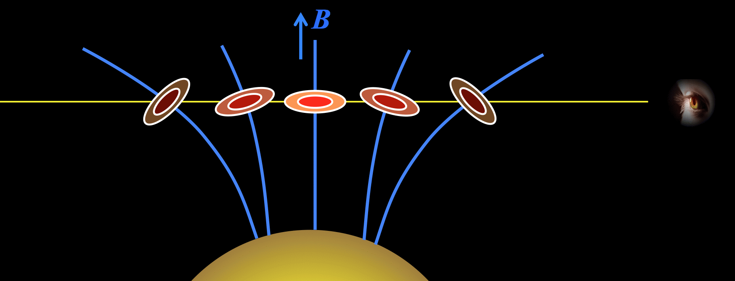
Anisotropic temperatures?
Scattering lines have different sensitivities to different T’s …
T_{e}
(via ionization balance)
line-of-sight projection of f(v)
≈ T _{ion} ┴
Sun-to-ion projection of f(v)
≈ T _{ion} | |

Slide 23
What did UVCS see?
In coronal holes (lowest density, least collisional), O VI line widths indicated LOS temperatures of order 100 MK… hotter than in solar core?!

Slide 24
The O VI 103.2, 103.7 nm doublet
Ratios below 2 indicate pumping from the 103.7 line … and thus u ≠ 0
T_{O+5} = 1, 10 MK
(std. coronal n_{e})

Slide 25
The O VI 103.2, 103.7 nm doublet
Ratios below 2 indicate pumping from the 103.7 line … and thus u ≠ 0
T_{O+5} = 1, 10 MK
(std. coronal n_{e})
T┴ = 165 MK (obs!)
T|| = 1, 3, 10, 30, 100 MK
obs. ratio at 3 R_{ʘ}

Slide 26
The power of off-limb UV spectroscopy
UVCS/SOHO led to new views of the collisionless nature of the solar wind.
Heavy ions are “minor ions,” but they’re valuable probes of the physics!
In coronal holes, heavy ions (e.g., O⁺⁵) both flow faster and are heated hundreds of times more strongly than protons and electrons, and have anisotropic velocity distributions.
T|| ≈ (0.1-0.3) T┴
T┴
(Kohl et al. 1995, 1997, 1998, 1999, 2006; Cranmer et al. 1999, 2008; Cranmer 2000, 2001, 2002)

Slide 27
Emission line profile shapes
Let’s take a step back…
For either collisional or scattering lines, the overall Doppler shifts & widths contain a great deal of information…

Slide 28
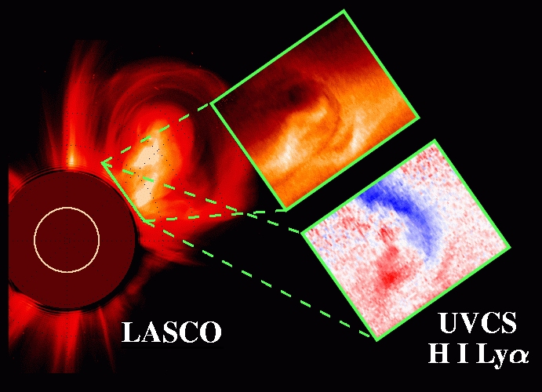
Emission line profile shapes
If line profiles are Doppler shifted up or down in wavelength (from known rest wavelength), this gives bulk flow speed along line of sight.
δλ
VLOS
=
λ₀
c
Very useful for CMEs:
δλ
λ₀
Profile widths tell us about unresolved (random?) motions along line of sight: perp. temperatures & MHD wave “sloshing.”
Space (many incoherent “elements” along line of sight)
Time (spectrum integration time >> intrinsic fluctuation time)
“unresolved” in

Slide 29
Line width diagnostics
Can we separate the two components of the width?
Δλ_{D}
thermal width
nonthermal width (waves?)
λ₀
Hypothesis #1: ideal MHD fluid: all T_{ion} are the same, and all ξ are the same.
If so, one can read off: T_{ion} (slope) and ξ ² (y-intercept)
and there shouldn’t be much scatter.
In practice: it works for some high-density regions near the limb.
v_{th,eff} ²
1/m_{ion}

Slide 30
Line width diagnostics
Hypothesis #2: for multiple ions, assume T_{ion} = T_{form} and solve for ξ ?
→ Dangerous: O VI is brightest oxygen line, but dominant ion at 10⁶ K is O VII !
Hypothesis #3: allow for widely varying T_{ion}’s, but assume all ξ are equal ?
→ If we observe >>1 ions at a given height…
→ We can compute ξ_{max} for each ion by assuming T_{ion} = T_{floor} (zero?)
→ The actual value of ξ must be ≤ min (ξ_{max})
→ Still only gives an upper limit for ξ
Hypothesis #4: make more assumptions... T_{ion} = const in r ? ξ(r) has known shape?
→ Dangerous !

Slide 31
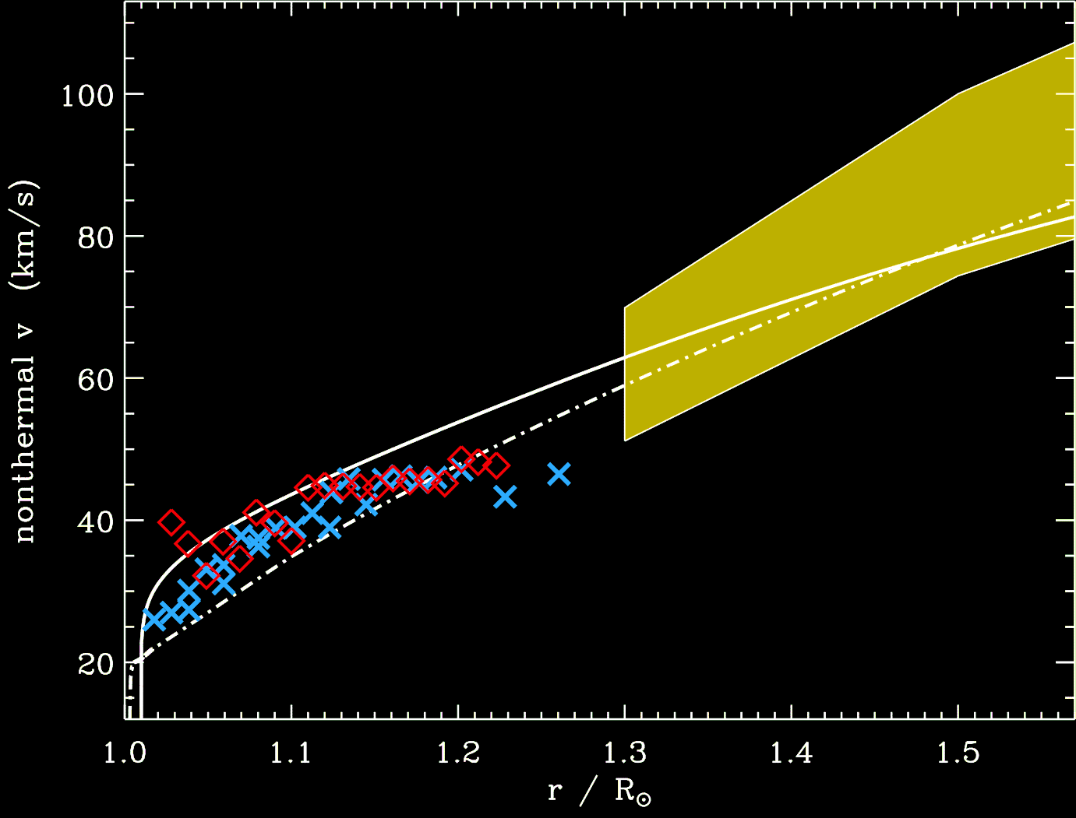
Transverse wave amplitudes?
Landi & Cranmer (2009)
ξ

Slide 32
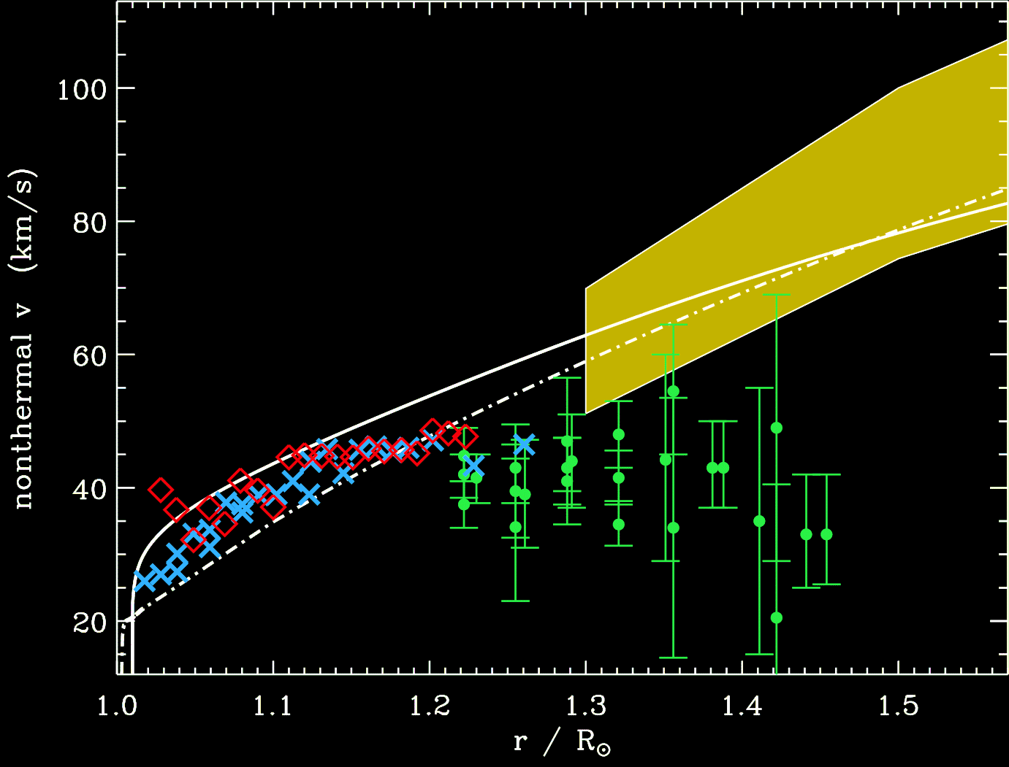
Transverse wave amplitudes?
Hahn & Savin (2012, 2013)
EIS/Hinode
ξ

Slide 33
Next time
Bridging remote-sensing (solar telescope) and in situ (space probe) diagnostics.
More about departures from Maxwellian distributions.
Radio sounding of the corona (w/ natural & “unnatural” sources) also bridges the traditional gap.
(no video?)

