Slide 1
Hale COLLAGE (CU ASTR-7500)
“Topics in Solar Observation Techniques”
Spring 2016, Part 1 of 3: Off-limb coronagraphy & spectroscopy
Lecturer: Prof. Steven R. Cranmer
APS Dept., CU Boulder
steven.cranmer@colorado.edu
http://lasp.colorado.edu/~cranmer/
Lecture 9:
Collisional lines: diagnostics & results

Slide 2
Brief overview
Goals of Lecture 9:
Discuss collisionally dominated lines: what plasma parameters are they sensitive to?
Understand relative benefits/tradeoffs of narrow-band imaging vs. high-resolution slit spectroscopy
Can we constrain the Differential Emission Measure (DEM) of the corona?

Slide 3
Collisionally dominated lines
Deep in atmosphere/interior, n_{e} is very high…
detailed balance:
(Boltzmann’s excitation formula in LTE)
A₂₁ >> C₂₁
J ≈ 0
In the corona, n_{e} is lower, and the radiation field is “weak”

Slide 4
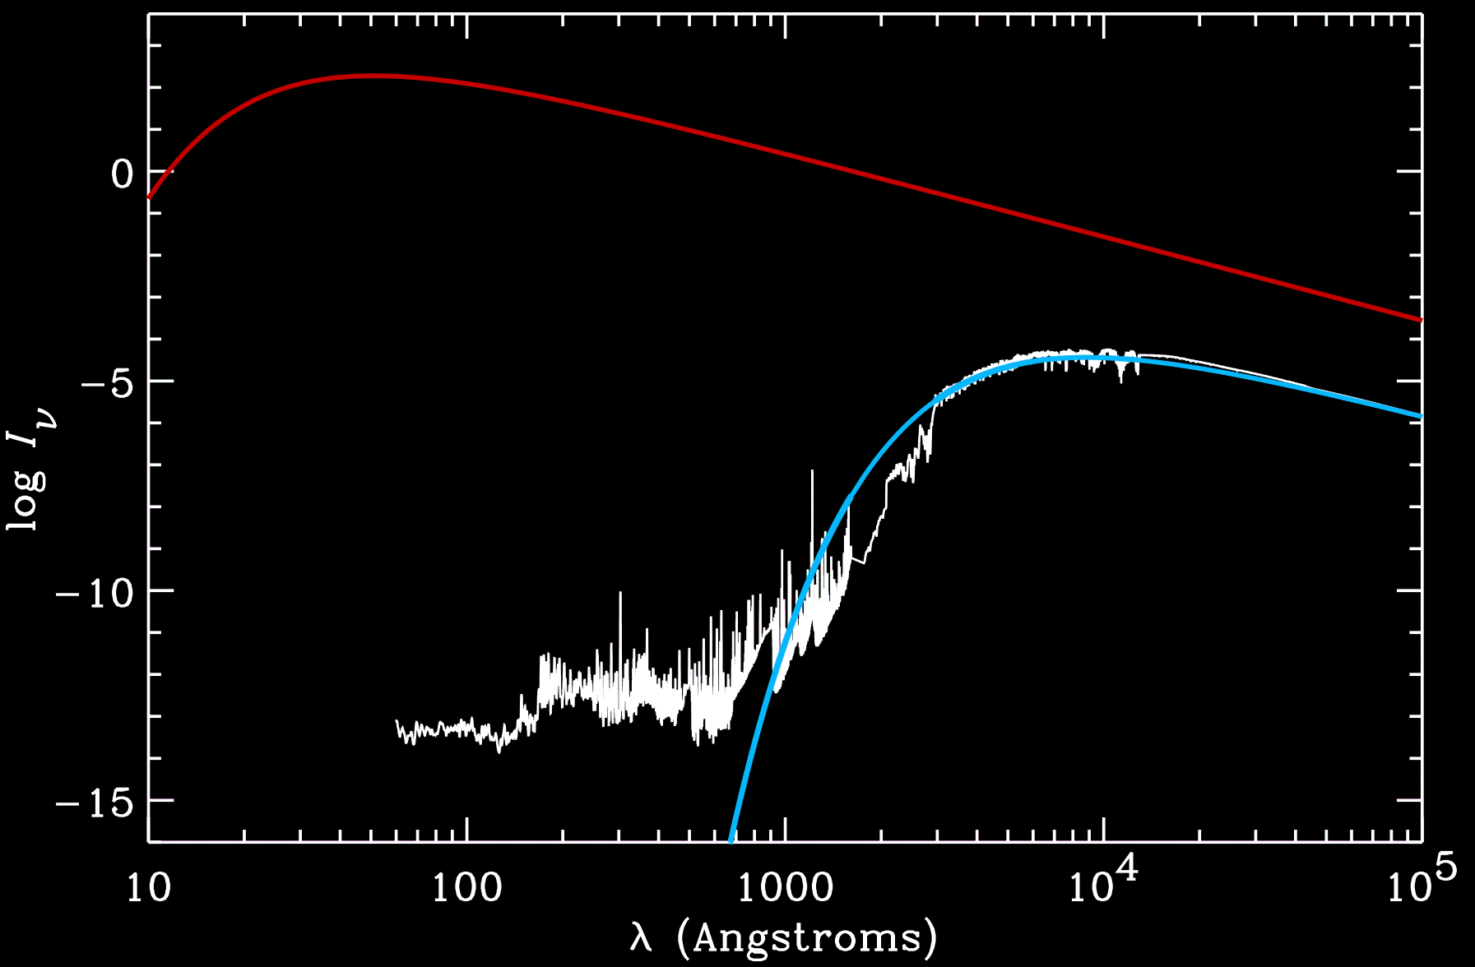
The coronal radiation field
B_{ν} (10⁶ K)
J_{ν} at surface
B_{ν} (5770 K)

Slide 5
Collisionally dominated lines
Deep in atmosphere/interior, n_{e} is very high…
detailed balance:
(Boltzmann’s excitation formula in LTE)
A₂₁ >> C₂₁
J ≈ 0
In the corona, n_{e} is lower, and the radiation field is “weak”
“coronal” detailed balance:

Slide 6
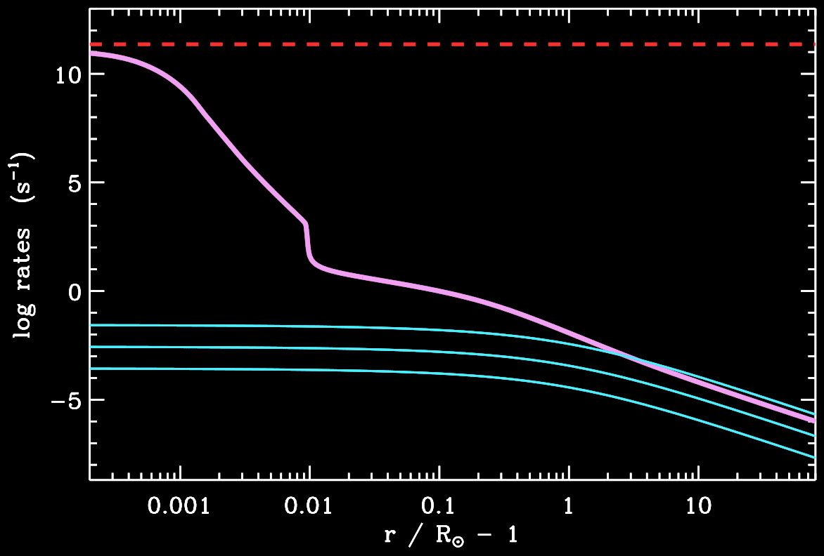
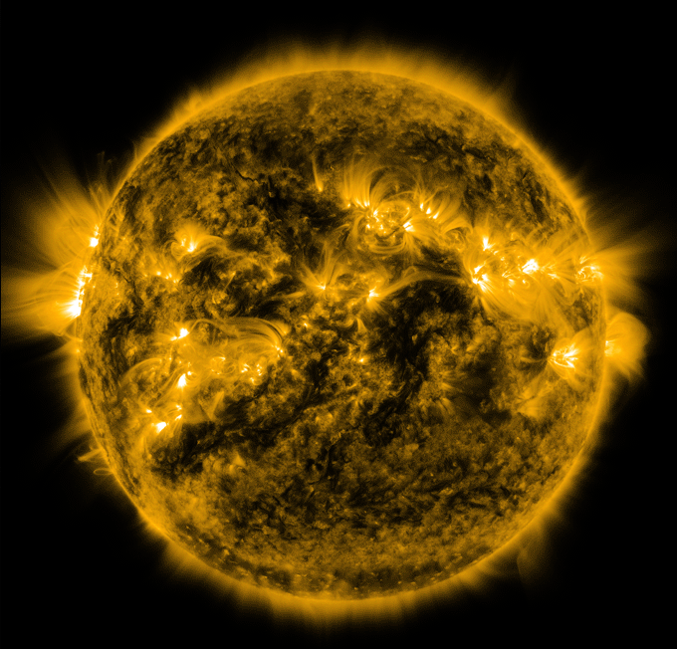
Example: Fe IX 17.1 nm
A₂₁
C₂₁
B₂₁ J

Slide 7
Density-squared integrand
There’s a lot wrapped up in this…
≈ 0.85 for standard solar abundances
relative population of lower level
ionization fraction
elemental abundance
≈ 1 for resonance lines

Slide 8
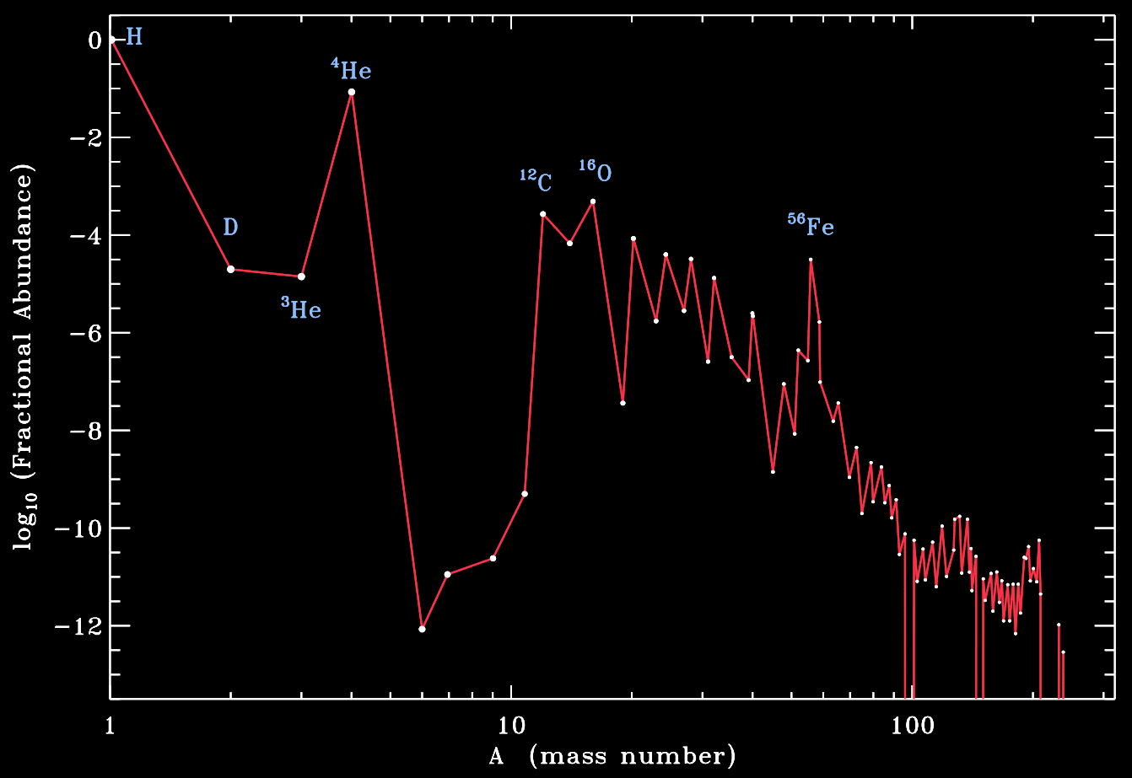
Elemental abundances
Asplund et al. (2009)

Slide 9
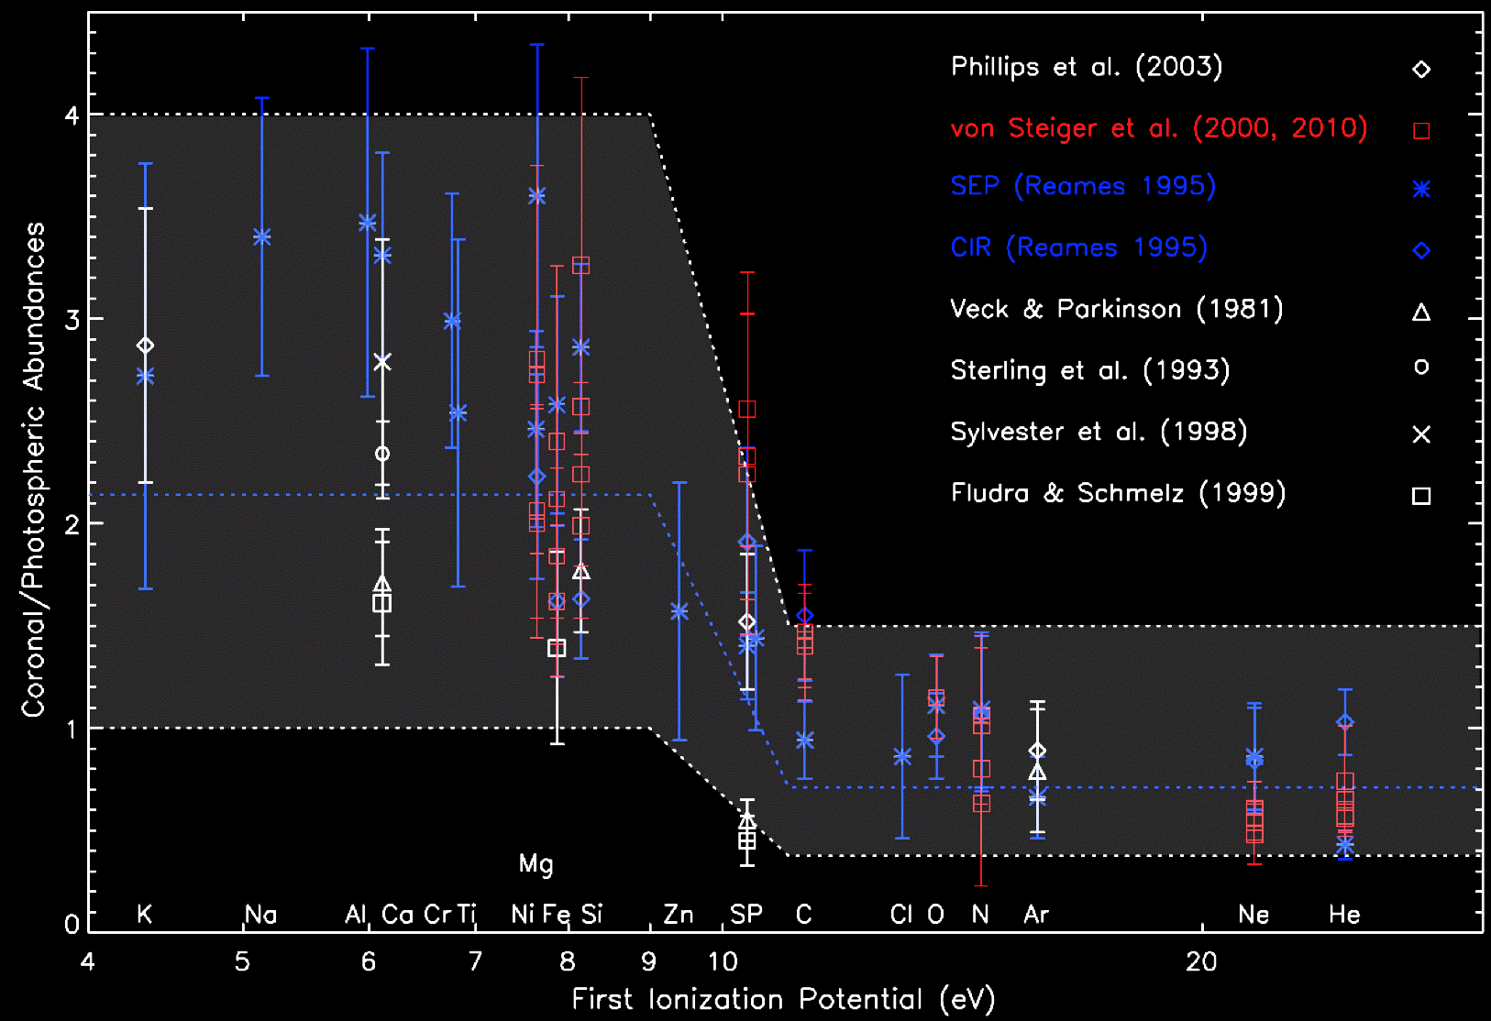
Elemental abundances: the FIP effect

Slide 10
Ionization balance
0 ?

Slide 11
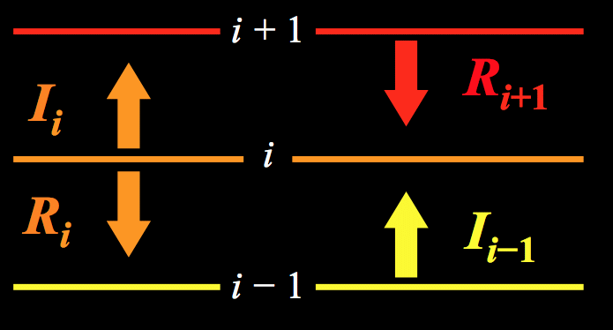
Ionization balance

Slide 12
Ionization balance: processes

Slide 13
Collisional ionization balance
In different regions, certain terms dominate the total ionization/recombination rates:

Slide 14
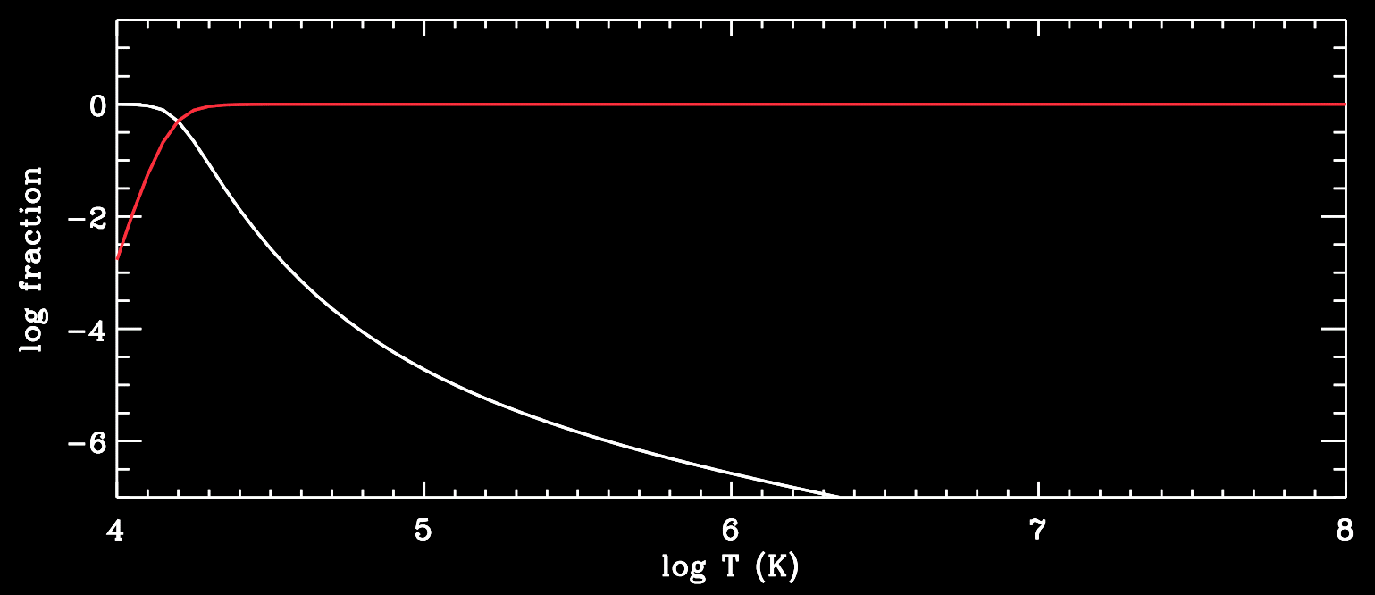
Collisional ionization balance
H II
H⁺¹
H I
H⁰

Slide 15
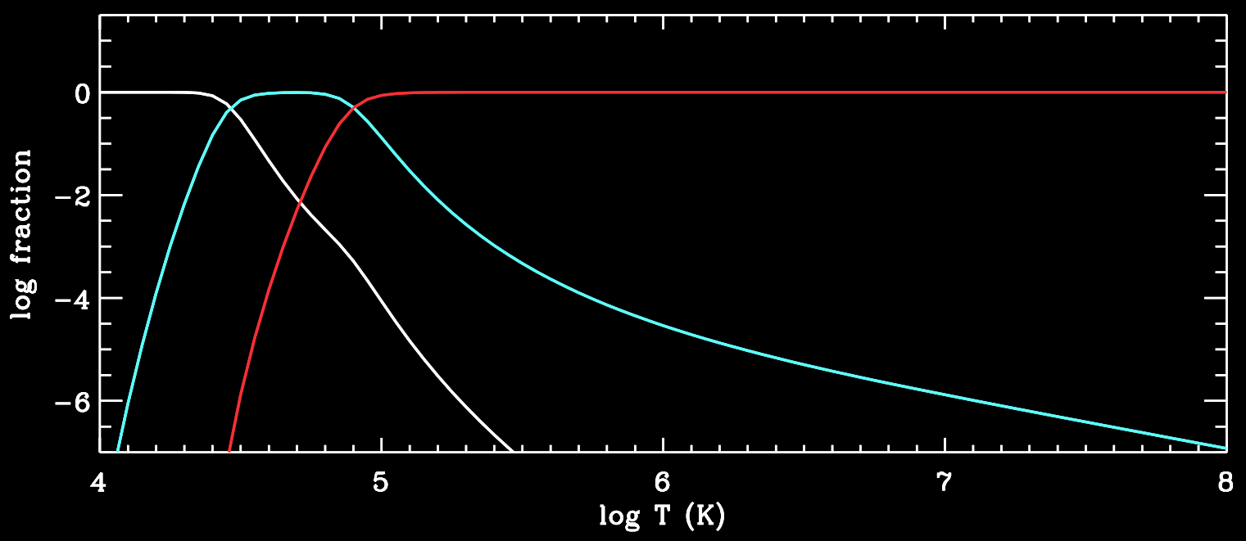
Collisional ionization balance
He I
He III
He II

Slide 16
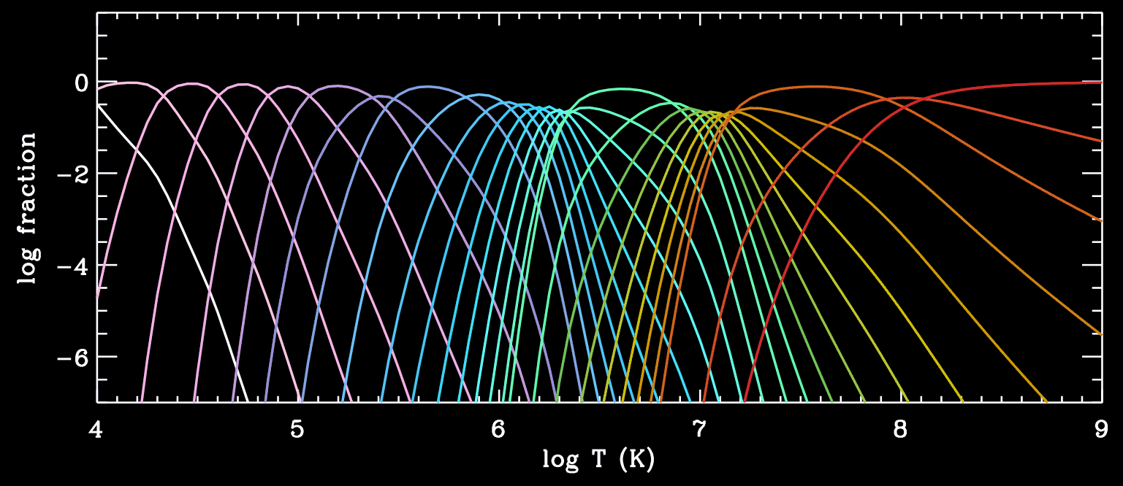
Collisional ionization balance
Fe I
Fe XXVII

Slide 17
Collisional ionization balance
Definitions:
One often sees lines identified with a “formation temperature” T_{form}
It’s just temperature at which its ion has maximum fractional abundance.
Note: (nearly) all temperatures discussed above are electron temperatures T_{e}
q(T), α(T) rates depend on the properties of free-electron “bullets.”

Slide 18
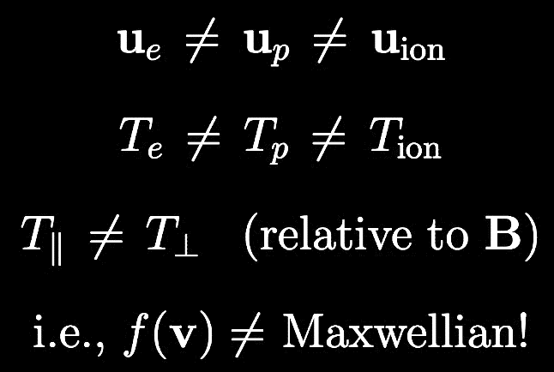
Collisional ionization balance
Definitions:
One often sees lines identified with a “formation temperature” T_{form}
It’s just temperature at which its ion has maximum fractional abundance.
Note: (nearly) all temperatures discussed above are electron temperatures T_{e}
q(T), α(T) rates depend on the properties of free-electron “bullets.”
In the extended corona…

Slide 19
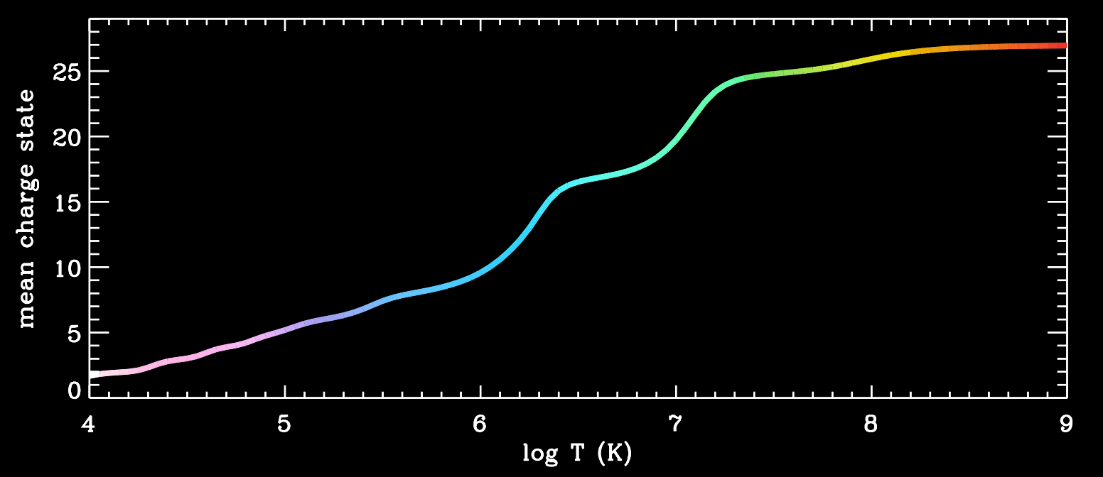
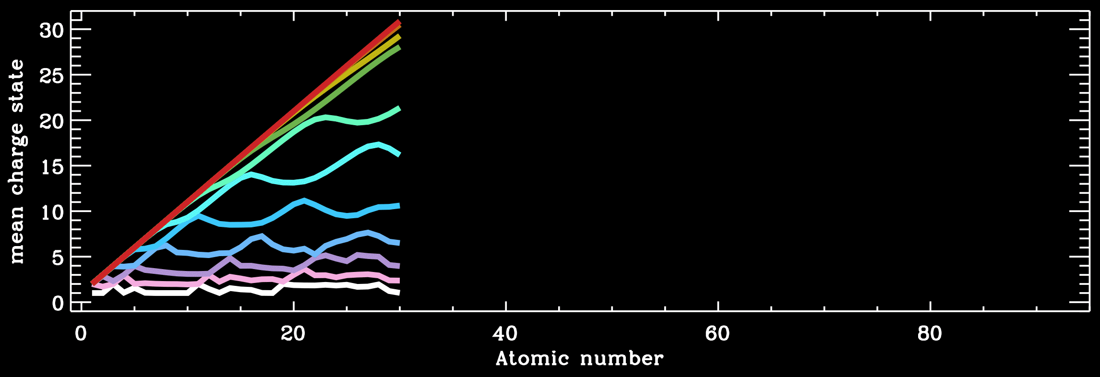
Collisional ionization balance
Fe
log T = 4, 5, 6, 7, 8, 9

Slide 20
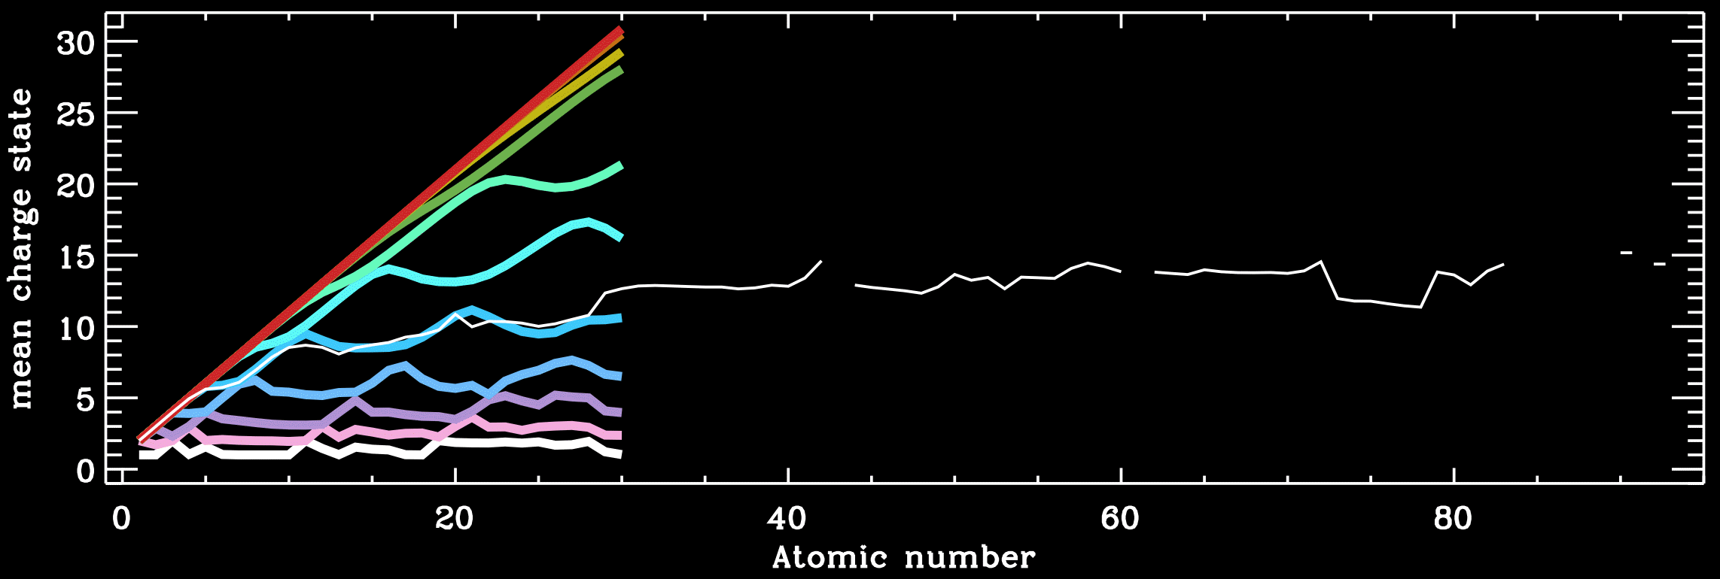
Collisional ionization balance
Fe
log T = 4, 5, 6, 7, 8, 9
(Cranmer 2000)

Slide 21
What can we do with these line intensities?

Slide 22
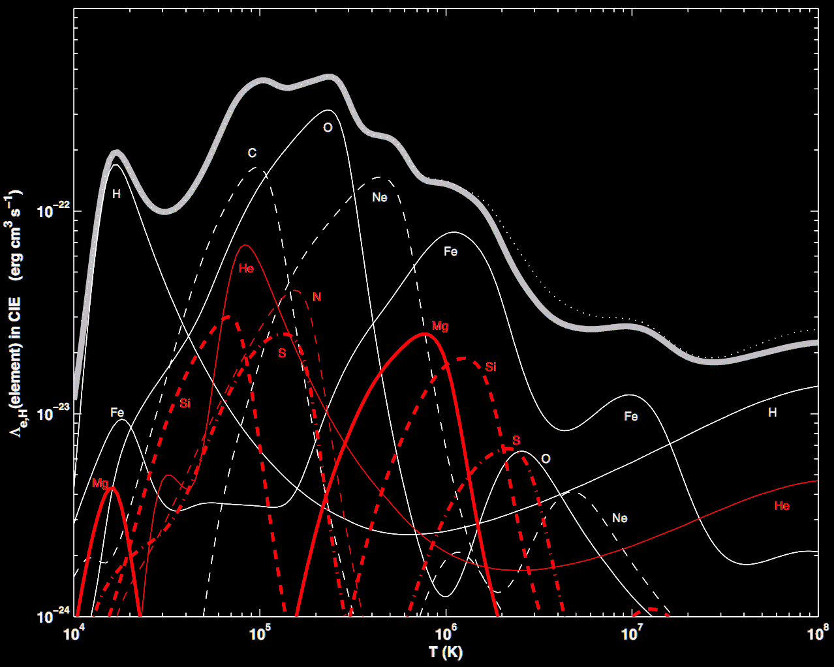
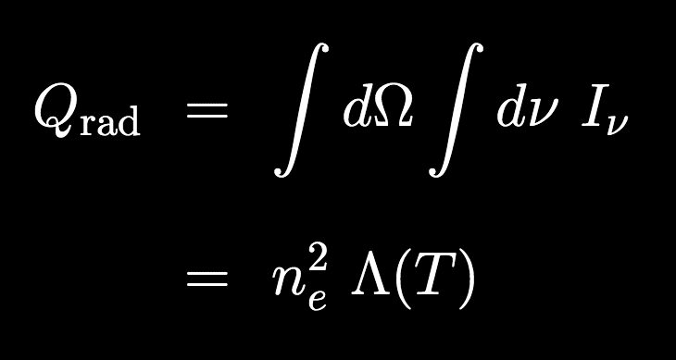
Radiative losses
If we integrated over all lines (i.e., the entire spectrum), we can compute how much energy leaves the system → i.e., a “cooling curve” vs. T
(Gnat & Ferland 2012)
(erg / s / cm²)
Λ(T) depends on abundances & ionization balance.
Useful in coronal heating models!

Slide 23
Do we know about all the lines?
Maybe not yet… see Boerner et al. (2014); Kurucz (arXiv:0912.5371)

Slide 24
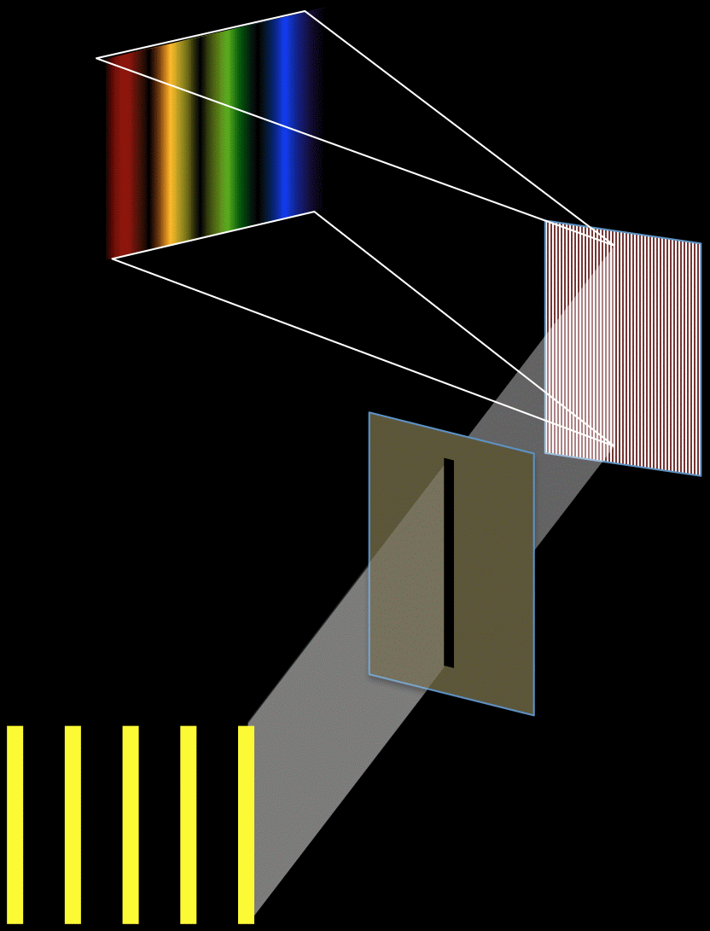
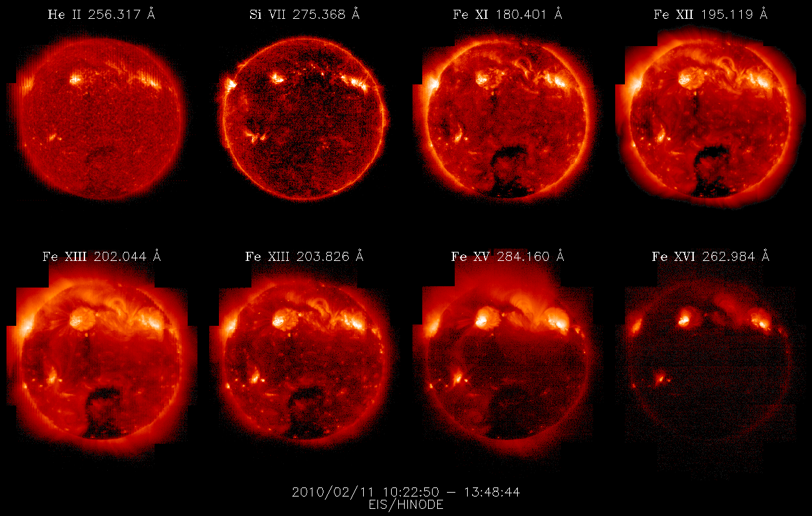
UV slit spectroscopy + rastering
Hinode Extreme-ultraviolet Imaging Spectrometer (EIS):

Slide 25
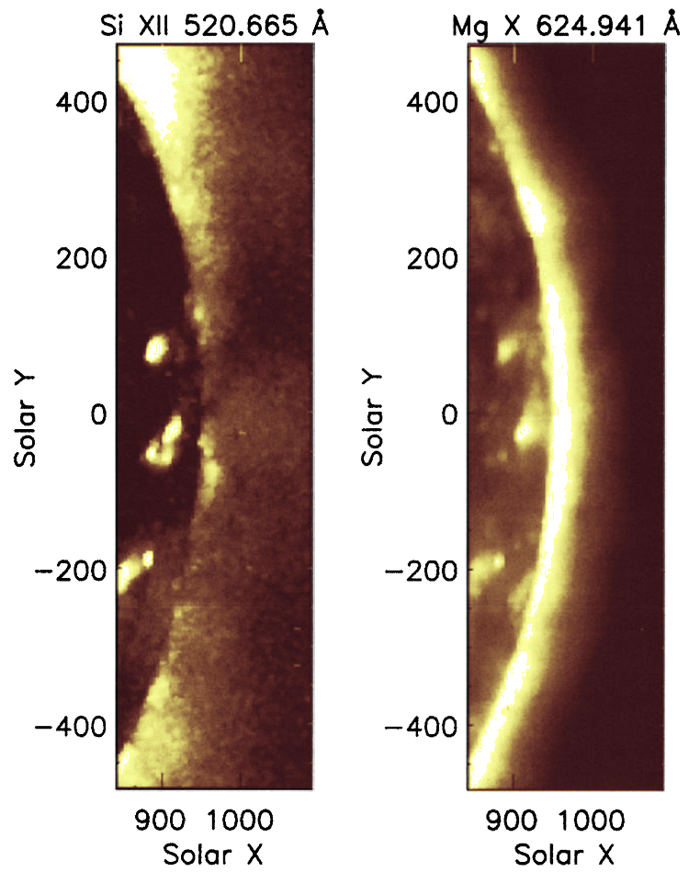
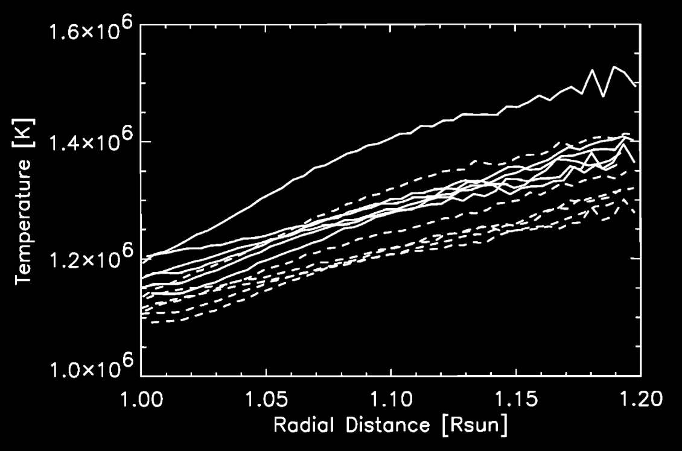
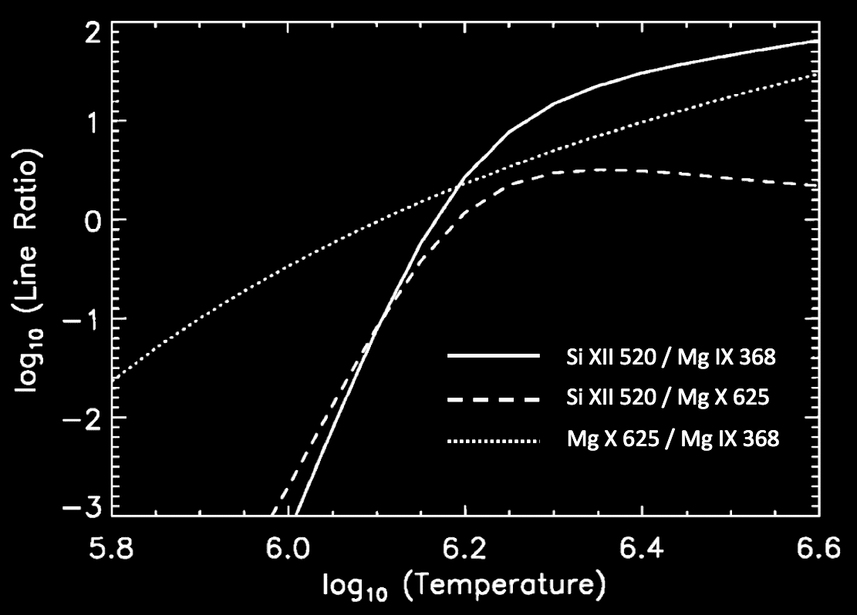
Line ratio diagnostics
Comparing two lines with different G(T) functions allows T to be constrained…
Example: Fludra et al. (1999) rastered an off-limb region with CDS/SOHO…

Slide 26
Emission measure(s)
If we assume the “plasma parcel” has a representative n_{e} & T, we can collect the density and line-of-sight path length (Δx) into an emission measure…
If the spatial extent (Δx) is known, EM can be used to measure coronal density. However, there are better density diagnostics…
For example: Strong collisional lines have I ~ n_{e}² … but other (forbidden/ subordinate) lines may be more “radiative” in the corona (I ~ n_{e}).
i.e., some line ratios are density-sensitive.
Typically, these give higher values than n_{e} derived from EM. Why?
Really… EM_{h} = n_{e}² f Δx f = filling factor… sometimes only ~1%

Slide 27
Emission measure(s)
EM_{h} is useful, but more generally, we can assume the parcel consists of multiple (unresolved) sub-regions of different temperatures. (“multi-thermal plasma”)
The differential emission measure DEM(T) describes how much stuff there is in the parcel, in a “temperature bin” centered on T…
First usage: Batstone et al. (1970)
Used to interpret X-ray data from a Bragg crystal spectrometer placed on a British Skylark rocket (launched 8 August 1967).
Note: astronomers sometimes define these EM quantities differently…
dx → dV ?

Slide 28
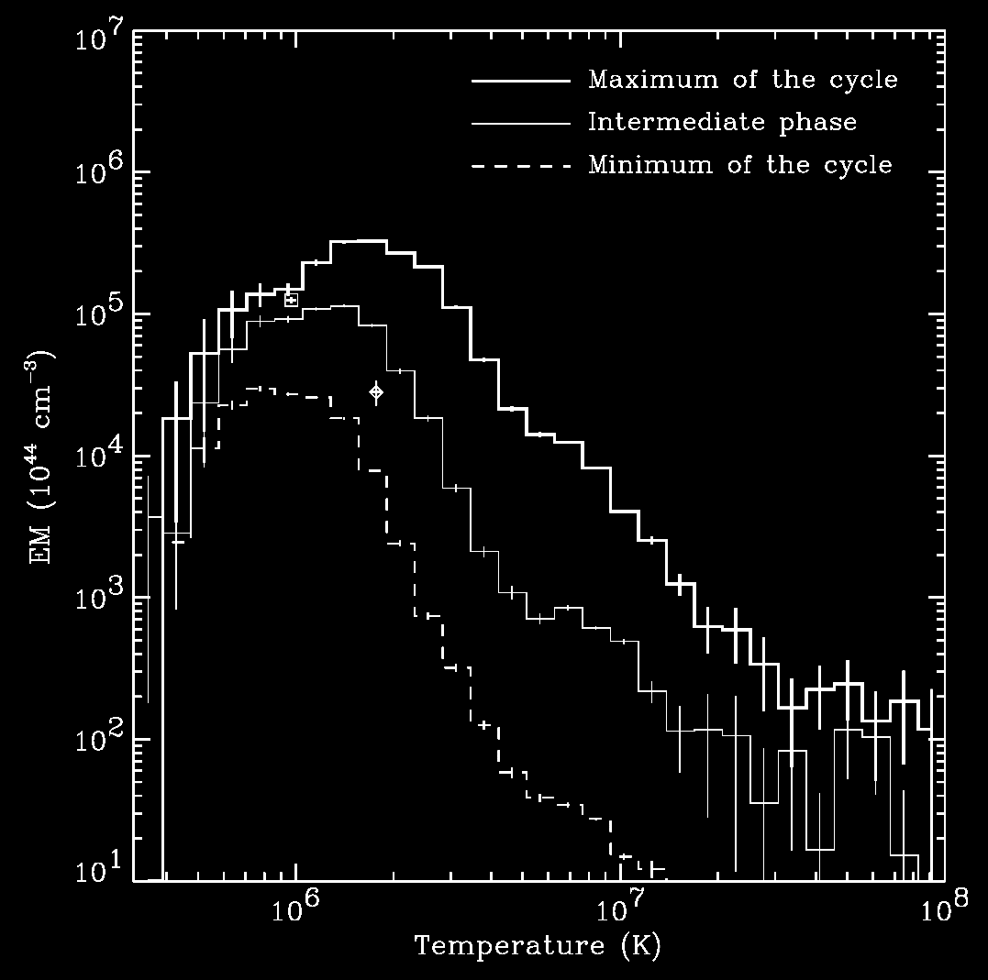
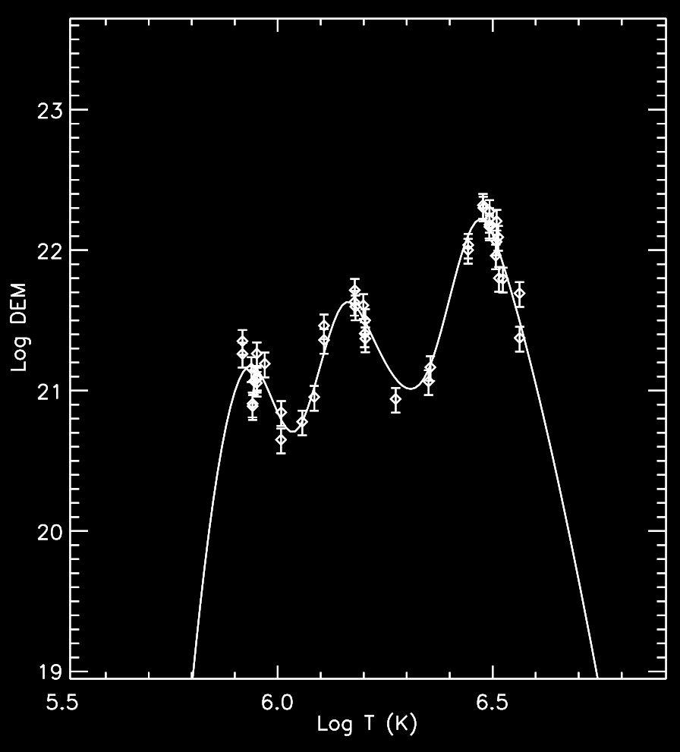
DEM of the solar corona
Peres et al. (2000) combined multiple X-ray filters to see the “Sun as a star:”
Landi & Feldman (2008) looked above the limb with SUMER/SOHO…
QS,
AR
AR
CH,
QS,
AR
DEM width is ~proportional to centroid T (see also Schmelz et al. 2014)

Slide 29
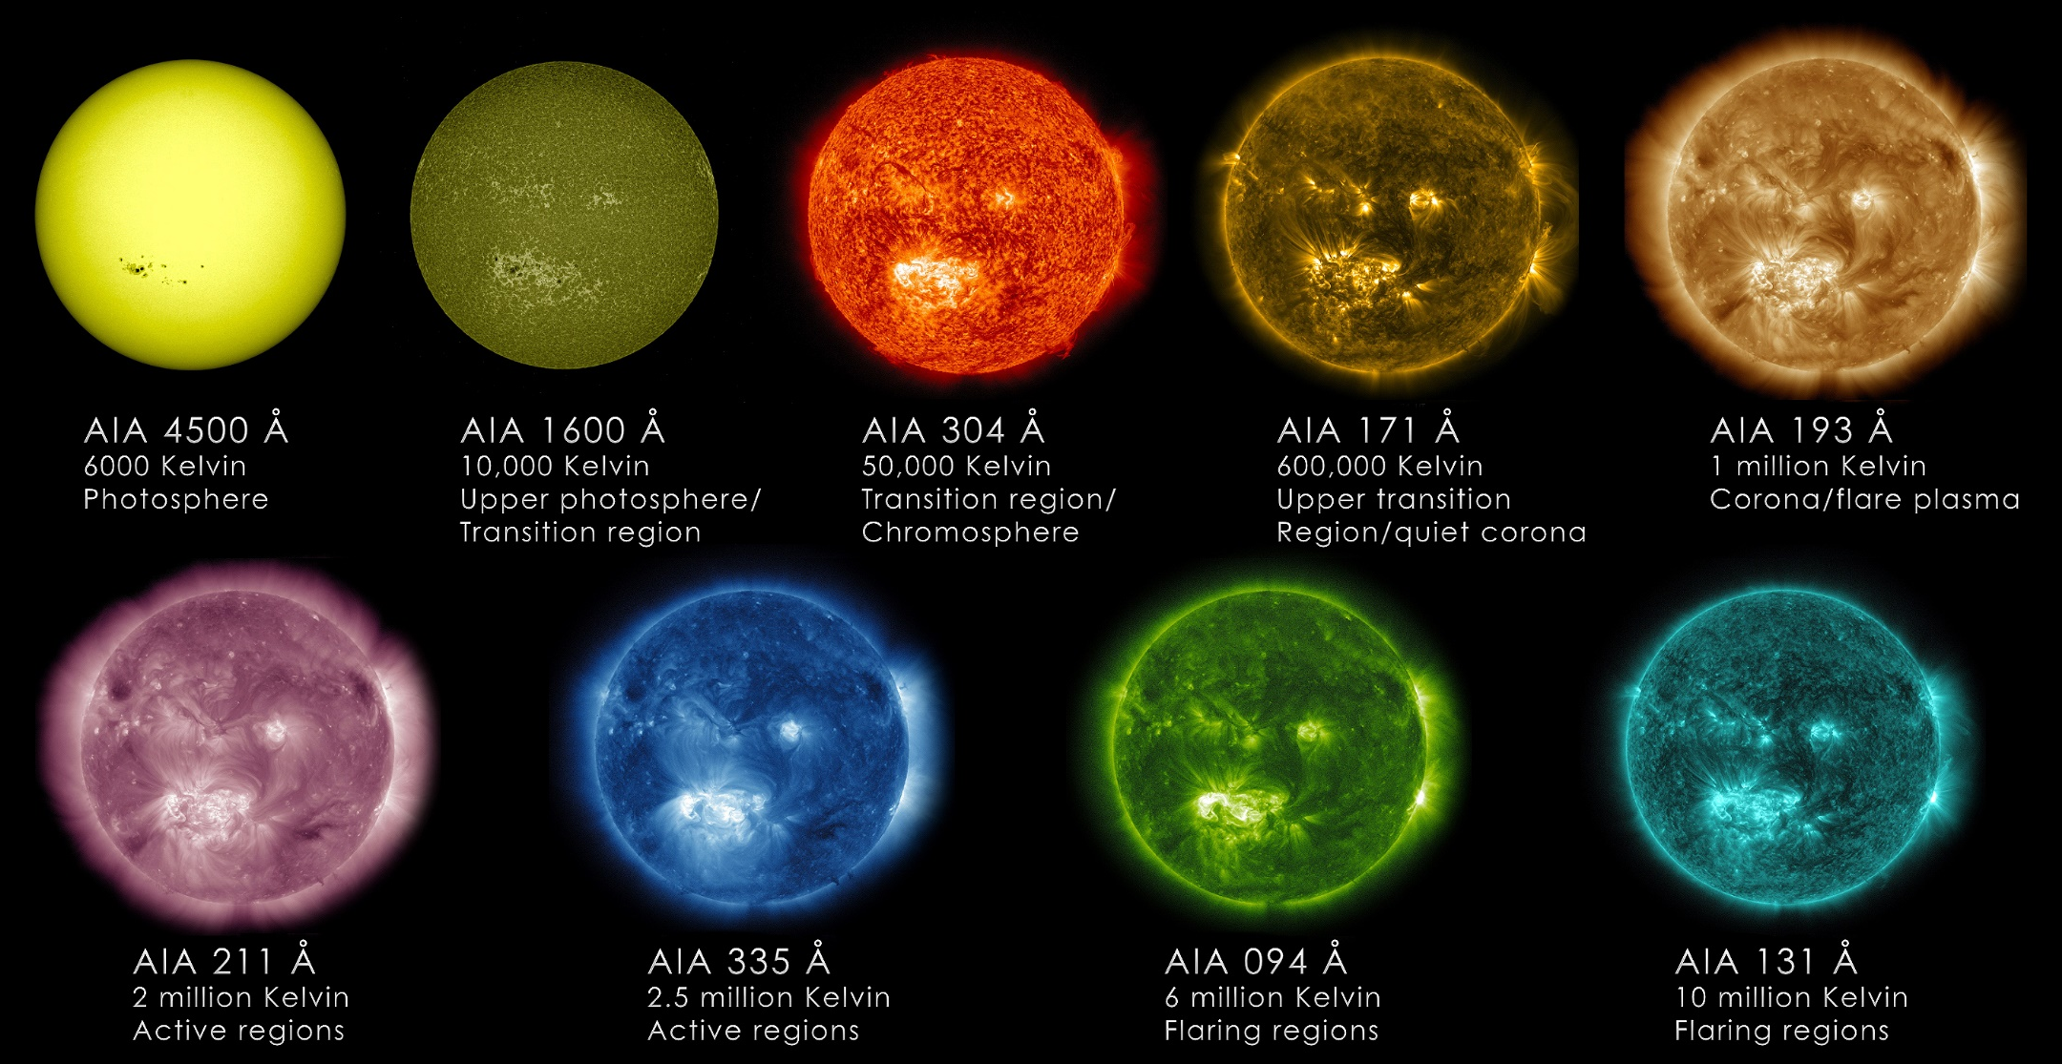
Coronal imaging = stealth spectroscopy

Slide 30
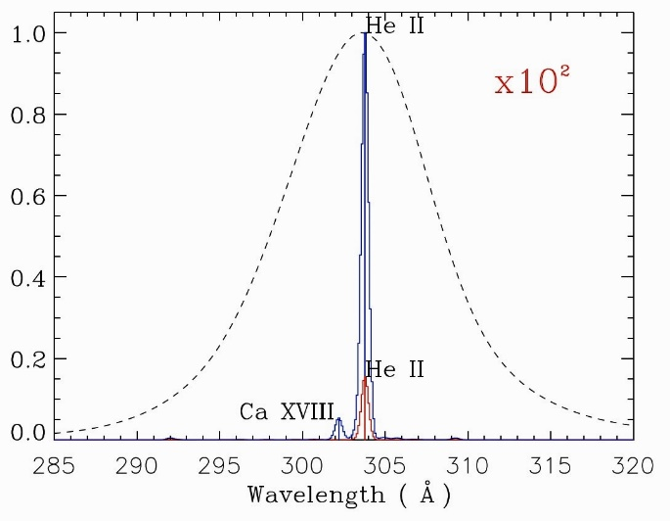
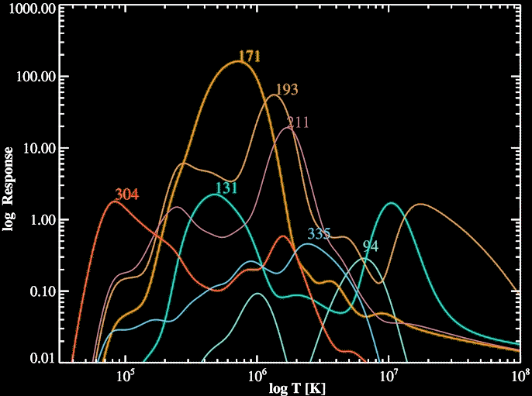
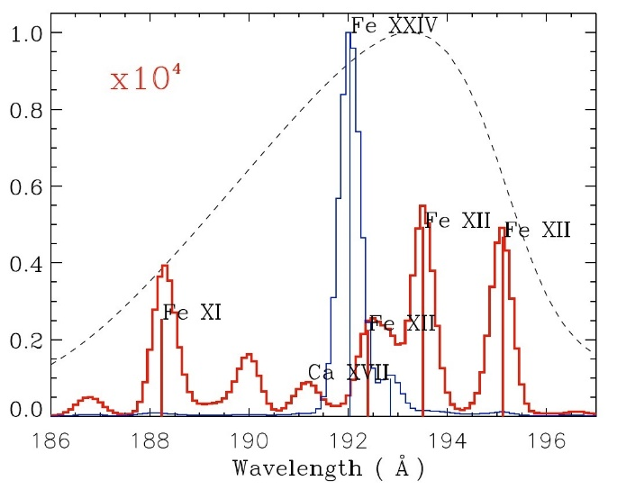
Coronal imaging = stealth spectroscopy
SDO AIA passbands were chosen very carefully to sample a wide range of T
Sometimes, though, there are still >>1 lines in the narrow bands…
304
flare
quiet
193

Slide 31
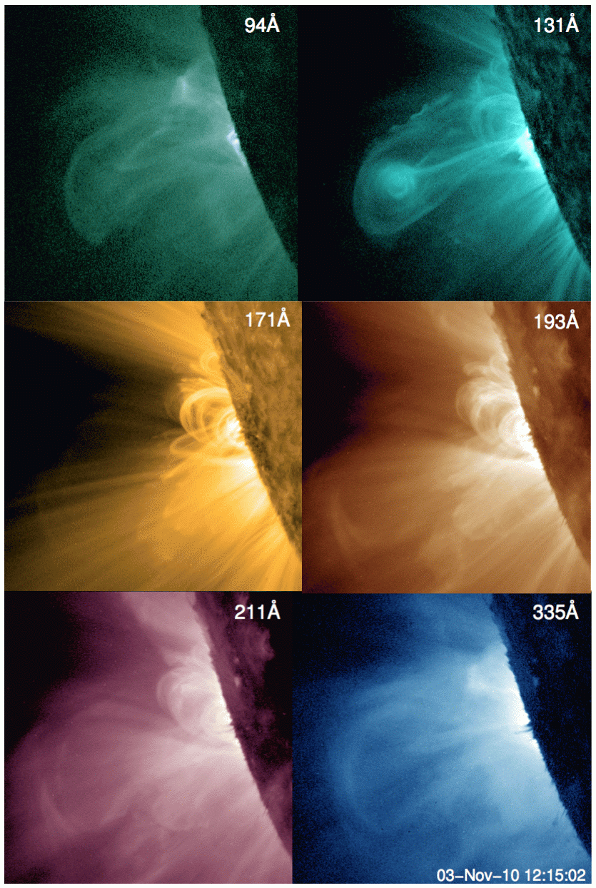
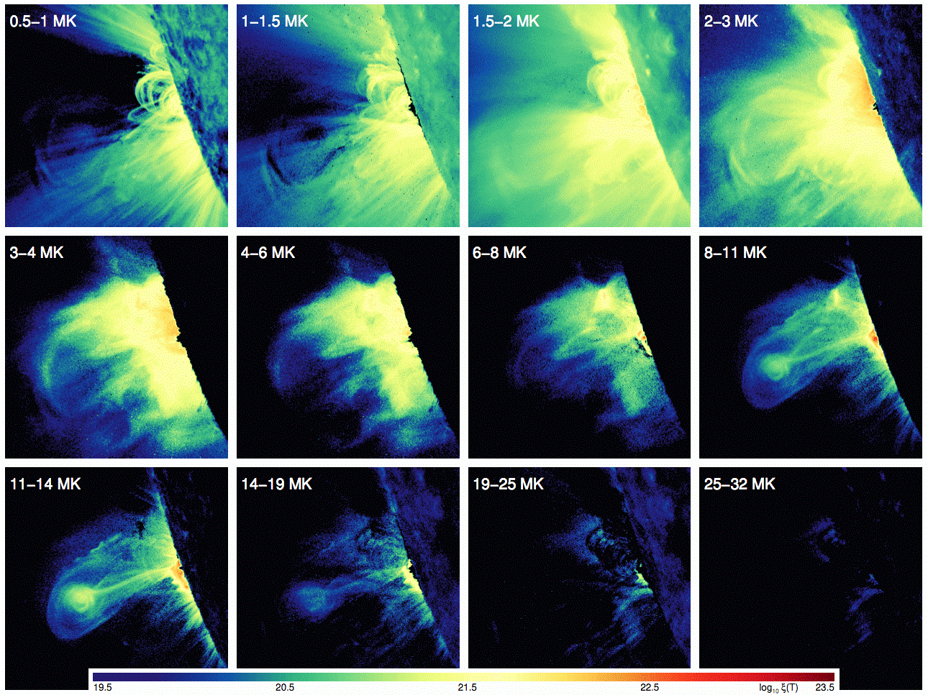
DEM of the solar corona
Hannah & Kontar (2013) used AIA to reconstruct CME DEMs in each pixel:

Slide 32
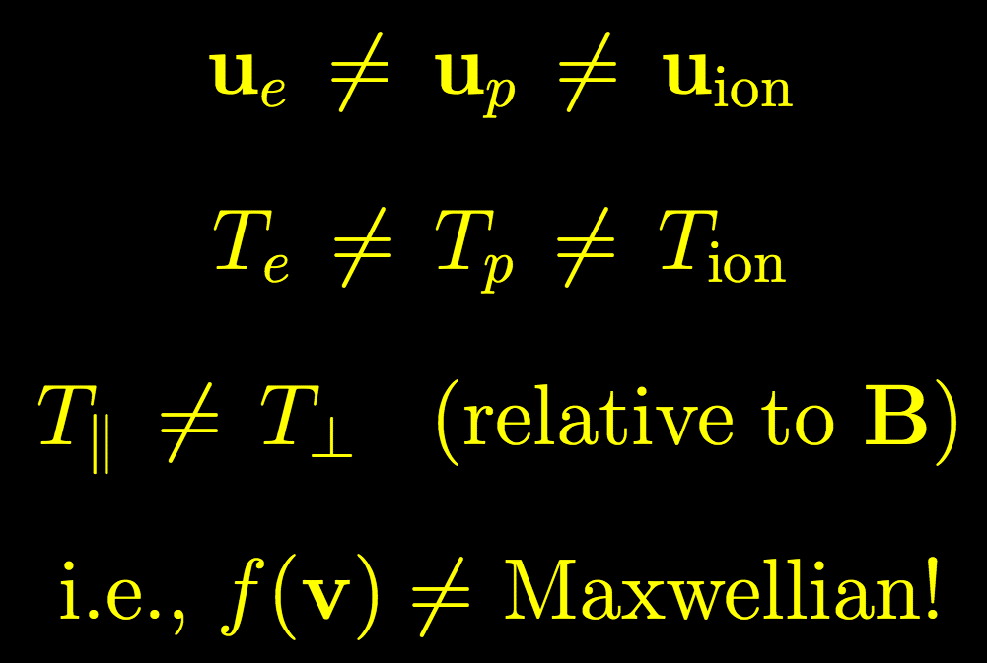
Next time
Line profile shapes: sensitive to motions along line of sight
Lines dominated by radiative/scattering processes: sensitive to lots of other (kinetic, non-MHD) plasma parameters.
In the low-density outer corona…

