Slide 1
Hale COLLAGE (CU ASTR-7500)
“Topics in Solar Observation Techniques”
Spring 2016, Part 1 of 3: Off-limb coronagraphy & spectroscopy
Lecturer: Prof. Steven R. Cranmer
APS Dept., CU Boulder
steven.cranmer@colorado.edu
http://lasp.colorado.edu/~cranmer/
Lecture 8:
Coronal emission line formation

Slide 2
Brief overview
Goals of Lecture 8:
Review physics of emission-line spectroscopy above the solar limb
Discuss collisional vs. radiative excitation mechanisms
“Allowed” (UV, X-ray) vs. “forbidden” (visible, IR) lines

Slide 3
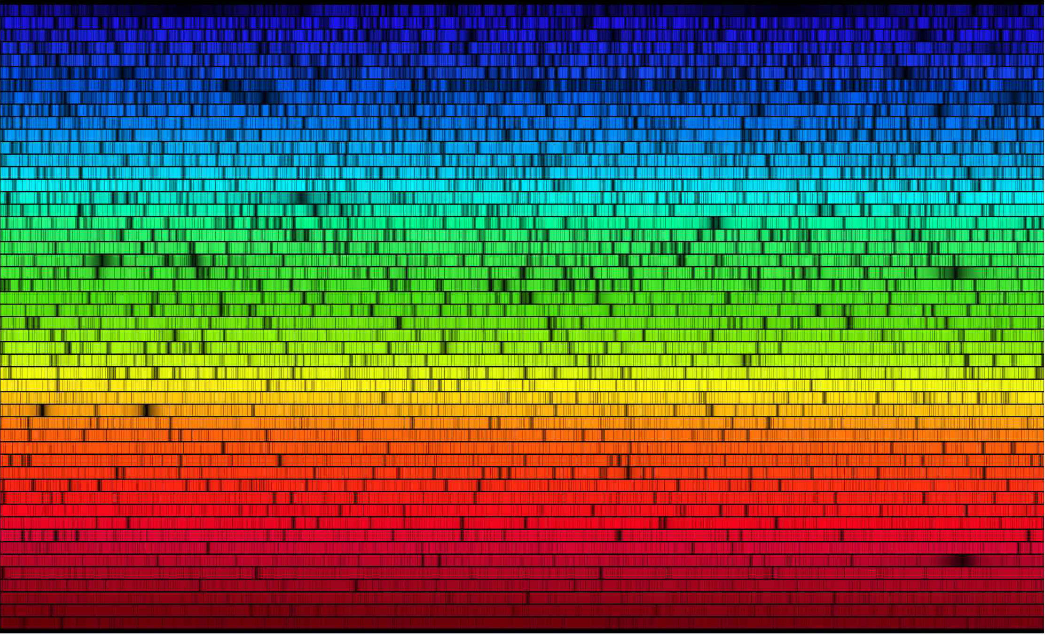
Spectroscopy

Slide 4
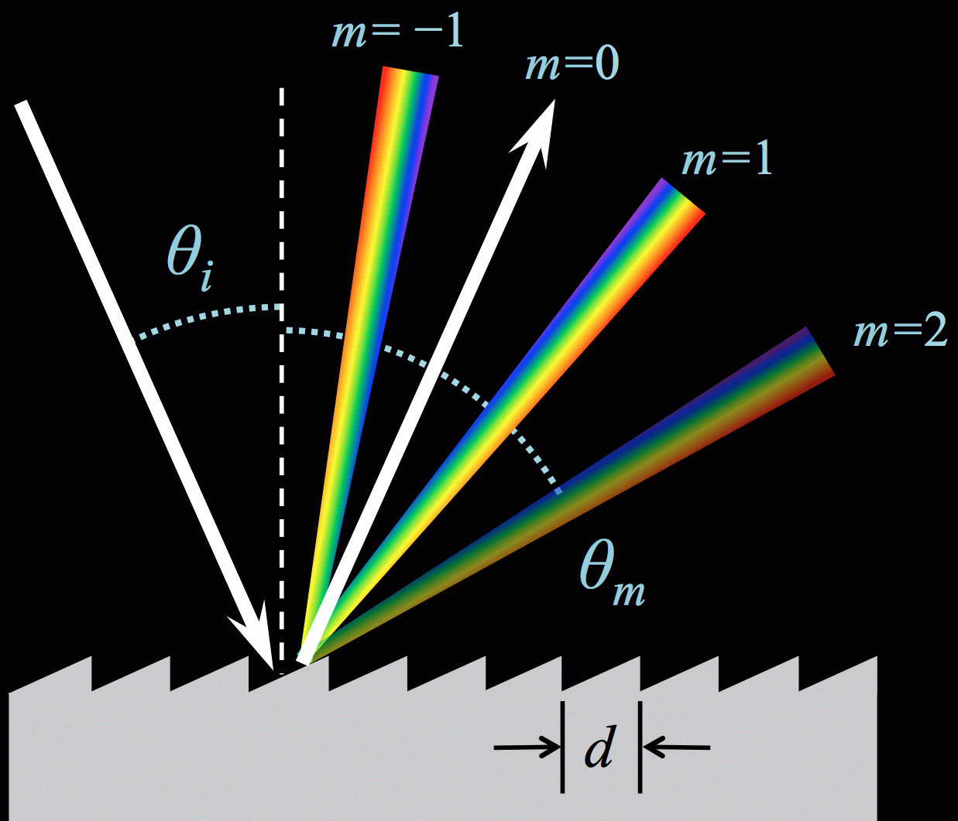
Spectroscopy
Definition: the dispersion of light into its spectral energy distribution (SED), and the study of the interaction between radiation and matter via analysis of SEDs.
Refraction: prisms refract light differently depending on frequency; refractive index n(λ)
Reflection: diffraction gratings tend to be used more often in solar spectroscopy.
Much like a row of narrow slits, each ruled surface acts as an independent source of diffraction.
Combinations… “grisms”

Slide 5
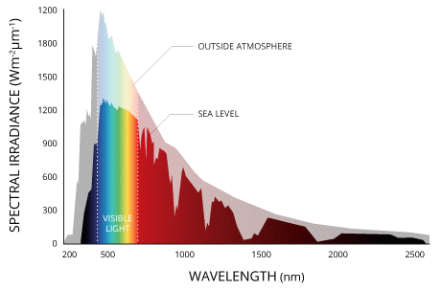
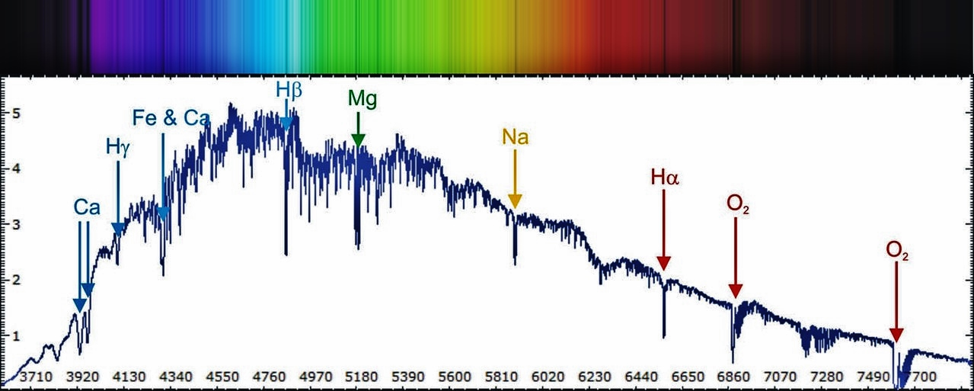
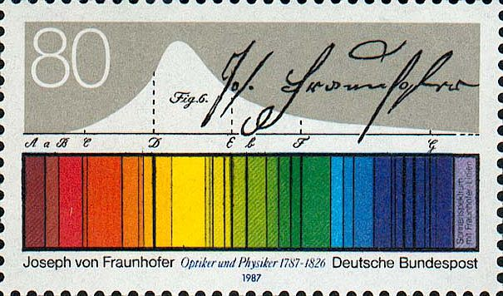
The solar spectrum
In visible wavelengths, the solar disk’s spectrum is dominated by narrow absorption lines.
Joseph von Fraunhofer identified the strongest lines: A → K

Slide 6
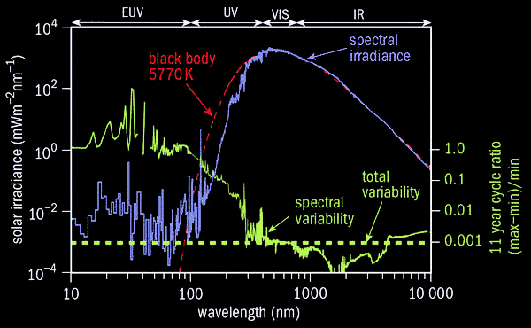
The solar spectrum: coronal for λ < 100 nm

Slide 7
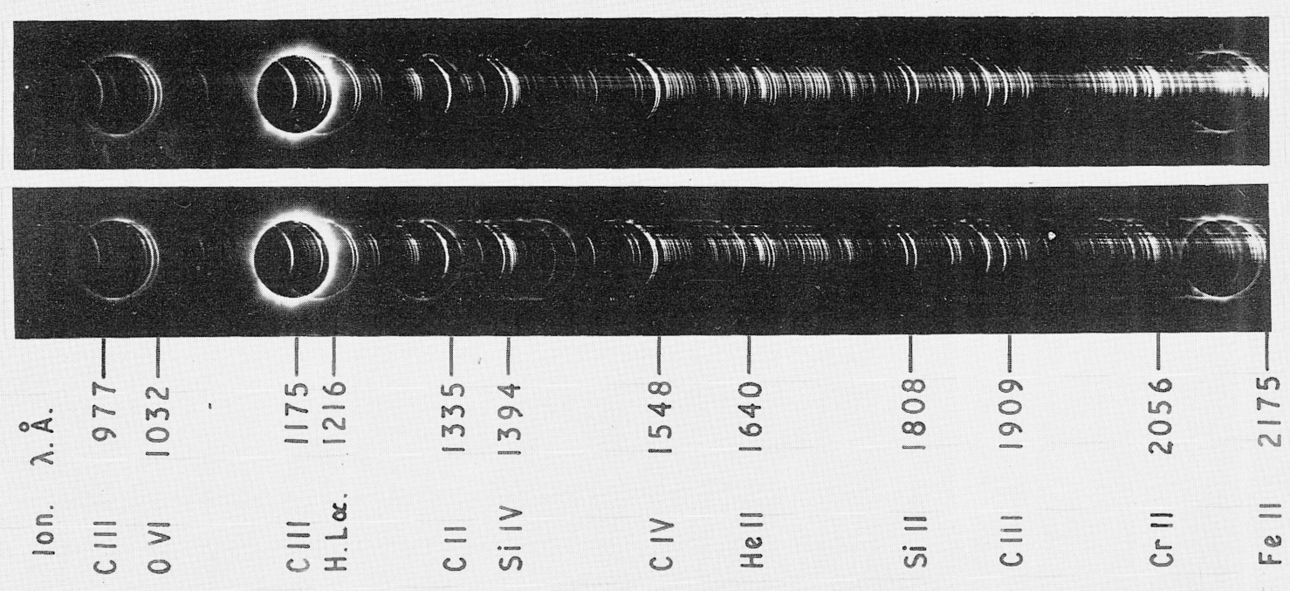
Off-limb coronal spectrum
In the visible, spectrum dominated by K & F continuum, with a few emission lines.
In X-ray and UV, spectrum is dominated by (mostly) the same lines seen on-disk.
Gabriel et al. (1971) launched UV spectrometers on an Aerobee rocket during a solar eclipse.

Slide 8
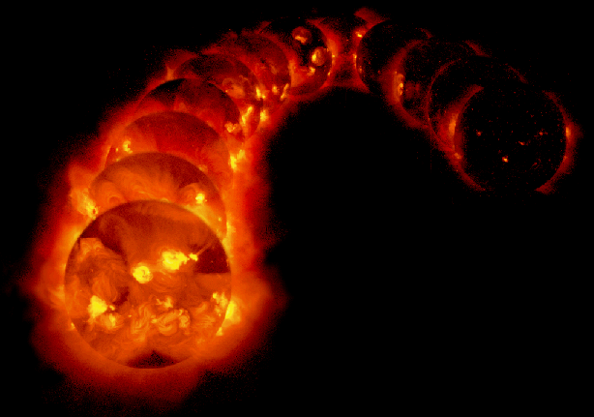
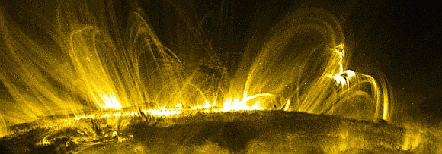
Coronal imaging = stealth spectroscopy
Transmission filters admit light from only a small number of emission lines…
Yohkoh Soft X-ray images over 6 years
TRACE 17.1 nm passband

Slide 9
How are emission lines formed?

Slide 10
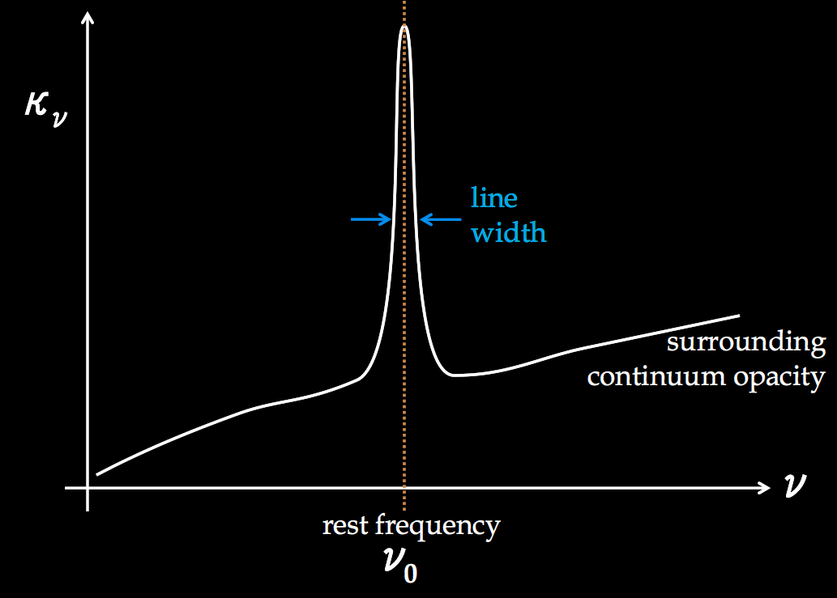
Radiative transfer for lines
Bound atoms produce much greater opacity than, say, free electrons.
Discrete orbitals = resonant oscillators for photons in a narrow range of energies.
Consider a given line as a transition between energy levels 1 (lower) & 2 (upper).
line profile function:
E₂ – E₁ = hν₀
Assume underlying continuum opacity is negligibly small.
Assume all other transitions in the atom don’t matter: effectively it’s a two-level atom.

Slide 11
Line broadening: what is ϕ(ν) ?
Almost a whole course’s worth of material…
Consider the transition between energy levels 1 & 2 to be “sharp” (in atom’s frame).
ΔE Δt ≥ h / 2π

Slide 12
Line broadening: what is ϕ(ν) ?
Almost a whole course’s worth of material…
Consider the transition between energy levels 1 & 2 to be “sharp” (in atom’s frame).

Slide 13
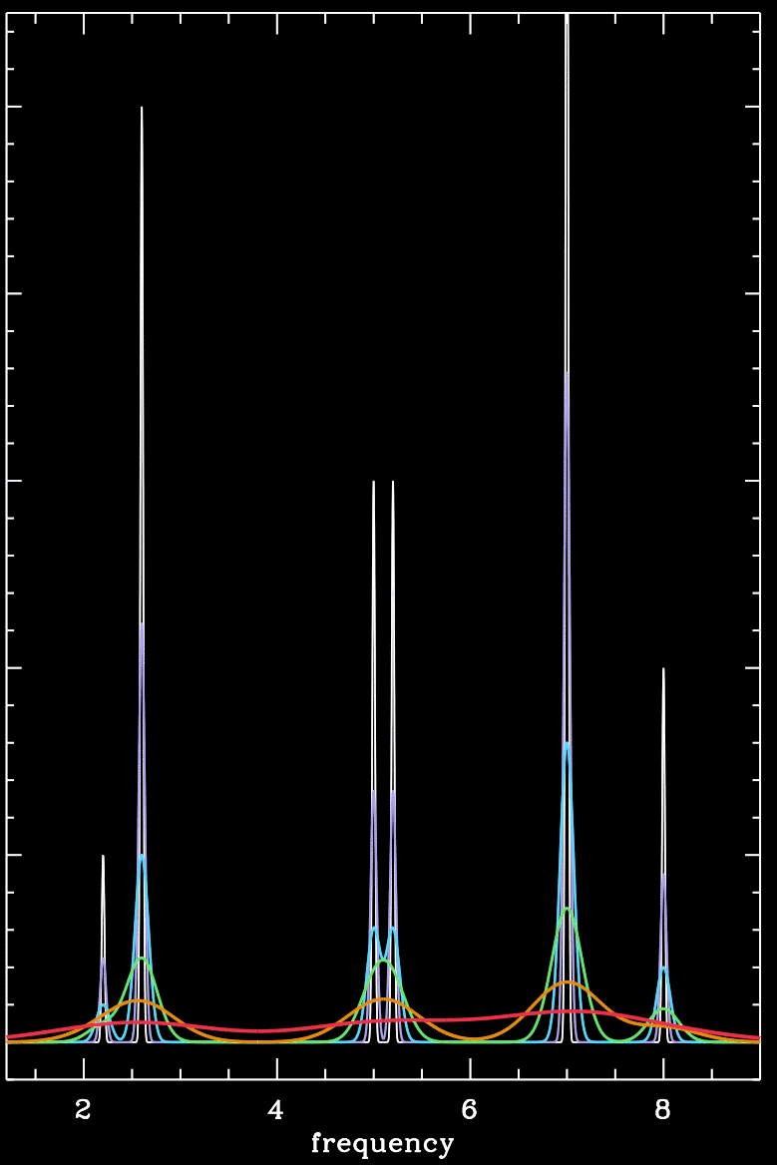
Line broadening: what is ϕ(ν) ?
Almost a whole course’s worth of material…
Consider the transition between energy levels 1 & 2 to be “sharp” (in atom’s frame).
Convolve these with the atom’s random (Maxwell-Boltzmann) velocity field…
thermal width
nonthermal width (waves?)

Slide 14
Radiative transfer for lines
What processes move electrons up and down?
i.e., what determines χ_{L} ?

Slide 15
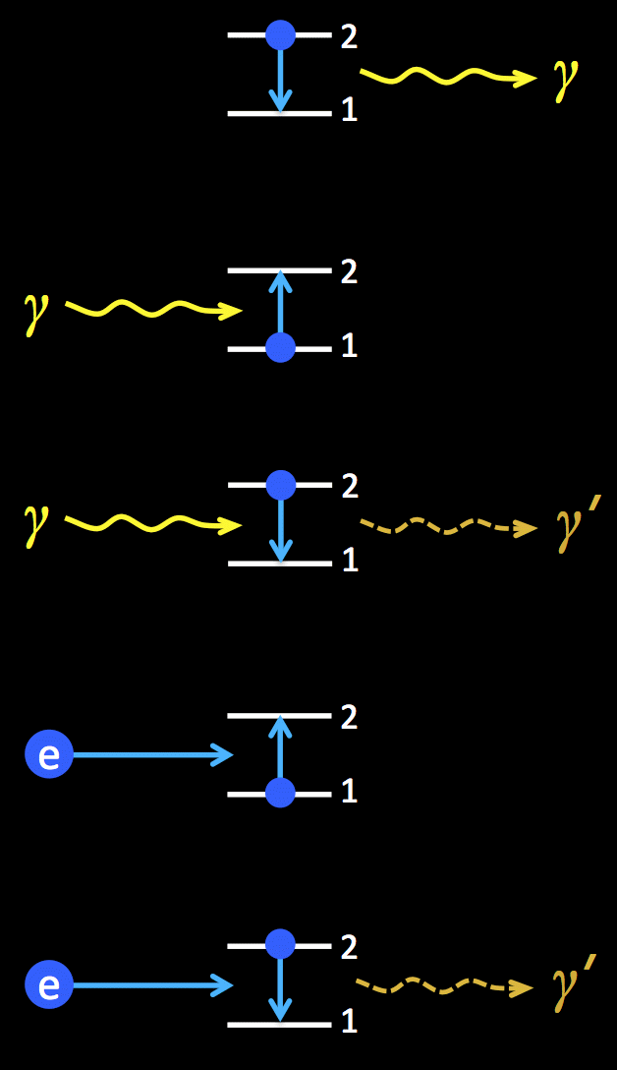
Radiative transfer for lines
What processes move electrons up and down?
specify rates
(# events / volume / time)
Spontaneous emission
Direct/induced absorption
Stimulated/induced emission
Collisional excitation
Collisional de-excitation
n₂ A₂₁
n₁ B₁₂ J
n₂ B₂₁ J
n₁ C₁₂
n₂ C₂₁

Slide 16
Radiative transfer for lines
Definitions: mean intensity integrated over the line:
Einstein relations…
A₂₁ ≈ 1 / (lifetime, or “half-life” of upper level)
g₁, g₂ = statistical weights of levels 1,2 = # of unresolved quantum sublevels
For each line, atomic databases tabulate ν₀, A₂₁, g₁, g₂, and C₁₂(n_{e}, T)
www.CHIANTIdatabase.org
www.atomdb.org
hea-www.harvard.edu/PINTofALE/

Slide 17
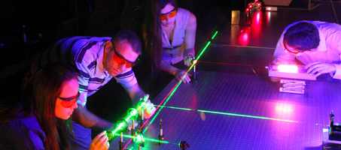
Radiative transfer for lines
In a time-steady equilibrium state, the number of 1→2 transitions is in detailed balance with the number of 2→1 transitions:
How do we write the line opacity? Consider only the processes that absorb incoming photons…
Stimulated emission = negative absorption?
Usually a small “correction term,” but for LASER/MASER systems, it’s so strong it results in amplification!

Slide 18
Radiative transfer for lines
For the optically thin (?) corona, we know how to integrate the emergent I_{ν} :
The source function can be derived from similar rate bookkeeping…
a_{ν} = effective “scattering albedo”
ϵ_{ν} = (1 – a_{ν}) = collisional destruction probability

Slide 19
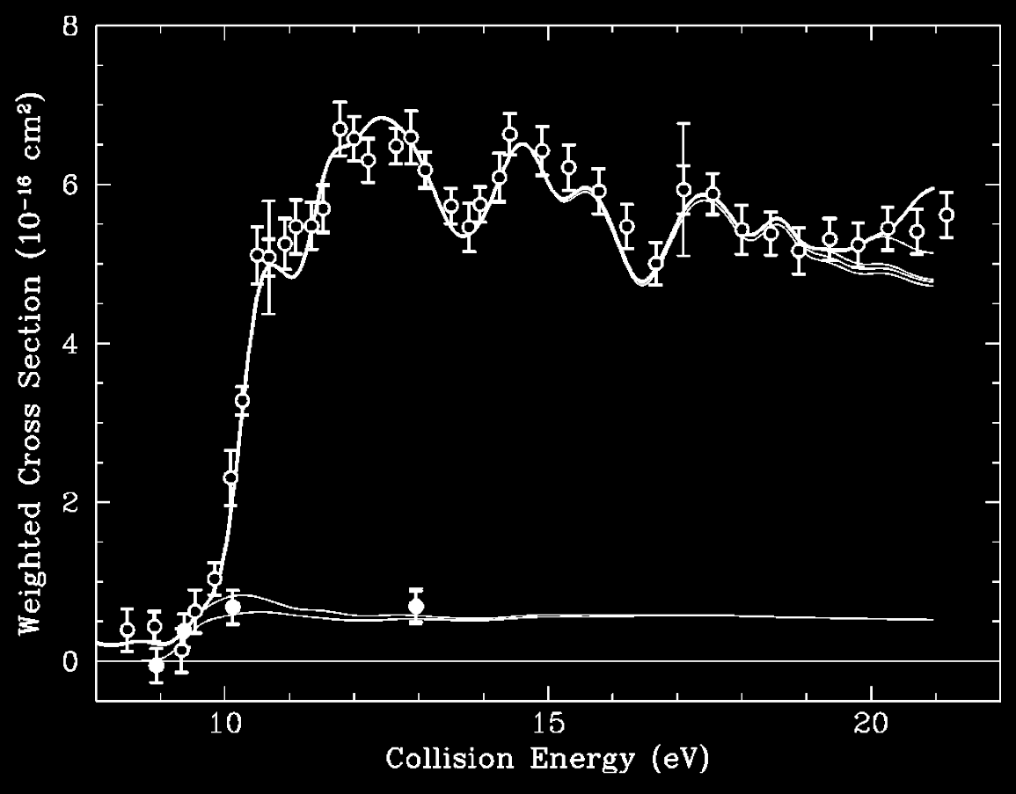
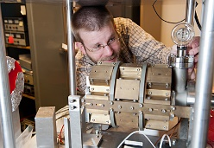
Collision rates
Major collaborations between astrophysics & experimental laboratory physics to measure cross sections of electron impact excitation…
σ for strong 120.7 nm line of Si ⁺² (Reisenfeld et al. 1999)

Slide 20
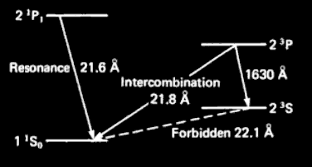
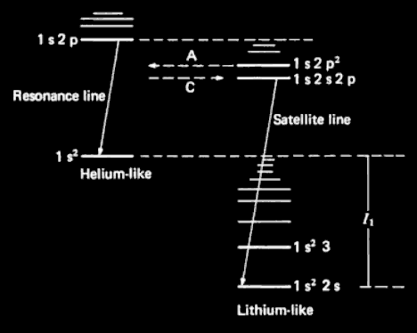
Which rates dominate?
We’ll see lots of different relative values of… A₂₁ vs. B₂₁ J vs. C₂₁
Allowed transitions:
Forbidden transitions:
γ → E dipole moment
γ → E quadrupole moment B dipole moment
strong (A₂₁ ~ 10⁶ – 10¹⁰ s⁻¹)
weak (A₂₁ ~ 1 – 10² s⁻¹)
Resonance lines:
Subordinate lines:
Intercombination lines:
Satellite lines:
1 = ground, 2 = excited (same multiplicity)
1 & 2 both excited
1 & 2 different multiplicities
recombining transition (from X^{n+1} to X^{n}) associated with a resonance line of X^{n+1}

Slide 21
Next time
Focus on collisionally dominated emission lines & their diagnostic capabilities
Narrow-band imaging vs. high-resolution slit spectroscopy

