Slide 1
Hale COLLAGE (CU ASTR-7500)
“Topics in Solar Observation Techniques”
Spring 2016, Part 1 of 3: Off-limb coronagraphy & spectroscopy
Lecturer: Prof. Steven R. Cranmer
APS Dept., CU Boulder
steven.cranmer@colorado.edu
http://lasp.colorado.edu/~cranmer/
Lecture 7:
Visible-light continuum diagnostics

Slide 2
Brief overview
Goals of Lecture 7:
Review how K-corona emission has been observed from 1950s to present.
What kinds of coronal quantities can be measured?
What can the dust-scattered F corona teach us?

Slide 3
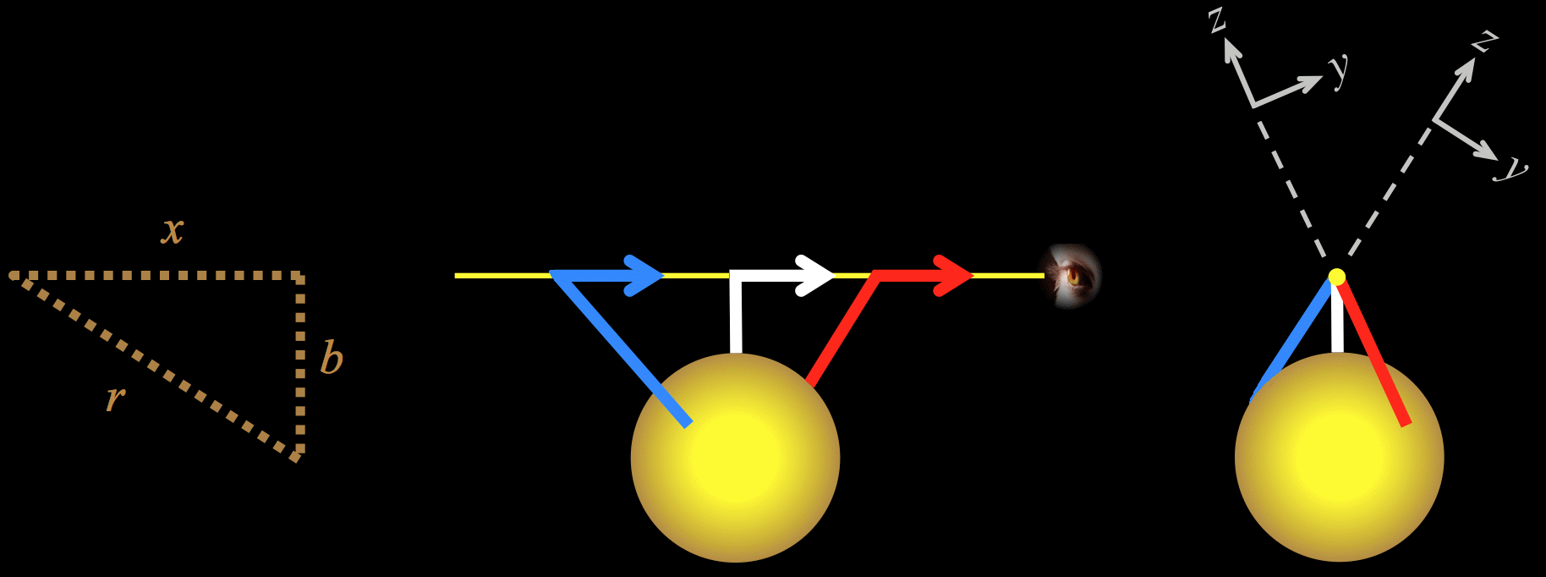
Thomson scattering
Recall: the visible-light K corona is optically thin and linearly polarized.
Intensity is proportional to weighted LOS-integral of electron density.

Slide 4
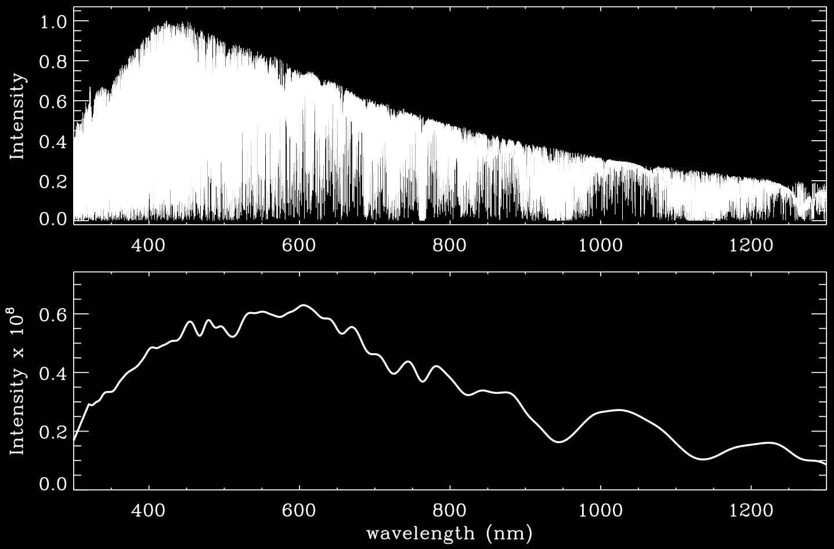
Separating the K & F coronae
Near the Sun, K corona is linearly polarized; F corona is unpolarized (more about this very soon…)
K corona follows magnetic structure; F corona is spherically symmetric
Original meanings: F = Fraunhofer, K = kontinuierlich (“continuous”)
F-corona: dust is cold; scatters full solar spectrum, absorption lines & all.
K-corona: free electrons are hot; Doppler broadening smears out lines in the spectrum.

Slide 5
Separating the K & F coronae
If we have a spectrum of the solar disk & the corona…
I_{disk}
I_{C}
F corona: same spectrum as disk
K corona: flat
I_{L}
ϕ I_{disk}
λ
λ
Known:
ϕ , I_{C} , I_{L}

Slide 6
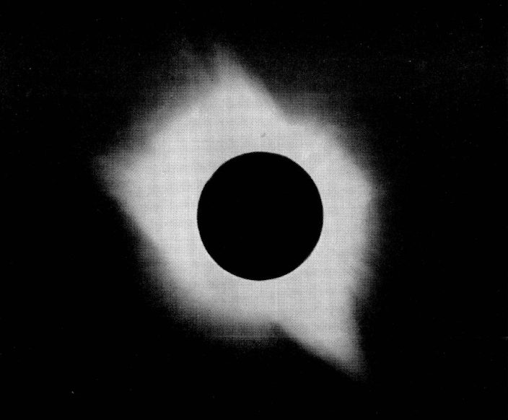
Total eclipses
1950s-1960s: First quantitative application of Thomson scattering theory to off-limb data.
Feb. 1952: Khartoum (von Klüber 1958)

Slide 7
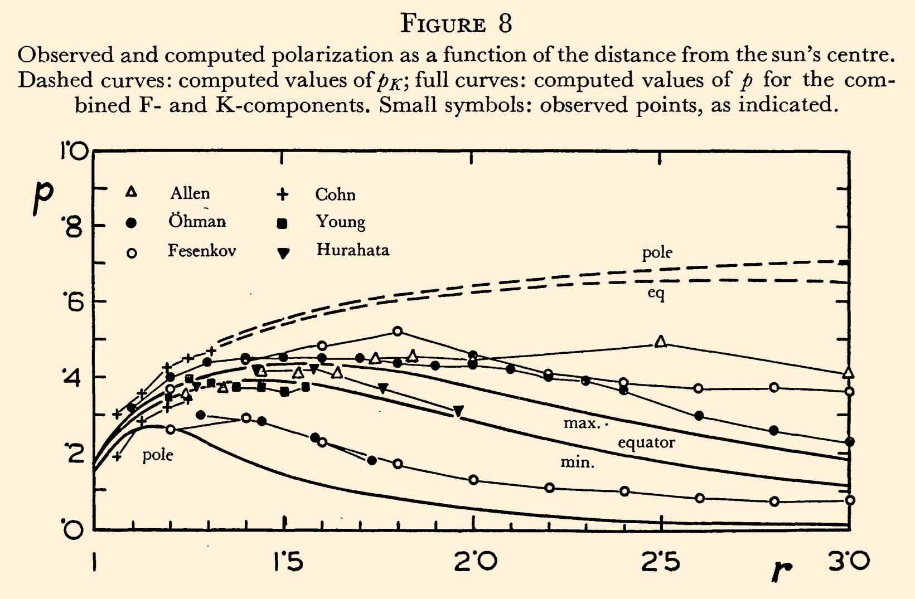
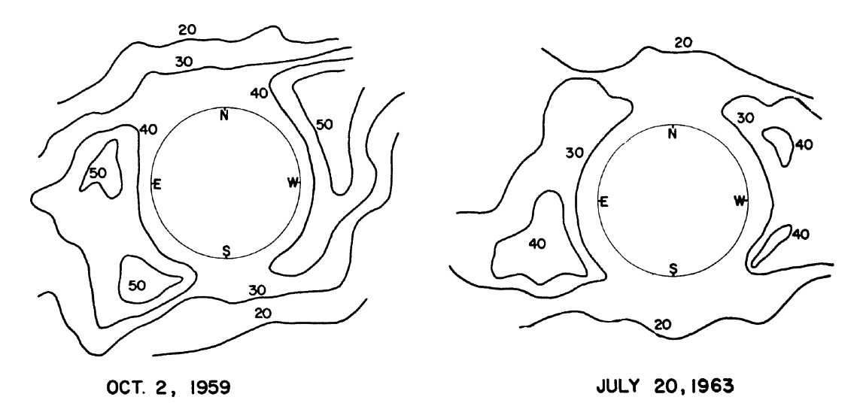
Total eclipses
1950s-1960s: First quantitative application of Thomson scattering theory to off-limb data.
Fractional polarization (Q/I) can exceed 50% in the corona (van de Hulst 1950; Gillett et al. 1964)
Feb. 1952: Khartoum (von Klüber 1958)

Slide 8
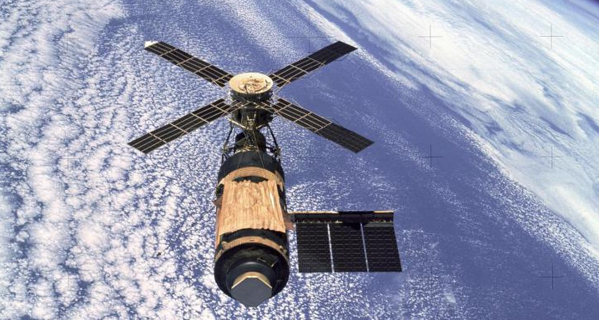
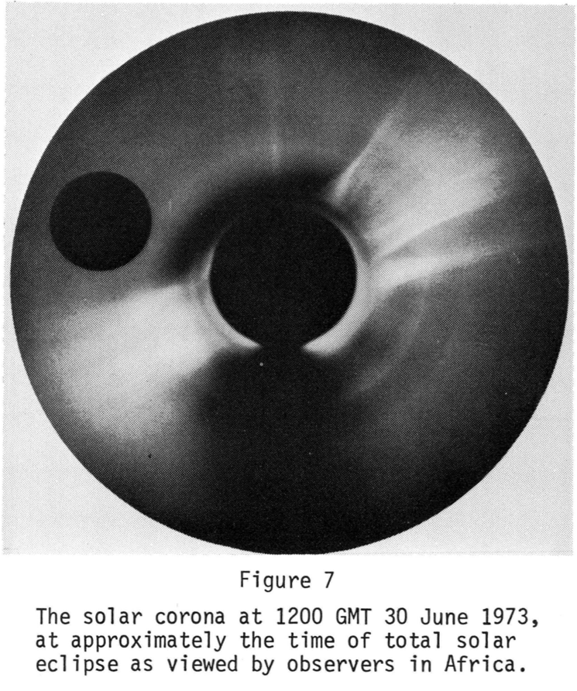
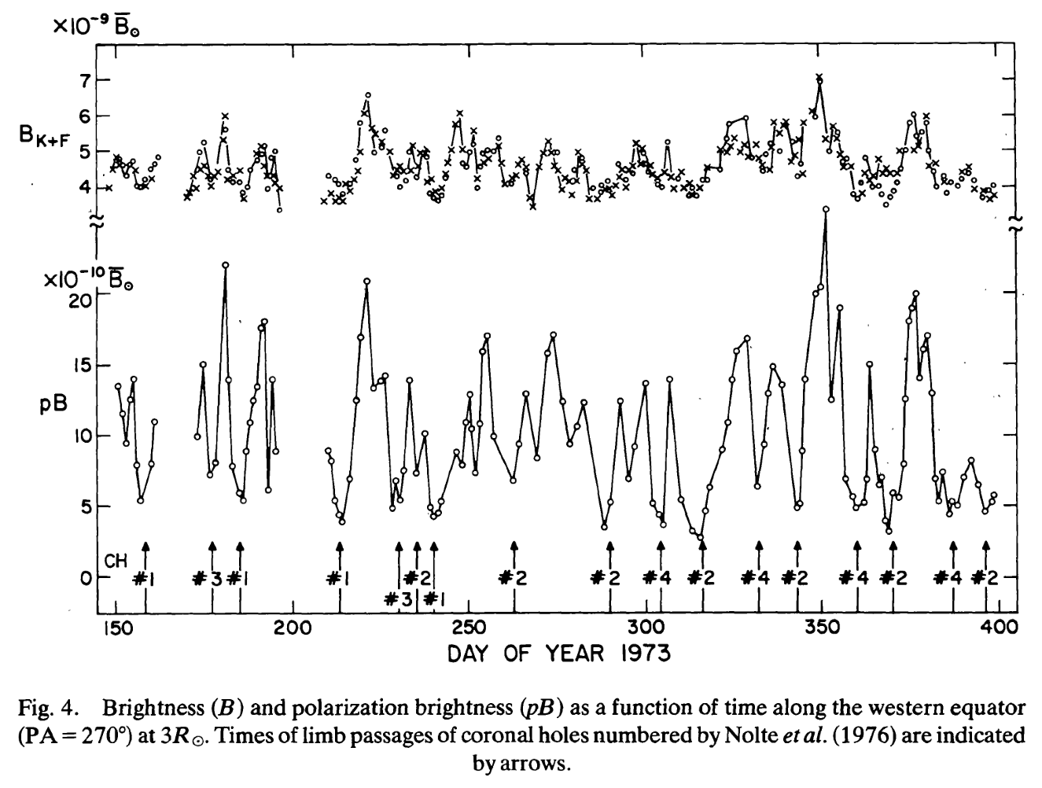
Consistent coronagraphy
1970s: HAO White Light Coronagraph flew on Skylab (MacQueen et al. 1974; Saito et al. 1977).

Slide 9
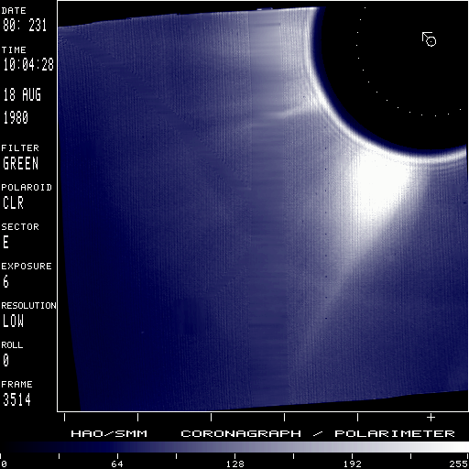
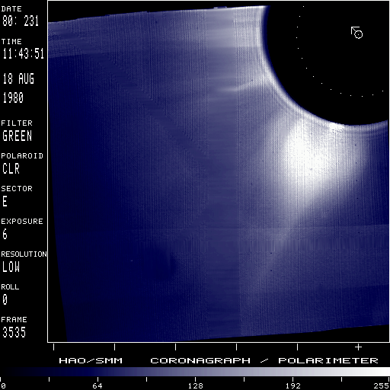
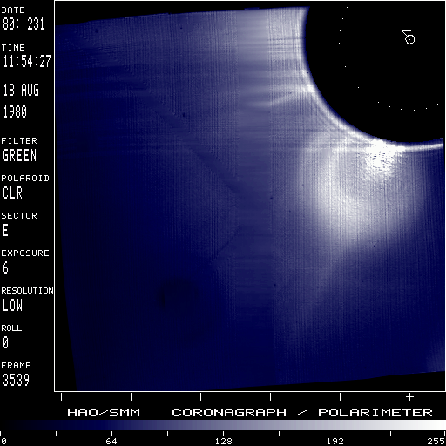
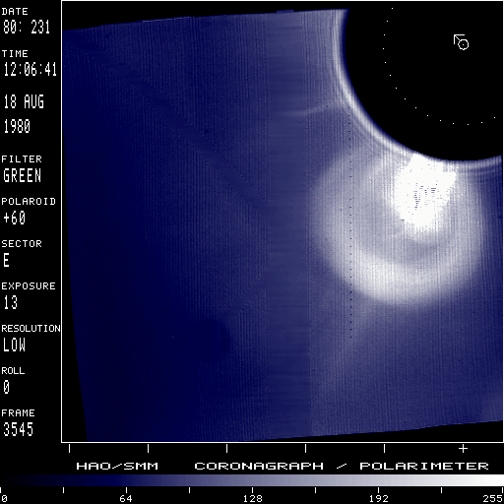
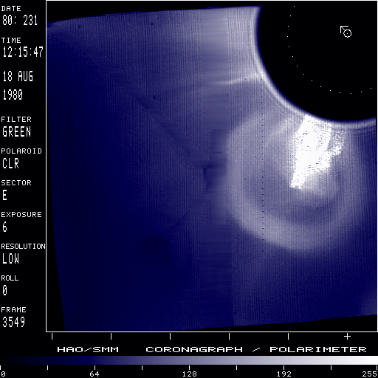
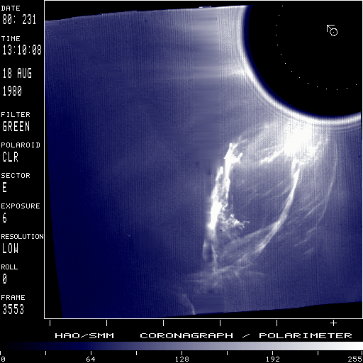
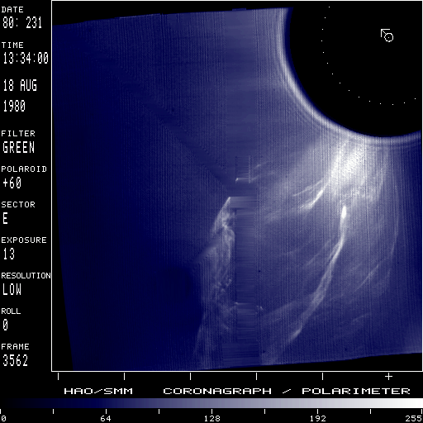
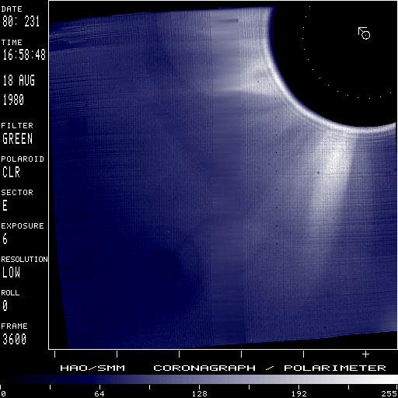
Consistent coronagraphy
1980s: Solar Maximum Mission (SMM): first high-quality characterization of coronal mass ejections (CMEs)!

Slide 10
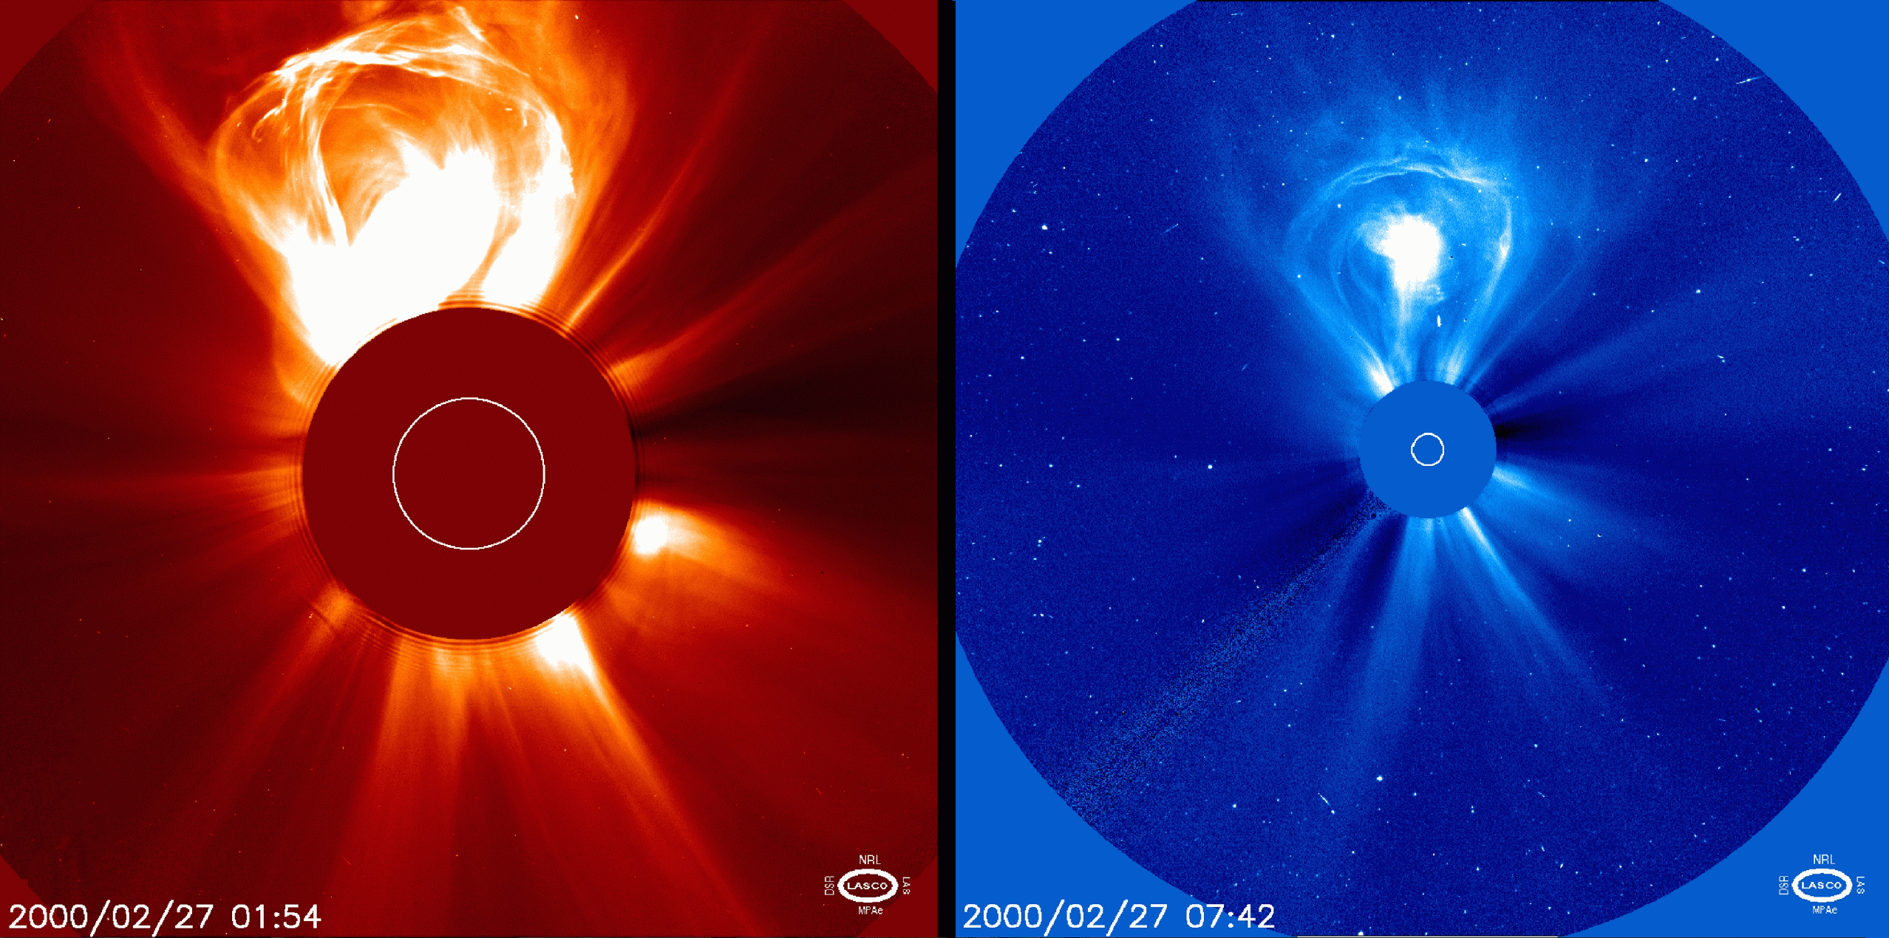
Consistent coronagraphy
1995: SOHO launched with 3 LASCO coronagraphs: C1 (emission line), C2, C3:

Slide 12
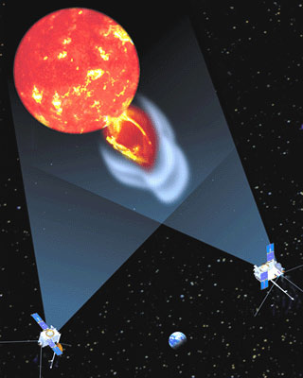
STEREO views…
2007: twin spacecraft launched to view Sun stereoscopically… also includes sideways “Heliospheric Imagers” in addition to coronagraphs.

Slide 13
STEREO views…
CMEs observed by STEREO A & B at 90º separation are detected by B & A in situ instruments (Byrne et al. 2010)

Slide 14
Results: coronal plasma diagnostics

Slide 15
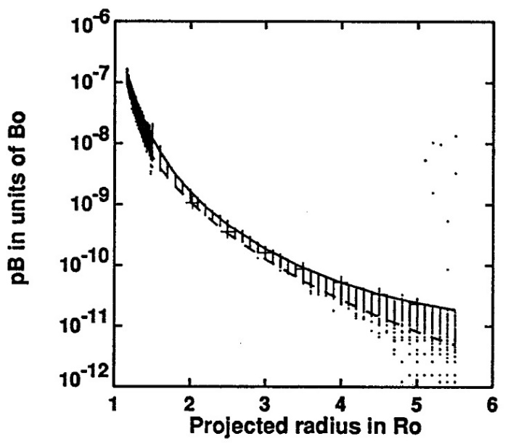
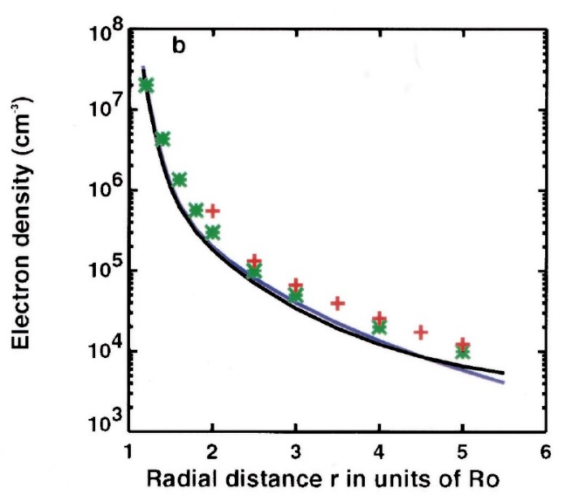
Electron density
Because F corona isn’t polarized, use Q = pB to determine density:
Even if n_{e}(r) is spherically symmetric, there is no straightforward “inversion” to compute it from pB(b).
There are some semi-analytic ways to do it, but the resulting n_{e}(r) needs to be “re-fit” to an analytic function after intermediate numerical steps.
Easiest: trial and error? Vary n_{e}(r) until integrated pB(b) agrees with data.
e.g., Fisher & Guhathakurta (1995)

Slide 16
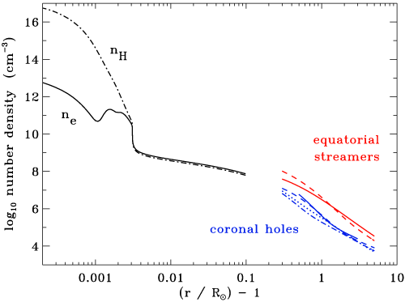
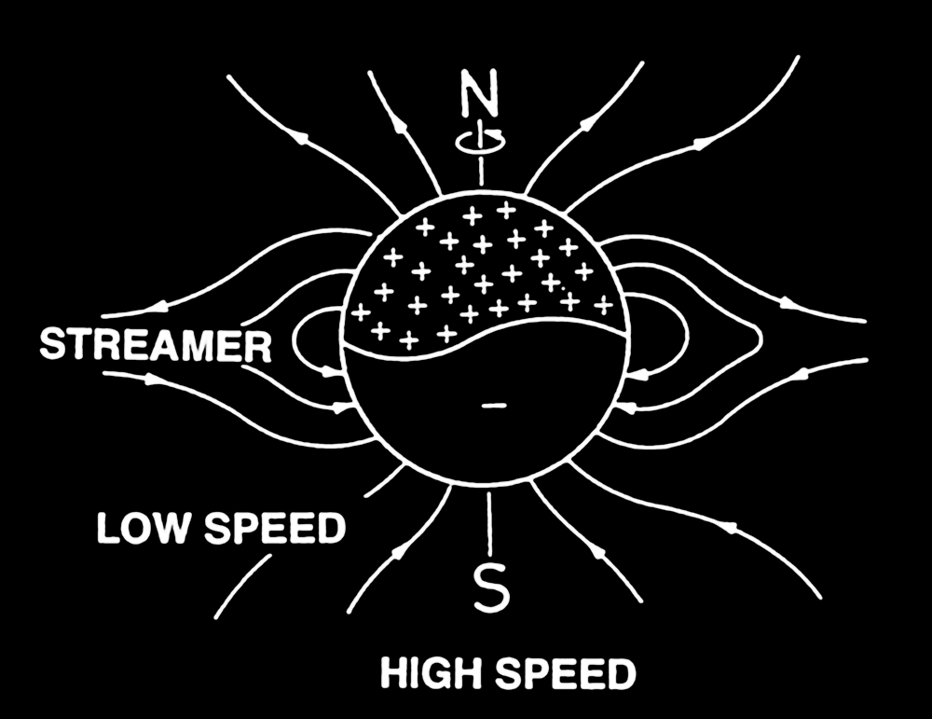
Electron density
Radial dependence of n_{e}(r) varies over factors of ~10 from polar coronal holes to low-latitude streamers…
LOW SPEED
HIGH SPEED

Slide 17
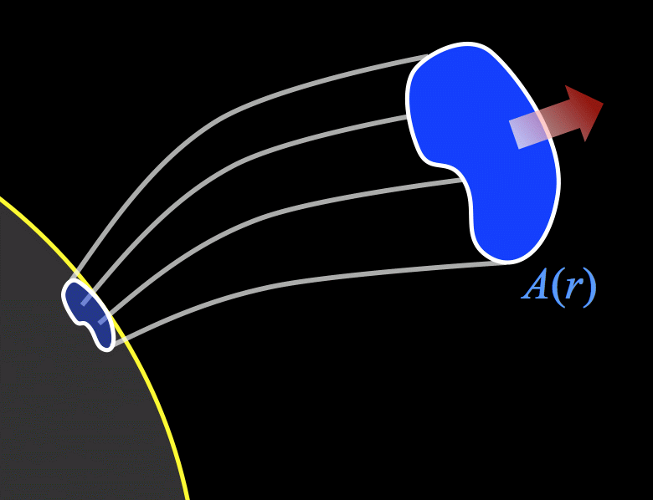
Electron density diagnostics
Solar wind mass flux: Along a steady-state collection of magnetic field lines…
If we know:
A(r), from images or B-field extrapolation
M, from in situ data at 1 AU
we can use observed density n(r) to infer the solar wind outflow speed u(r), in the primary region of solar wind acceleration.
Difficult in practice: observational estimates of A(r) are often unreliable at 20%–50% accuracy… not good enough for solar wind speed!

Slide 18
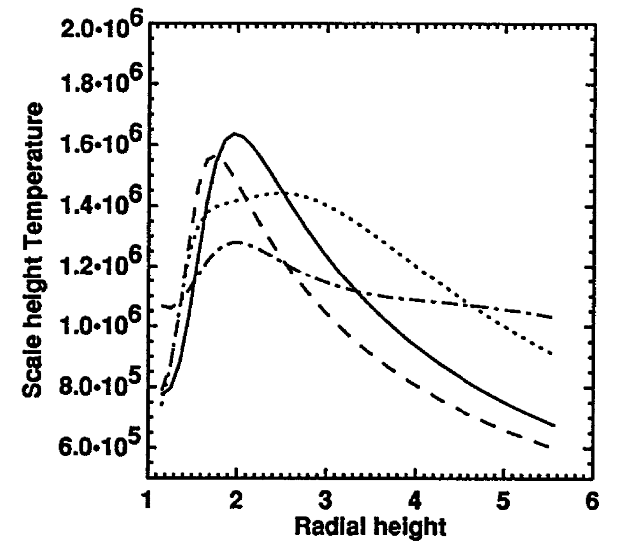
Electron density diagnostics
Hydrostatic temperature: Examine one-fluid momentum conservation:
Assume u = 0, and gas is 100% ionized H:
Fisher & Guhathakurta (1995)
We know n_{e}(r) drops much more rapidly than T(r)… pull T out of derivative?

Slide 19
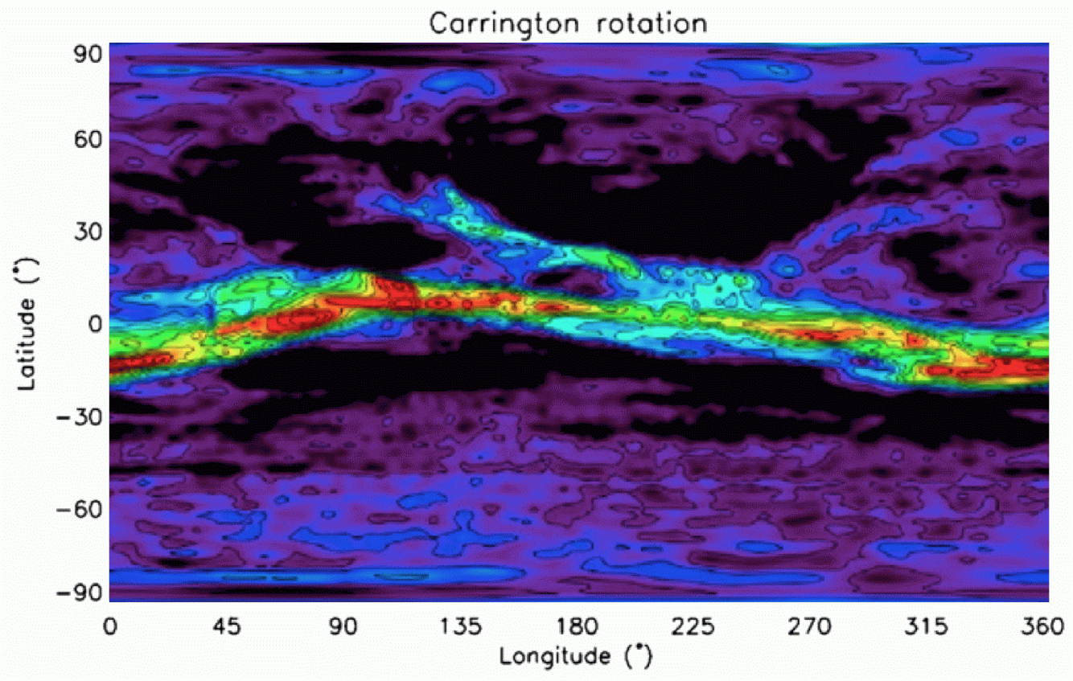
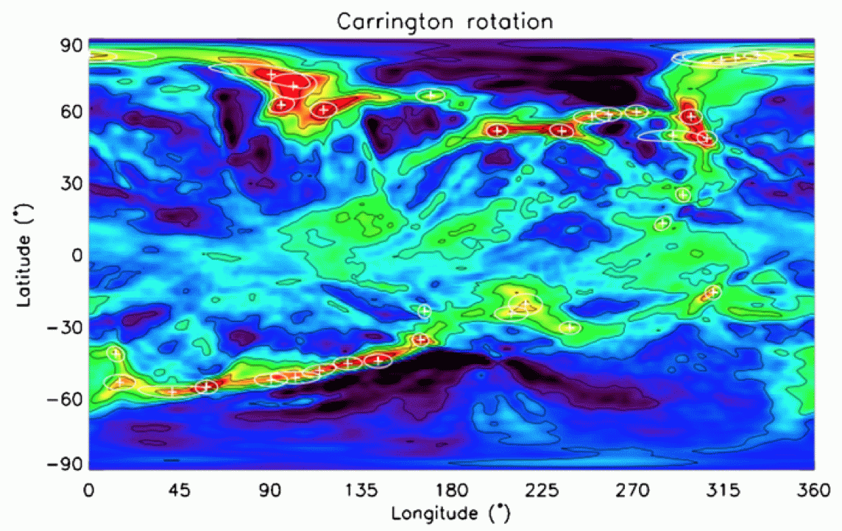
Electron density tomography
During times of low solar activity, the large-scale structure doesn’t change ~much on time scales of a few weeks.
“Big data problem:” Apply medical cat-scan techniques!
Kramar et al. (2009):
multiple radii
Morgan & Habbal (2010): solar min. vs. solar max.

Slide 20
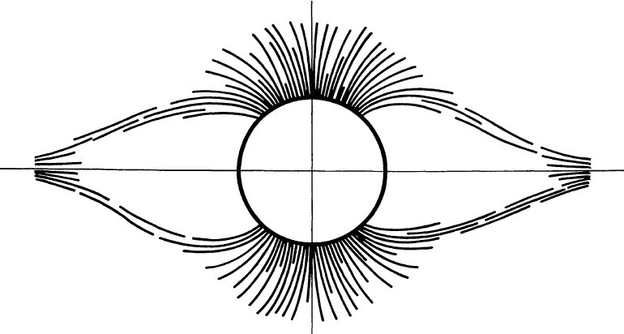
Polar plumes
Narrow bright rays have been noticed in coronal holes since early 20th century.
Rooted in magnetic bright points in the supergranular network. Plumes are:
Piddington (1972)
denser
hotter at footpoints
cooler high in corona
connected to slower solar wind (?)
M. Druckmüller, http://www.zam.fme.vutbr.cz/~druck/

Slide 21
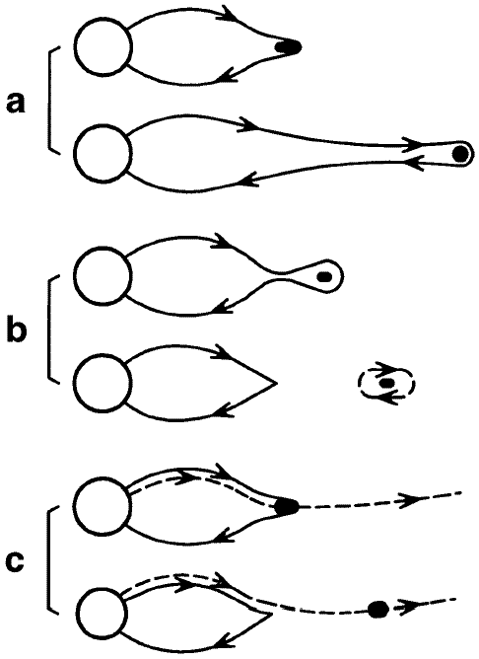
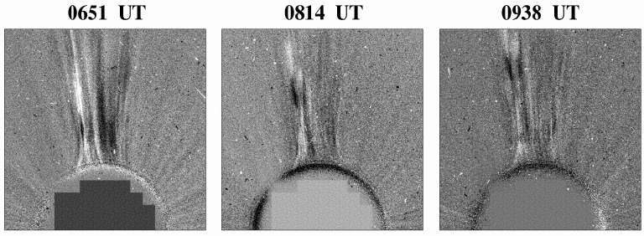
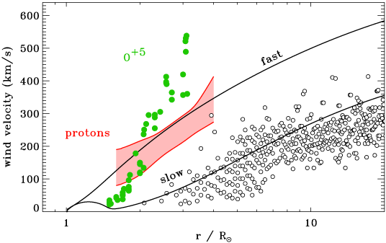
Do blobs trace out the slow wind?
Streamer “blobs”
Sheeley et al. (1997) discovered that the cusps of helmet streamers emit a continuous stream of low-contrast plasmoids.
Are they evidence for “interchange reconnection?”
Do they trace out the acceleration of the low-speed solar wind?
Wang et al. (2000)

Slide 22
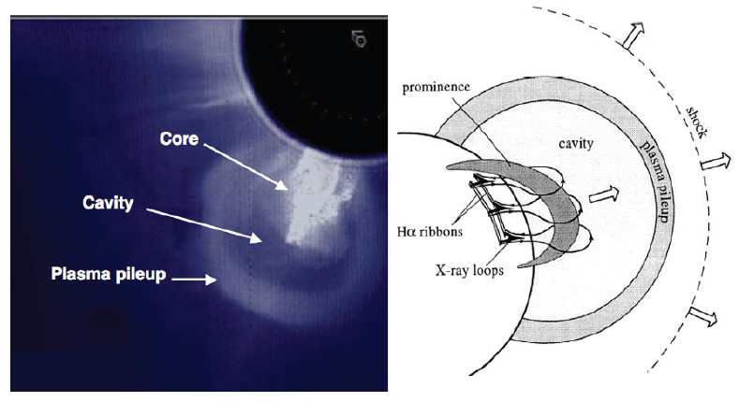
Coronal mass ejections
Parenti (2014)
The Sun continuously ejects twisted, helical strands of plasma.
CME eruptions often correlate with: but not always.
solar flares
energetic particles
Does the Sun need to eject CMEs in order for it to completely “flip” its magnetic field every 11 years?
Impossible to measure chirality (handedness) with LOS-integrated visible light emission.

Slide 23
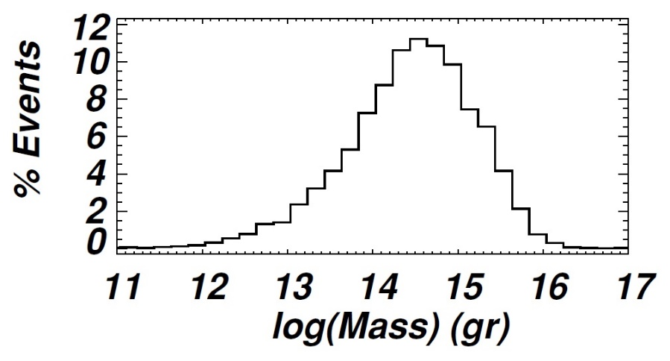
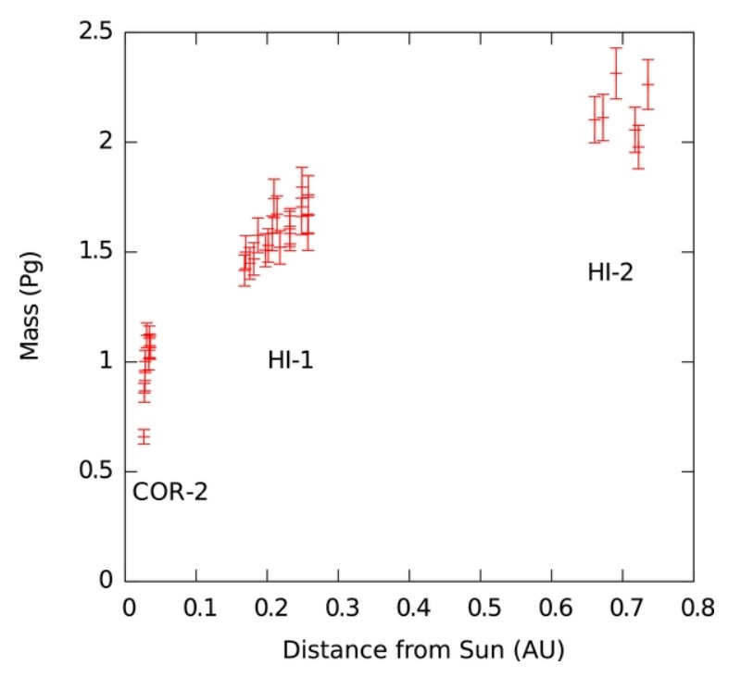
Coronal mass ejections: masses
Integrating Thomson-scattered n_{e} allows us to estimate CME masses.
Totals:
Vourlidas et al. (2010)
Solar min: ~2 Pg / rotation
Solar max: ~60 Pg / rotation
Solar wind mass loss: ~3000 Pg / rotation!
CME masses aren’t intrinsically important; they carry out much more magnetic energy than kinetic energy.
However, their MHD interactions with planetary magnetospheres do depend on how they “plow up” surrounding gas…
DeForest et al. (2013)

Slide 24
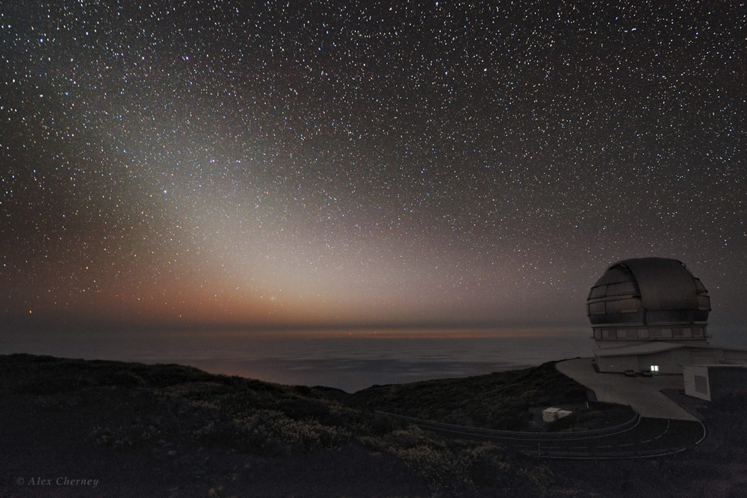
F corona = Zodiacal light

Slide 25
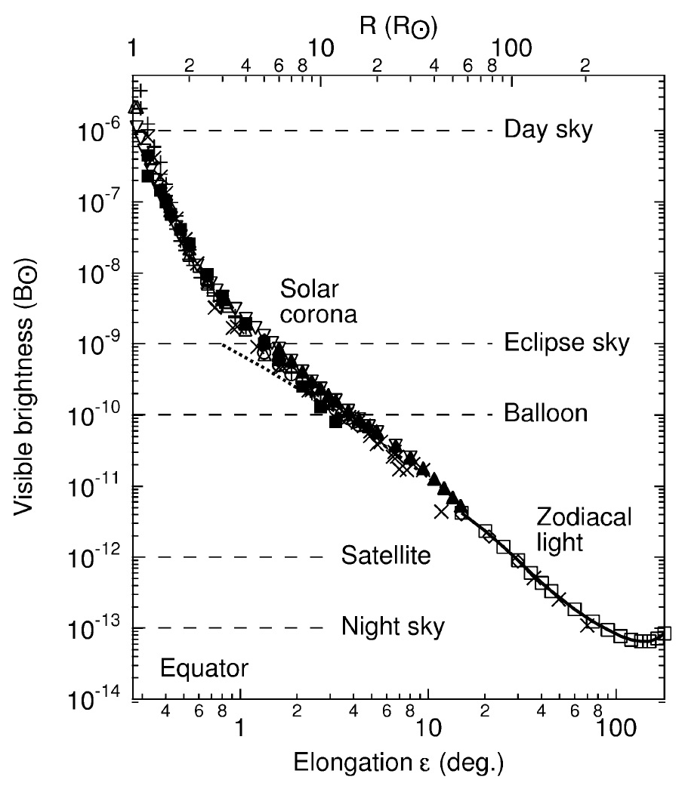
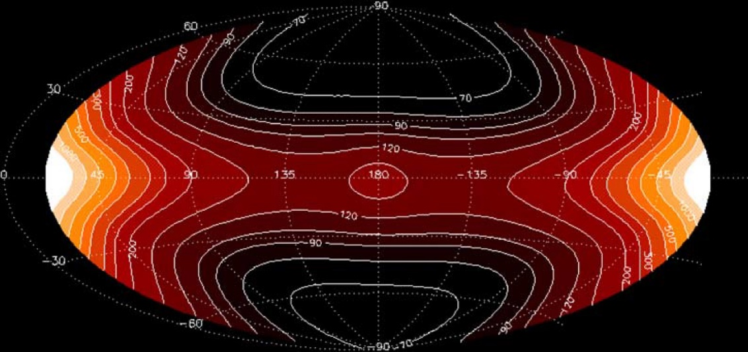
F corona = Zodiacal light
Well-characterized distribution on the sky; only very weak solar-cycle dependence.
Dust particles are concentrated in the ecliptic plane… survivors from the origin of the solar system?
Kimura & Mann (1998)
Kwon et al. (2004)

Slide 26
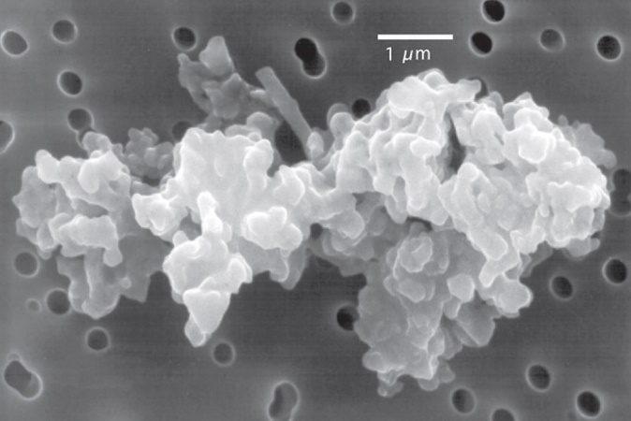
Dust grains: reflected light
Brightness depends on:
size distribution of grains
reflective properties
number density of grains
→ sources & sinks!
Jessberger et al. (2001)
collected from stratosphere
Doppler shifts of narrow Fraunhofer absorption lines probe the velocity distribution of grains:
some come in from the ISM
some ejected from comets & asteroids
some inspiral (Poynting-Robertson drag)

Slide 27
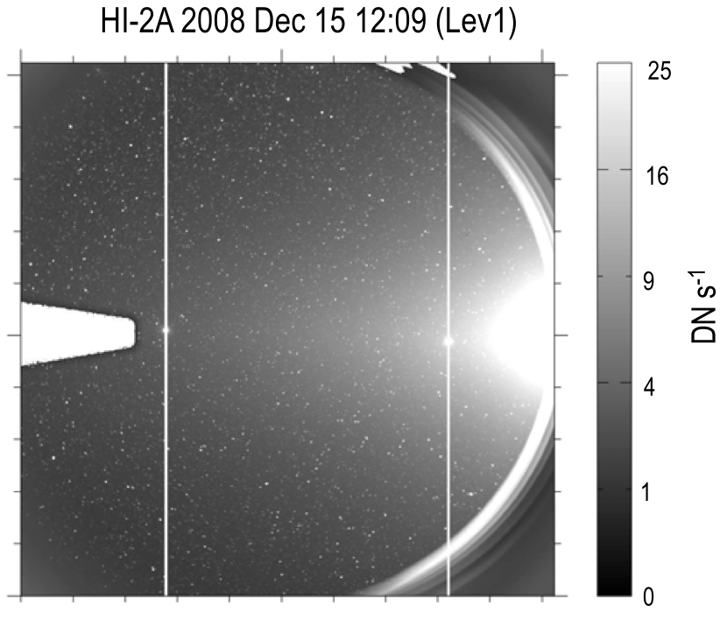
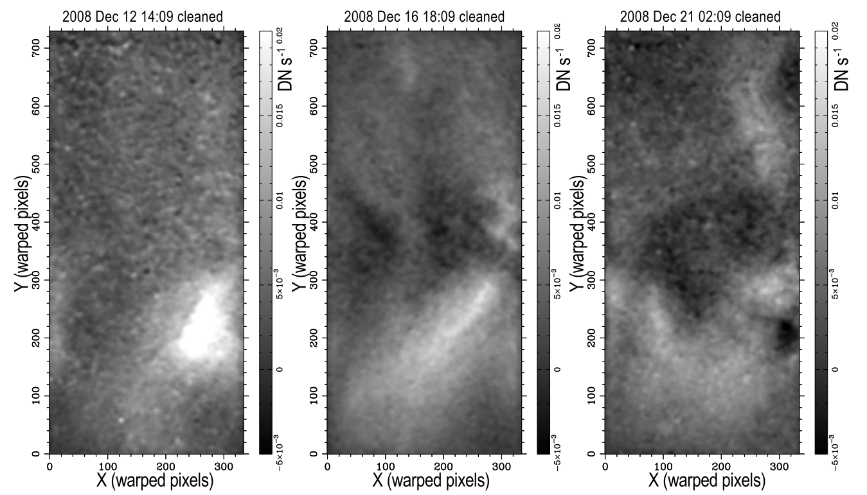
F corona: contamination?
Despite interesting dust-grain physics… we often want to get rid of it!
DeForest et al. (2011) developed sophisticated image-processing algorithms to “clean” STEREO HI images.
raw image: I ~ 10^{–13} I_{Θ}
cleaned K-corona image sequence: I ~ 10^{–17} I_{Θ}

Slide 28
Next time
Emission-line spectroscopy above the limb
Collisional vs. radiative excitation mechanisms
“Permitted” (UV, X-ray) vs. “forbidden” (visible, IR) lines

