Slide 1
Hale COLLAGE (CU ASTR-7500)
“Topics in Solar Observation Techniques”
Spring 2016, Part 1 of 3: Off-limb coronagraphy & spectroscopy
Lecturer: Prof. Steven R. Cranmer
APS Dept., CU Boulder
steven.cranmer@colorado.edu
http://lasp.colorado.edu/~cranmer/
Lecture 6:
The Thomson-scattered K corona

Slide 2
Brief overview
Goal of Lecture 6:
Understand the origin of visible-light continuum radiation in the extended corona.
K-corona: solar light Thomson-scattered by electrons
Diagnostic of electron density

Slide 3
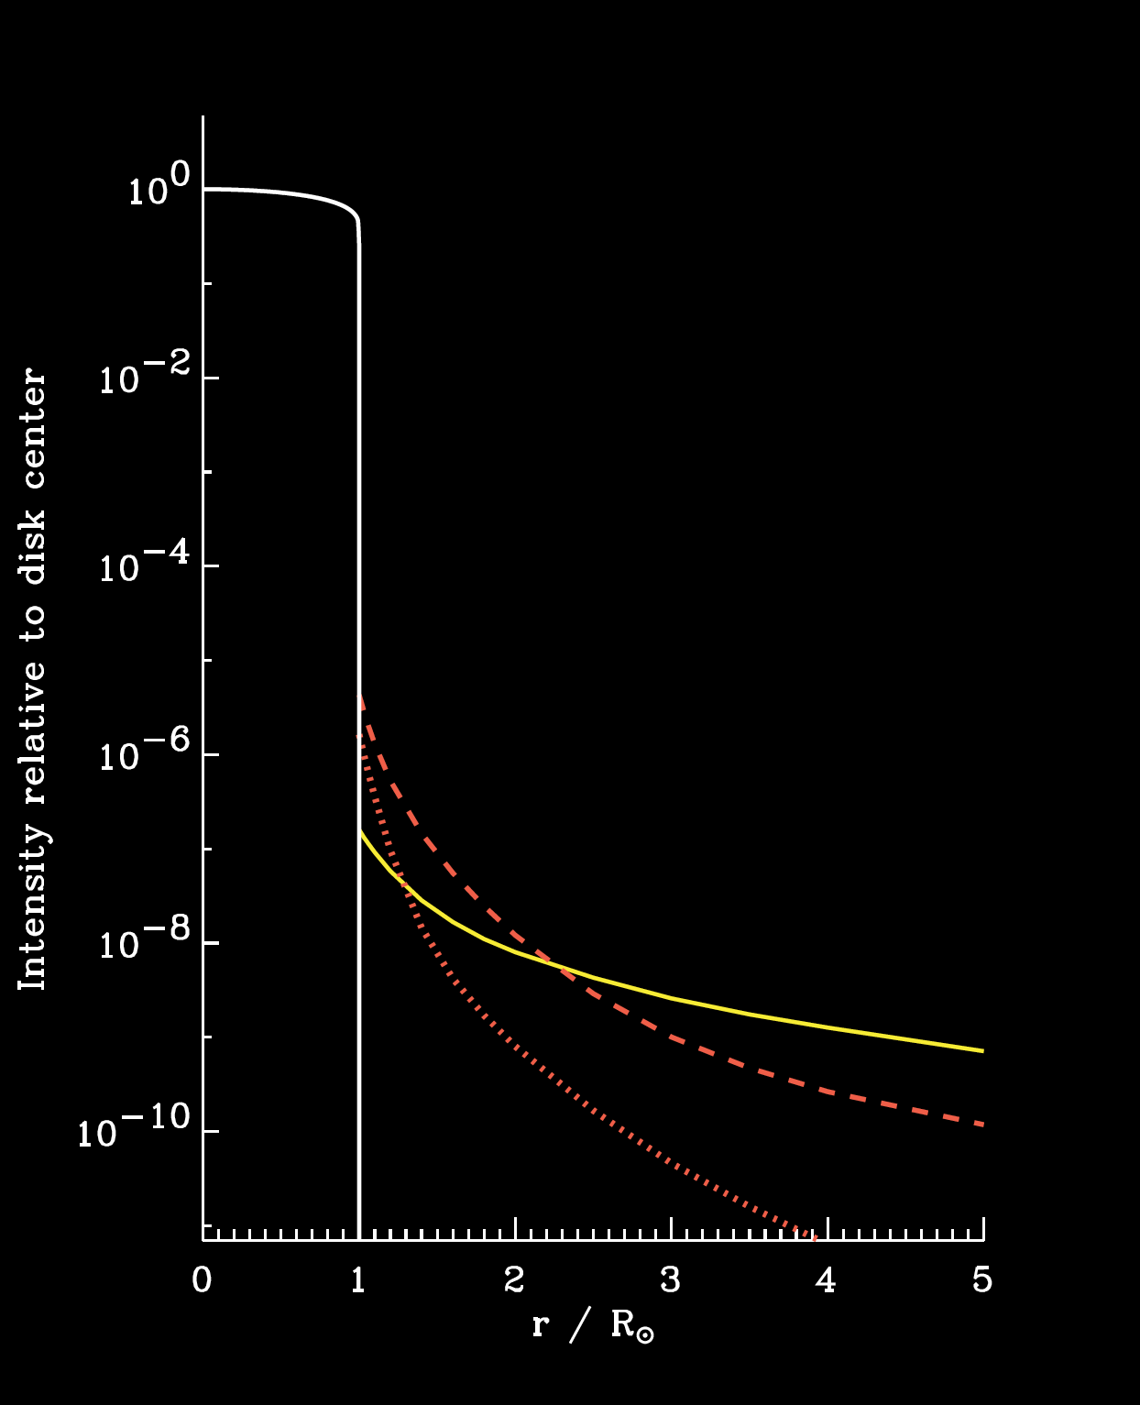
Intensity above the limb
Particles in the extended corona:
bound atoms/ions
free electrons
free nuclei (p⁺, He⁺²)
dust grains
Also: weaker
E corona (or L): emission lines
T corona: thermal IR from dust
F corona
K corona

Slide 4
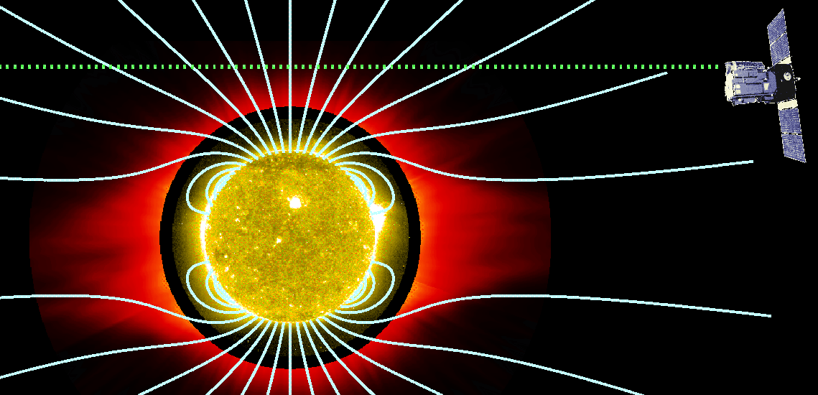
Intensity above the limb
Recall the solution to the equation of radiative transfer:
When observing above the limb, there is no illuminating source I_{ν}*
The extended corona is extremely optically thin (τ_{ν} ≈ 10^{–12} )

Slide 5
Optically thin emission
We still need to know how to evaluate the source function, but we also need to know the opacity: dτ = κ ρ dx = n σ dx
For the continuum processes we’ll study in this lecture, both σ and S_{ν} will be dominated by scattering.
Visible-light intensity is mainly a probe of the LOS-integral of the coronal number density.

Slide 6
The source function
Let’s look at two extreme cases:
If the plasma is hot and dense (τ >> 1),
j_{ν} is dominated by thermal emission
κ_{ν} is dominated by thermal absorption
i.e., the plasma & radiation field are kept in strict thermodynamic equilibrium (STE) by frequent photon–particle collisions.
I_{ν} must be isotropic, with no local gradients:
In STE, both are given by the Planck function…

Slide 7
The source function
In low-density plasmas, in the vicinity of a strong source of light, scattering may be the dominant contributor to j_{ν} and κ_{ν}
To describe the scattering, we need to know the photon redistribution function R(ν′, n′; ν, n), where
joint probability of scattering a photon:
from solid angle dΩ′
from freq. range ν′ to (ν′ + dν′)
into solid angle dΩ
into freq. range ν to (ν + dν)
It’s normalized such that:

Slide 8
The source function
If we want to know how many photons get scattered into a given direction and frequency range, we integrate over all of the “from” directions & frequencies.
Weight it by the intensity in those incoming bins, and that gives us the scattering source function:
Many scattering processes are coherent (ν′ = ν) and isotropic (random chance of ending up in outgoing direction n). In that case:
i.e.,

Slide 9
The source function
Thus, the fully general source function can be written as a linear combination of the collisional and scattering limits, with the so-called albedo a_{ν} determining how much of each there is:
Some emission lines have non-negligible contributions from both parts.
For now, let’s just consider pure scattering (a_{ν} = 1), but back up and think about the microphysics of oscillating electric & magnetic fields.

Slide 10
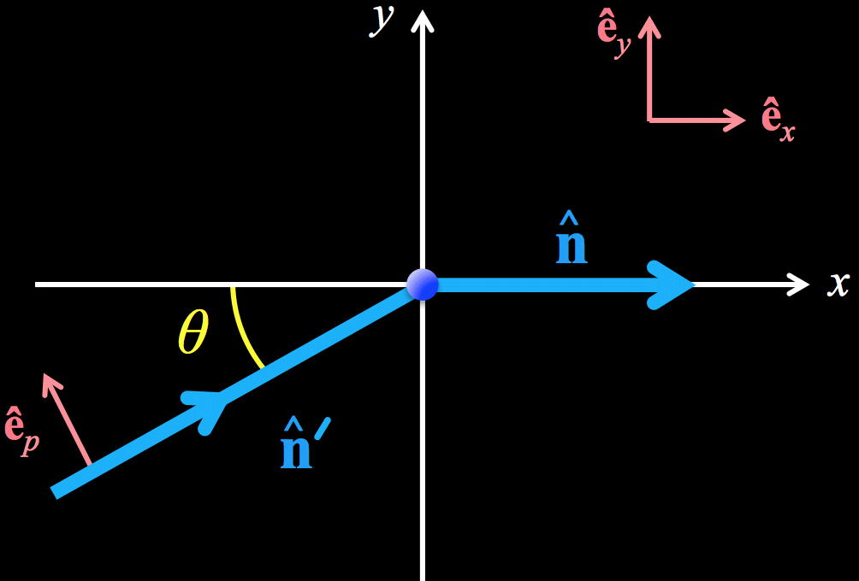
Thomson scattering
Consider a plane wave encountering a free electron at the origin.
The scattered E & B fields will go off in all directions, but we focus on one particular observer (LOS) along the x axis:
There are 2 unit vectors transverse to the incoming wave:
&

Slide 11
Thomson scattering
The incoming plane wave (presumably from the Sun) has electric field:
i.e., amplitude components:
The charged electron feels a Lorentz acceleration from the incoming E-field,
and the oscillating E-field produces a sinusoidally varying acceleration.

Slide 12
Thomson scattering
An accelerated charge radiates; i.e., it emits outward-propagating EM waves.

Slide 13
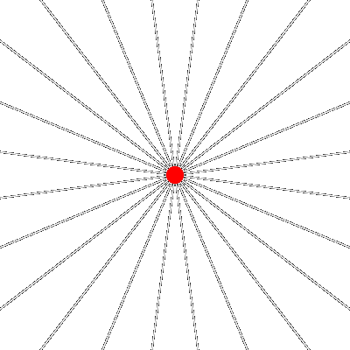
Thomson scattering
An accelerated charge radiates; i.e., it emits outward-propagating EM waves.
Consider a simple example: a charge at rest, then starts moving.
Acceleration is in a finite pulse.
“Information” about the new state of motion propagates out at the speed of light.
Our oscillating acceleration generates oscillating patterns of information propagation: i.e., “new” sinusoidal EM waves!

Slide 14
Thomson scattering
The outgoing waves propagating along a given direction have E-field given by:
valid for electron velocity << c
“classical” electron radius
Our chosen outgoing direction is along x axis, and the wave is indeed transverse:
out-of-plane component is ~unaffected

Slide 15
Thomson scattering
In many cases, the incoming wave will be an unpolarized mix of the E_{p} and E_{z} amplitudes.
Let’s write it as the total amplitude, rotated by an angle ψ
Later, we’ll average over all possible ψ’s. The outgoing amplitudes:

Slide 16
Thomson scattering
We can average the outgoing (squared) amplitudes over all the ψ angles…
Incoming Poynting flux <E_{Θ}²> was a plane wave, but outgoing Poynting flux components go as 1/r²

Slide 17
Thomson scattering
The outgoing intensity can be expressed in terms of the incoming intensity:
If there was no difference between I_{y} and I_{z} , the outgoing beam would be unpolarized.
However, we can define the Stokes parameters for our observer along x axis:

Slide 18
Thomson scattering
All of the above was for a single free electron.
Really, we expect our beam to encounter # of them…
where the Thomson cross section is:

Slide 19
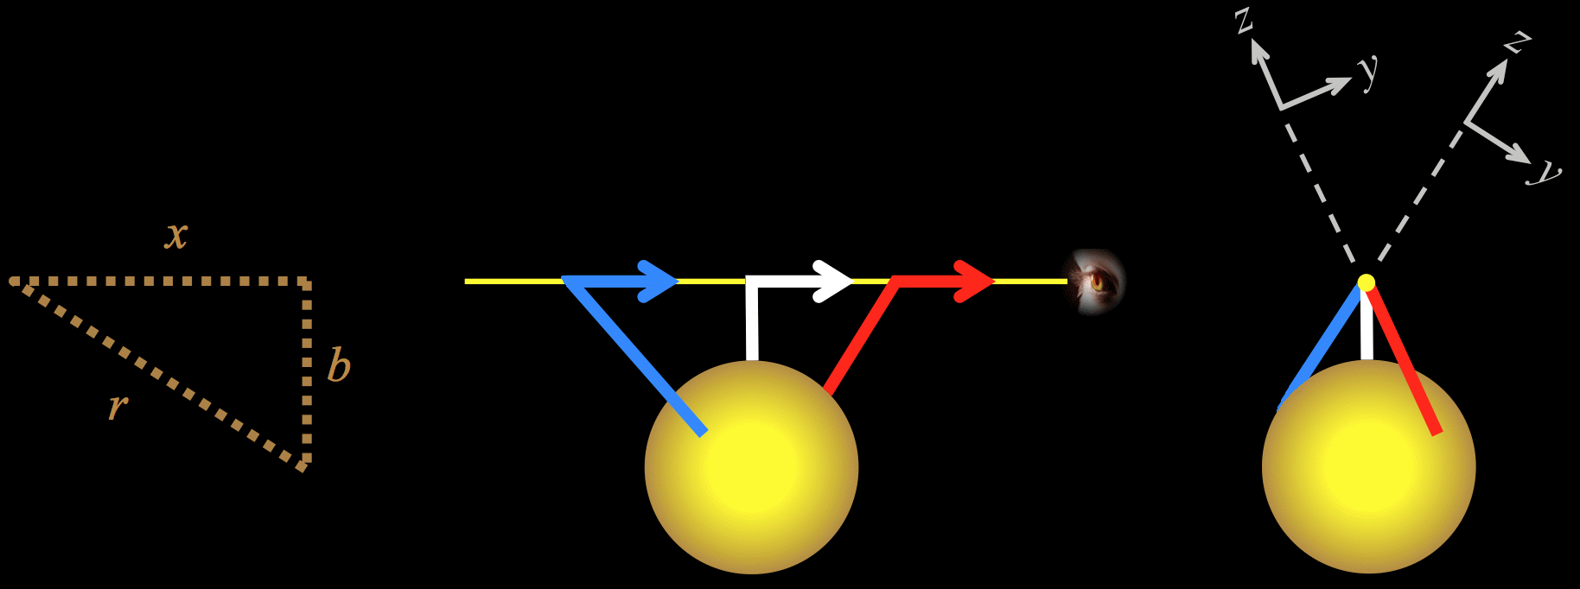
Thomson scattering
Are we done yet? Not quite! Two more complications:
Solar disk subtends a finite solid angle, & is limb-darkened.
Incoming rays don’t share the same y,z plane… need to rotate each set of Stokes parameters into a common frame.
Minnaert (1930);
van de Hulst (1950)

Slide 20
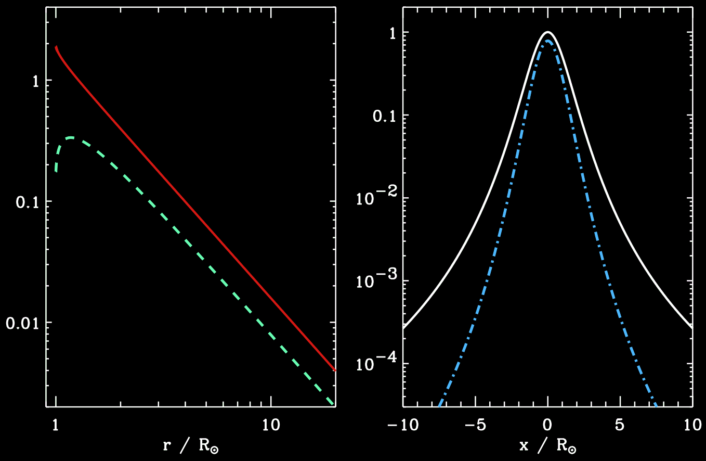
Thomson scattering
full dx integrands
Y(r)
I
A(r)
Q

Slide 21
Thomson scattering
The overall frequency redistribution isn’t really coherent.
Each scattering event preserves frequency in the electron’s frame, but the electrons have a Maxwellian velocity distribution.
Random Doppler shifts “smear” solar spectrum with a ~4 nm window.
Many visible-light filters, though, have bandpasses of 20 to 400 nm.
Why don’t other charged particles (e.g., H or He nuclei) contribute to the observed Thomson-scattered emission?

Slide 22
Next time
Survey actual observations of the K corona, from 1950s to present.
How do we use these measurements as diagnostics of the plasma properties of the corona?
What about the dust-scattered F corona?

