Slide 1
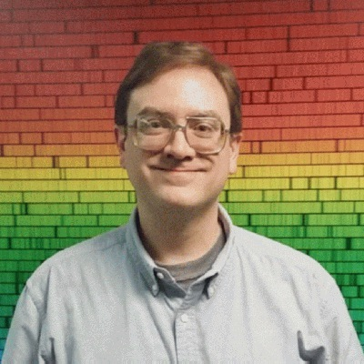
Hale COLLAGE (CU ASTR-7500)
“Topics in Solar Observation Techniques”
Spring 2016, Part 1 of 3: Off-limb coronagraphy & spectroscopy
Lecturer: Prof. Steven R. Cranmer
APS Dept., CU Boulder
steven.cranmer@colorado.edu
http://lasp.colorado.edu/~cranmer/
Lecture 5:
Dealing with Diffraction in Real Coronagraphs

Slide 2
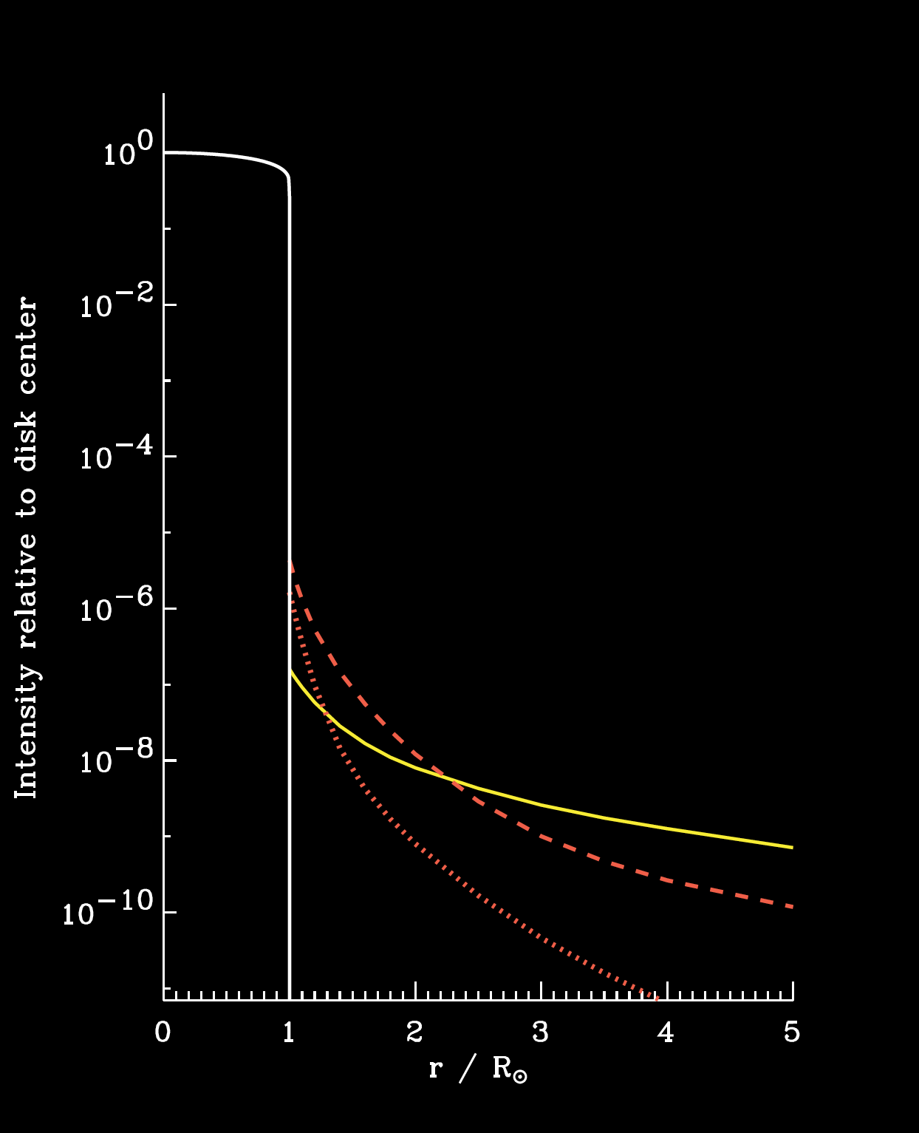
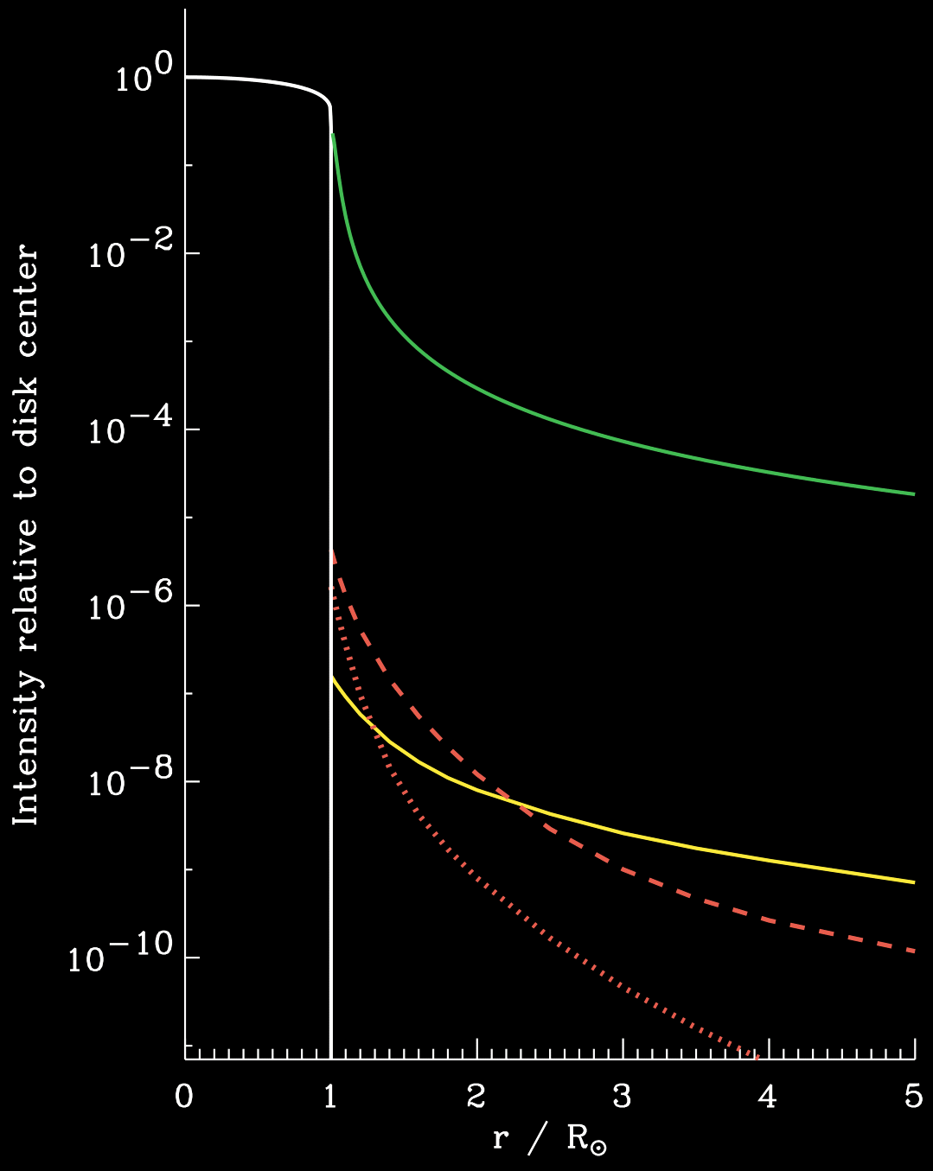
The problem…
What are our options?
We have to move the occulter much further away (like the distance of the Moon?),
or we need to experiment with other shapes (other than a straight-edge),
or we need to just deal with the diffracted light after it enters the telescope.
λ = 500 nm
R = 2 m

Slide 3
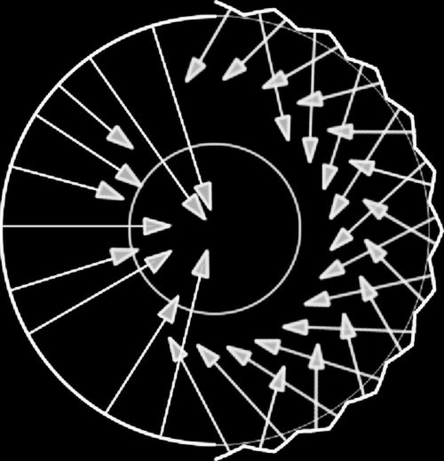
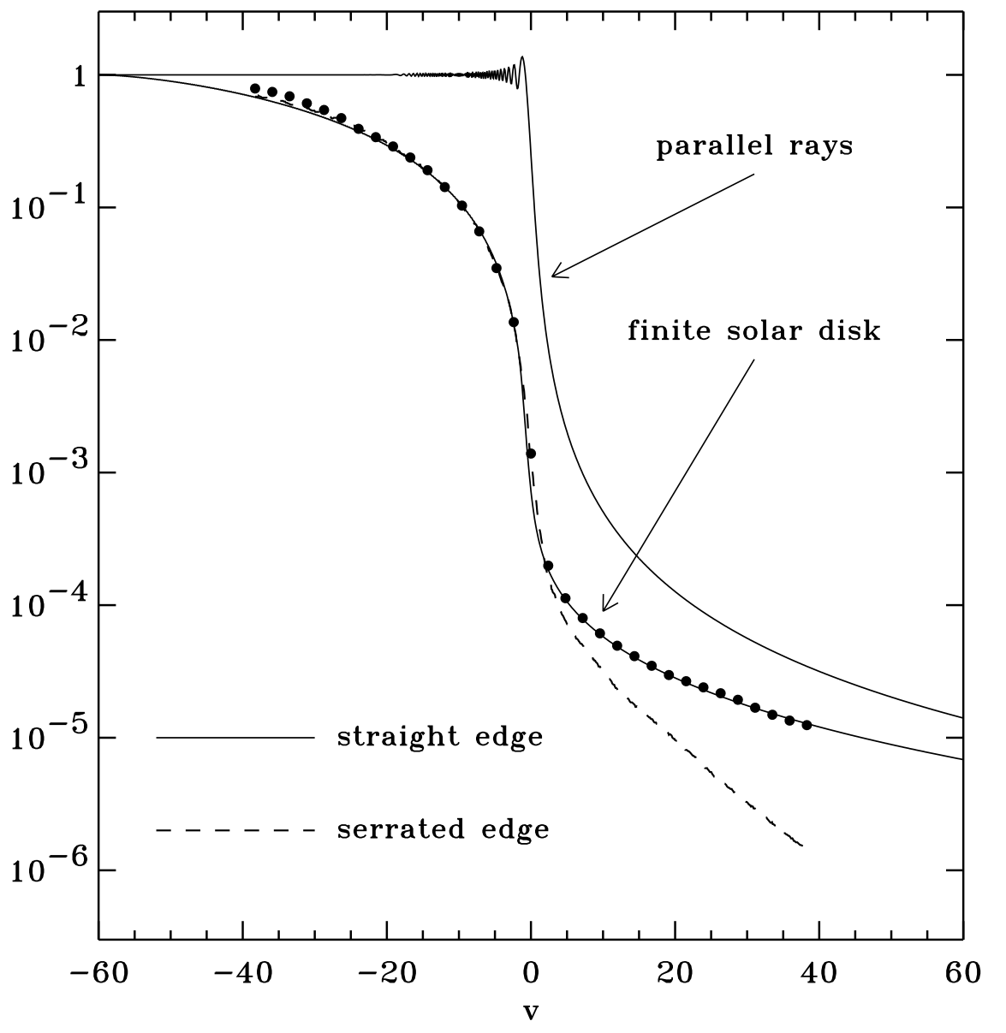
Other shapes
Apodization: changing the shape of the occulter edge (especially on scales ~ λ) in order to modify the diffraction pattern around it.
Traditional fix: sawtooth / serrated edges:

Slide 4
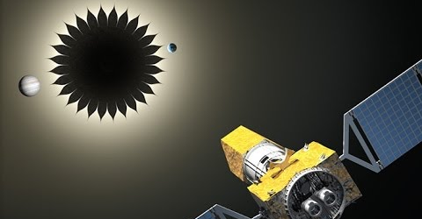
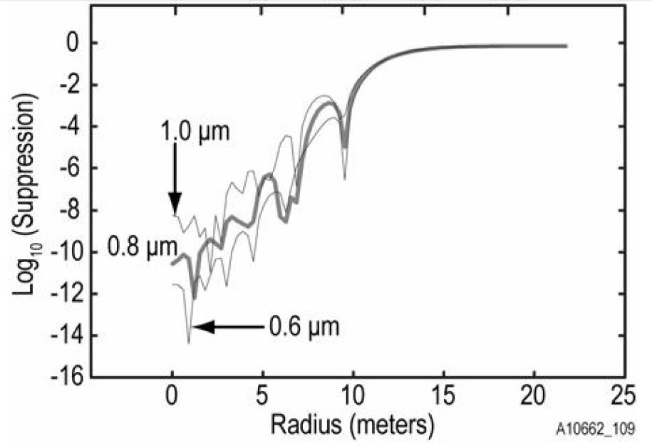
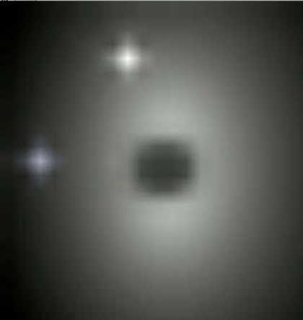
Other shapes
Web Cash at CU Boulder is exploring flower-petal shaped “starshades” that may drastically reduce diffraction for extrasolar planet direct imaging.
For a 30 m wide occulter at a distance of ~80,000 km, the diffraction signal can be of order 10^{–10} x unobstructed:
Earth & Venus at distance of 10 pc (Cash 2007):
without starshade with starshade

Slide 5
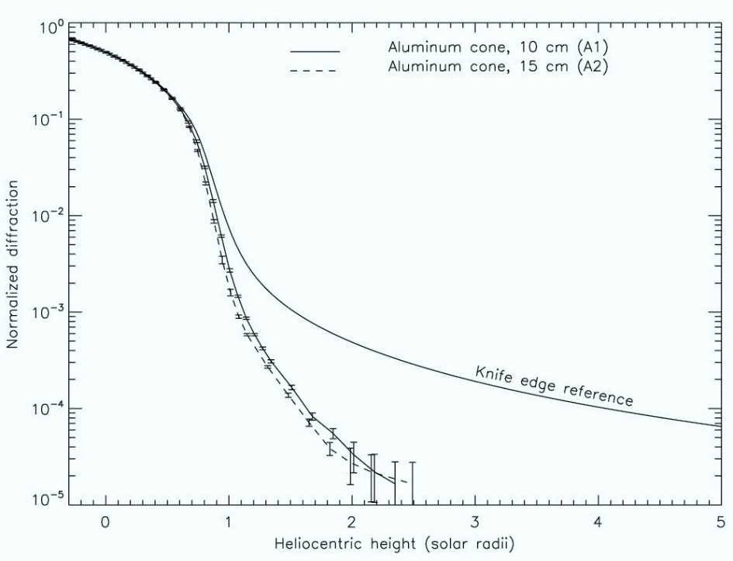
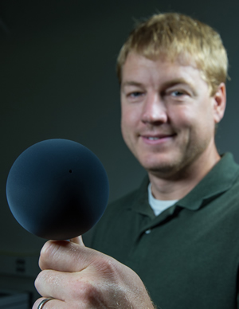
Other shapes
Most space-based solar coronagraphs use either multiple occulters (discrete baffles) or a continuous stack of occulters shaped into a cone/barrel configuration.
Landini et al. (2011)
Phil Chamberlin at Goddard is extending the idea of multiple baffles to occultation around spherical balls coated in carbon nanotubes.
Buffington (2000) showed that the PSF might transition from power-law to exponential in θ !

Slide 6
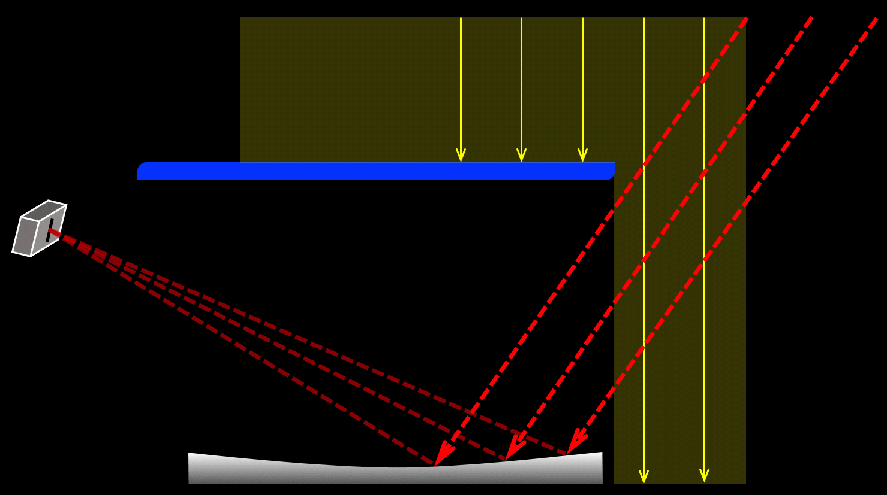
Basic optical paths (linear cut)
We’re stuck with some diffracted light. What can we do with it?
Good news: because diffracted rays are not coming “from infinity,” a mirror will focus them at a different place than the un-diffracted coronal rays.

Slide 7
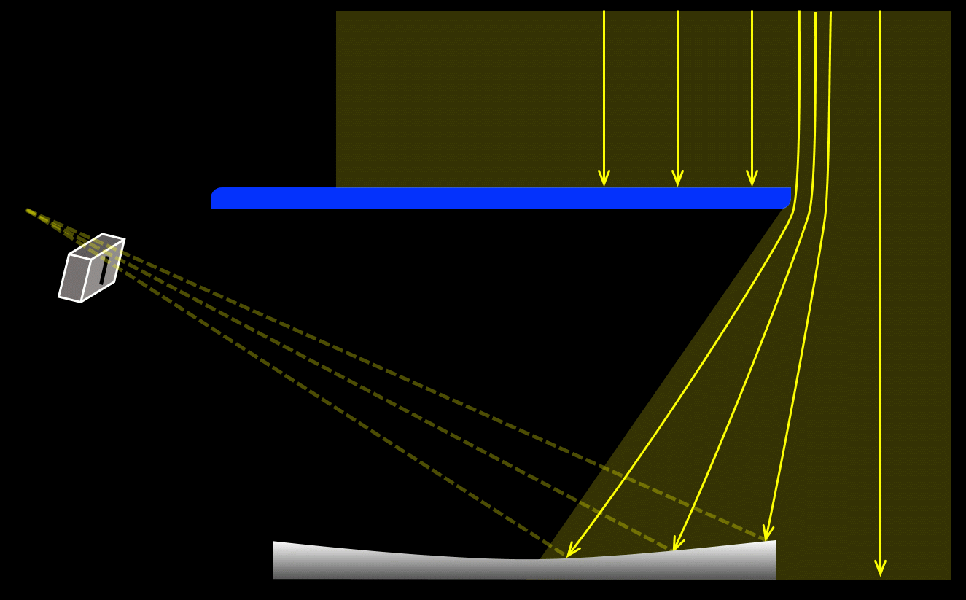
Basic optical paths (linear cut)
We’re stuck with some diffracted light. What can we do with it?
Good news: because diffracted rays are not coming “from infinity,” a mirror will focus them at a different place than the un-diffracted coronal rays.

Slide 8
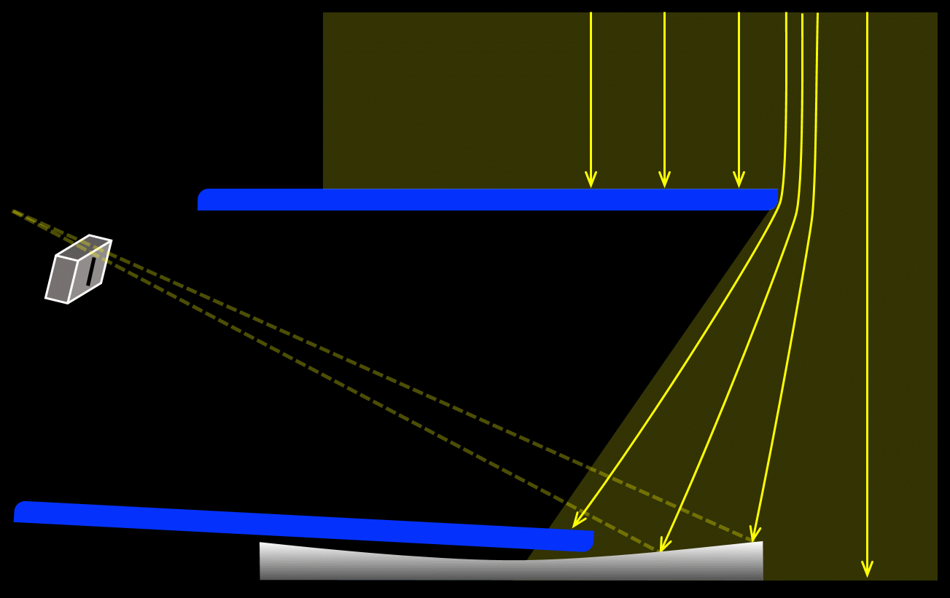
Basic optical paths (linear cut)
Bad news: some diffracted rays will get in, despite being out of focus.
Good news: a well-placed internal occulter (“Lyot stop”) can block them.

Slide 9
Non-specular reflection
Where does that leave us?
Some diffracted light has entered the system, but if those rays are reflected via ideal geometrical optics, they won’t propagate further into the telescope.
geometrical
optics
physical
optics !
Bad news #1: finite mirror size produces diffraction
Bad news #2: mirror’s surface is never ideal
Bad news #3: (ground-based telescopes) mirrors collect dust

Slide 10
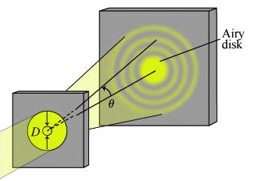
Diffraction from a finite-sized mirror
Think of it like a finite “aperture.” Fraunhofer diffraction is the proper limit:
cylindrical symmetry:
On detector, vary x, set y = 0

Slide 11
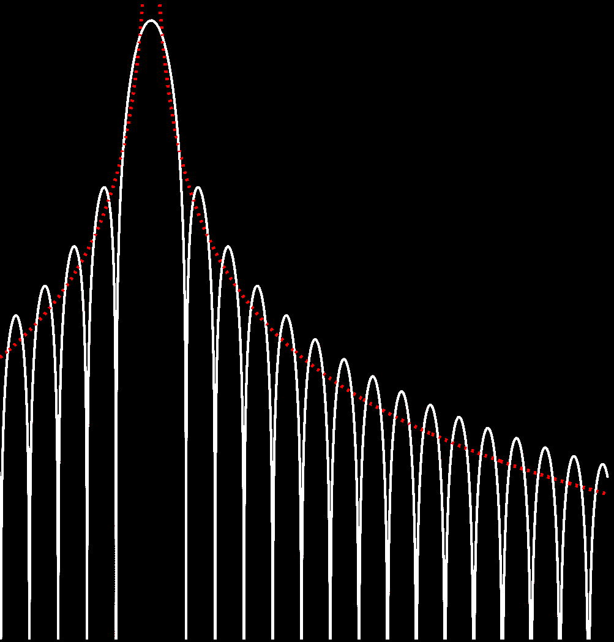
Diffraction from a finite-sized mirror
Fraunhofer diffraction broadens the central peak, but also creates large-angle wings:

Slide 12
Diffraction from a finite-sized mirror
Fraunhofer diffraction broadens the central peak, but also creates large-angle wings:
A rectangular mirror/aperture has a different large-angle PSF…
θ ^{–2}
θ ^{–3}
θ ^{–4}

Slide 13
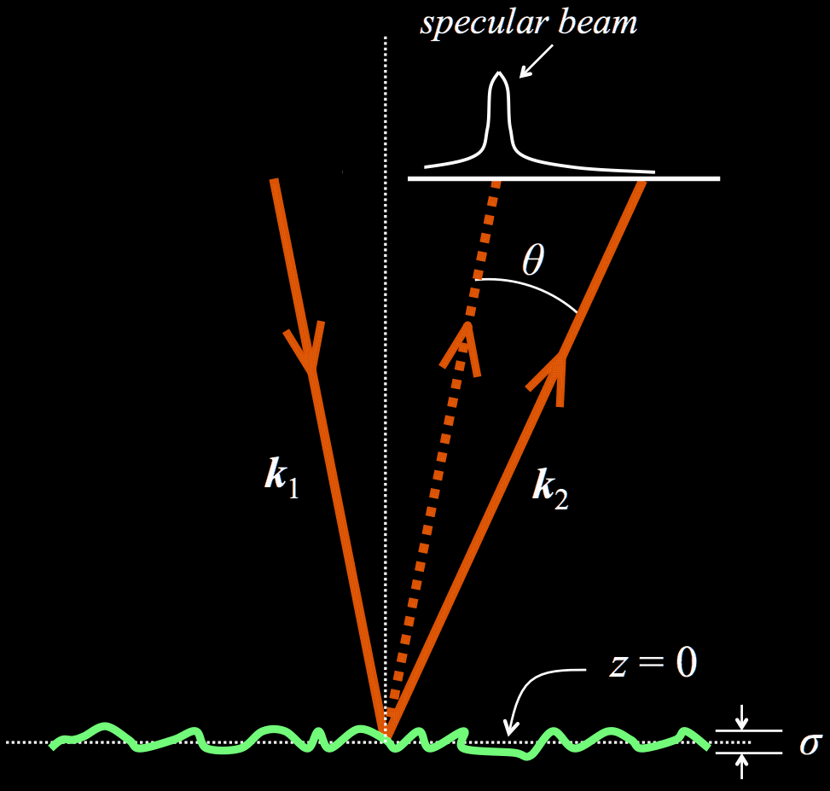
Mirror surface roughness
On small scales (nm), it’s an issue of proper polishing/finishing.
Root-mean-square σ can be as small as 0.5-1 nm.
On large scales (cm), it’s an issue of grinding to the proper figure: aberrations reduce the effective D.

Slide 14
Dust on mirrors
Dust is everywhere… higher fraction surface coverage → more scattering wings.

Slide 15
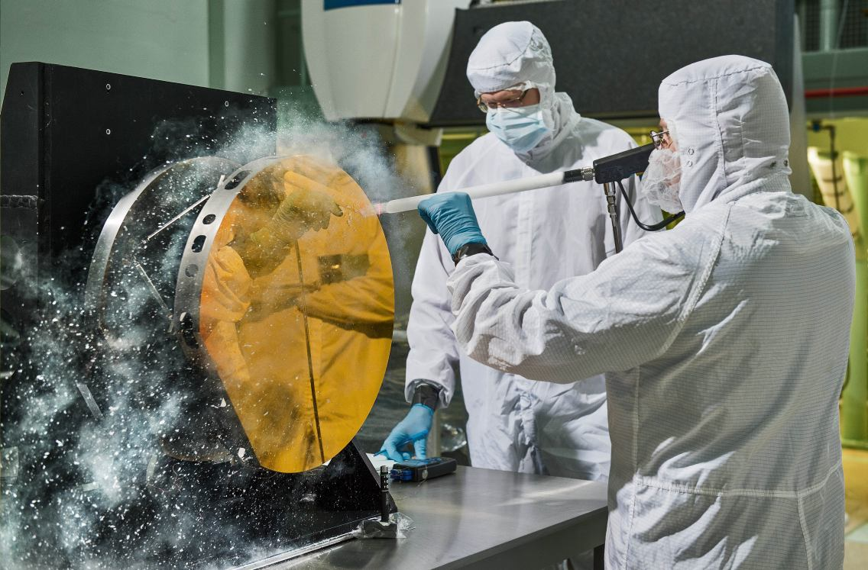
Dust on mirrors
Dust is everywhere… higher fraction surface coverage → more scattering wings.
Ground-based telescope mirrors: require frequent cleaning (e.g., CO₂ “snow”).

Slide 16
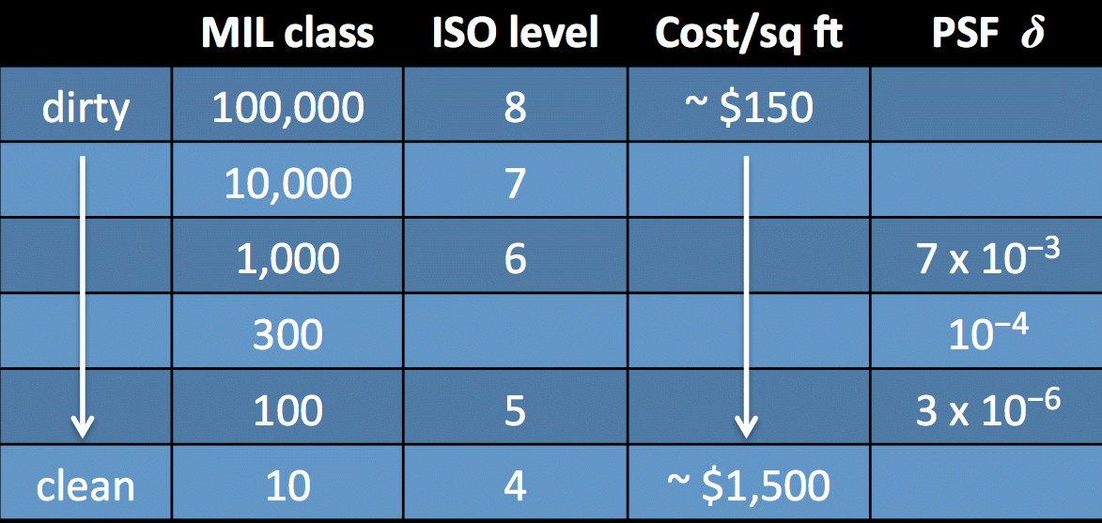
Dust on mirrors
Dust is everywhere… higher fraction surface coverage → more scattering wings.
Ground-based telescope mirrors: require frequent cleaning (e.g., CO₂ “snow”).
For mirrors being launched into space, it all depends on the clean-room…

Slide 17
Next time
Assuming we can isolate “coronal rays…”
What determines the intensity & polarization state of the photons that we see?
Start with the visible-light continuum: K corona & F corona

