Slide 1
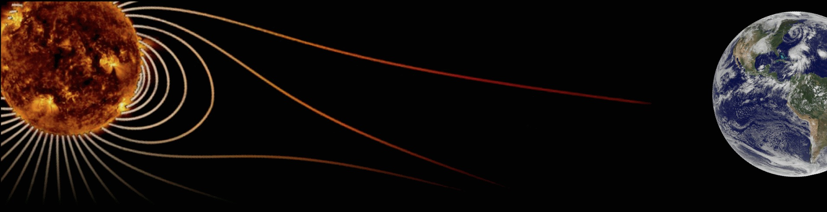








Hale COLLAGE (CU ASTR-7500)
“Topics in Solar Observation Techniques”
Spring 2016, Part 1 of 3: Off-limb coronagraphy & spectroscopy
Lecturer: Prof. Steven R. Cranmer
APS Dept., CU Boulder
steven.cranmer@colorado.edu
http://lasp.colorado.edu/~cranmer/
Lecture 3:
Basic concepts in radiative transfer & polarization

Slide 2
Brief overview
Goals of Lecture 3:
Introduce basic ideas of radiative transfer (interaction between radiation and matter)
Discuss polarization of the radiation field

Slide 3
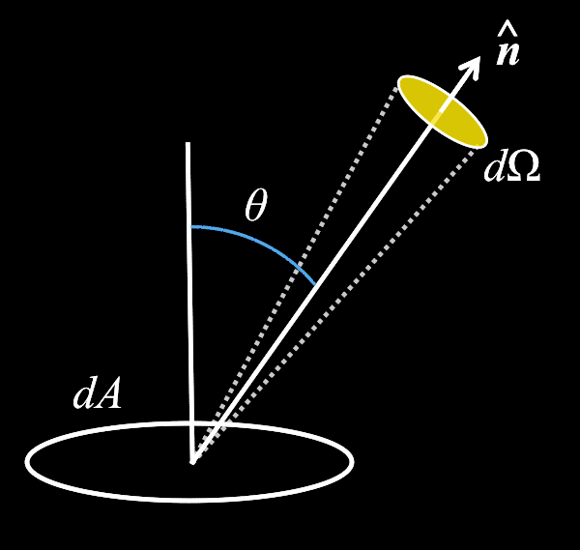
Specific intensity
Recall that, in vacuum, I_{ν} is constant along any given ray…
I_{ν} describes how much photon energy is flowing
through a particular area
in a particular direction (i.e., through a particular sold angle)
per unit frequency (i.e., energy “bin”)
per unit time

Slide 4
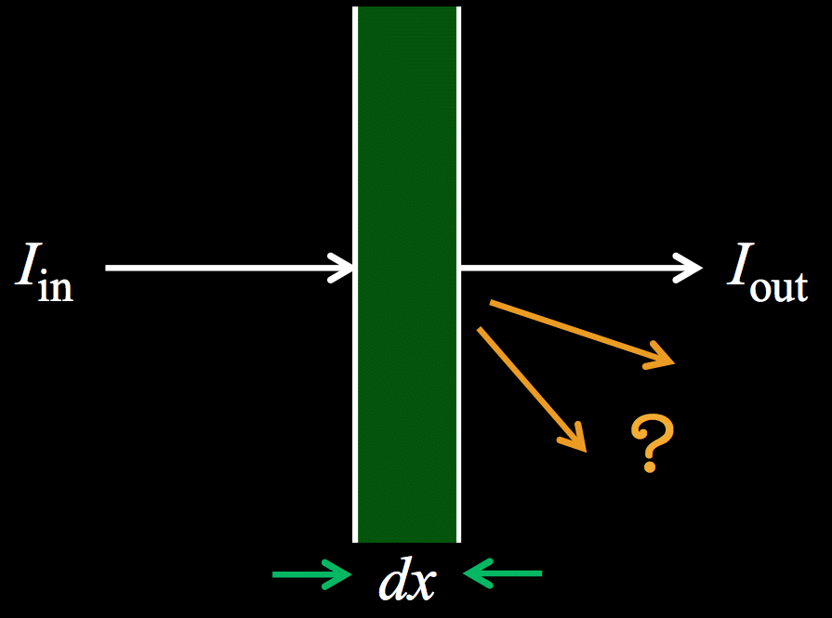
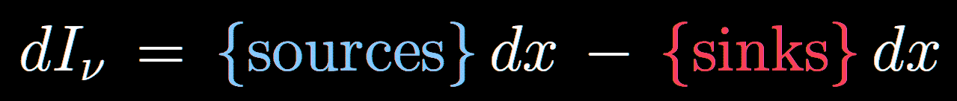
Radiative transfer
When photons interact with particles
they can be created or destroyed.
(atoms, ions, free electrons, dust grains, … )
Photons can be absorbed by atoms/ions.
Photons can be emitted “spontaneously” by atoms/ions.
Photons can be lost by being scattered away from a given direction n, or up/down in λ.
Photons can be scattered into the beam (with a given n, λ) by coming from some other direction or wavelength.

Slide 5
Radiative transfer
Photons can be absorbed by atoms/ions.
Photons can be emitted “spontaneously” by atoms/ions.
Photons can be lost by being scattered away from a given direction n, or up/down in λ.
Photons can be scattered into the beam (with a given n, λ) by coming from some other direction or wavelength.

Slide 6
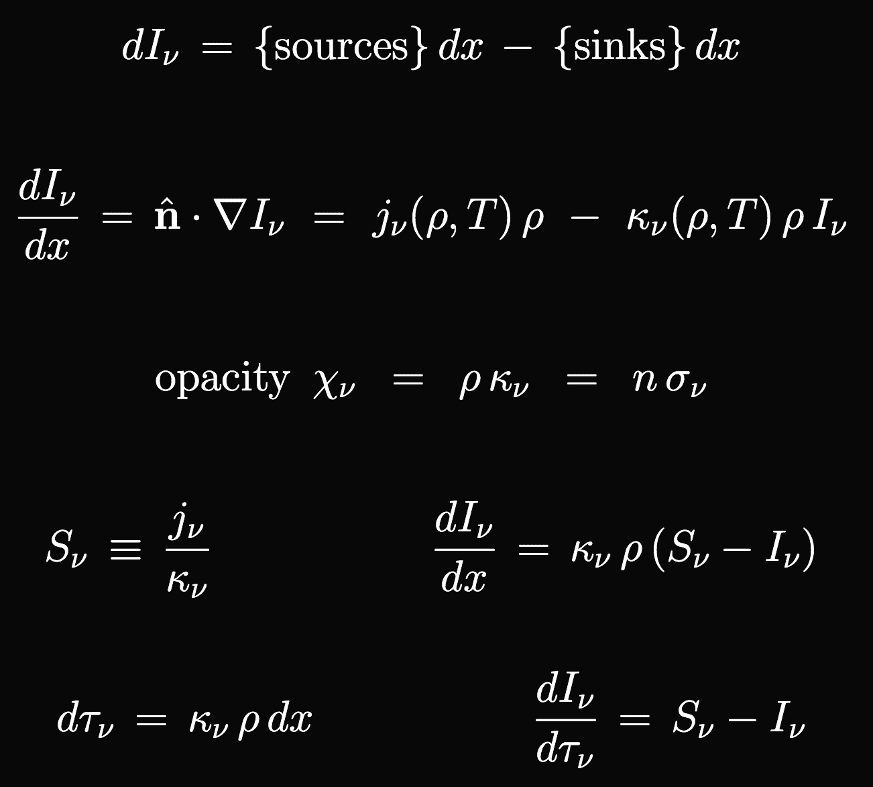
Radiative transfer
Rate depends on:
local ρ,T & incoming I_{ν}
local ρ,T only
local ρ,T & incoming I_{ν}
local ρ,T & I_{ν} in all other directions
Photons can be absorbed by atoms/ions.
Photons can be emitted “spontaneously” by atoms/ions.
Photons can be lost by being scattered away from a given direction n, or up/down in λ.
Photons can be scattered into the beam (with a given n, λ) by coming from some other direction or wavelength.
The Equation of Radiative Transfer:
emission coefficient
absorption coefficient

Slide 7
Radiative transfer
Different units are often used…
cm² / g
cm²
1 / length
The emission coefficient is often written as an intensity-like quantity called the source function.

Slide 8
Radiative transfer: optical depth
A key dimensionless quantity that describes the overall interaction between radiation and matter is the optical depth: opacity x path length
Optical depth τ_{ν} (frequency dependent!) is the integral of dτ_{ν} over a given region.
τ_{ν} << 1 : “optically thin” regions where photons mainly flow freely; absorptions & scatterings are rare.
τ_{ν} >> 1 : “optically thick” regions where photons are trapped. Absorptions/scatterings are so frequent that the distribution I_{ν} (n) is rapidly randomized to be ~isotropic.
τ_{ν} ~ 1 : this defines the “photosphere;” i.e., the layer where most of the photons we see are created.

Slide 9
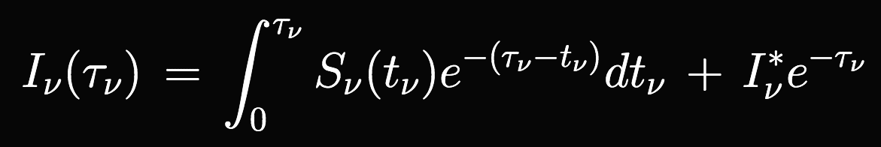
Radiative transfer: the “formal solution”
The equation of radiative transfer is a first-order ordinary differential equation, solvable by the integrating factor method:
This assumes we know the source function.
When scattering is important, S_{ν} depends on the radiation field in directions other than n!
The problem becomes an integro-differential equation…

Slide 10
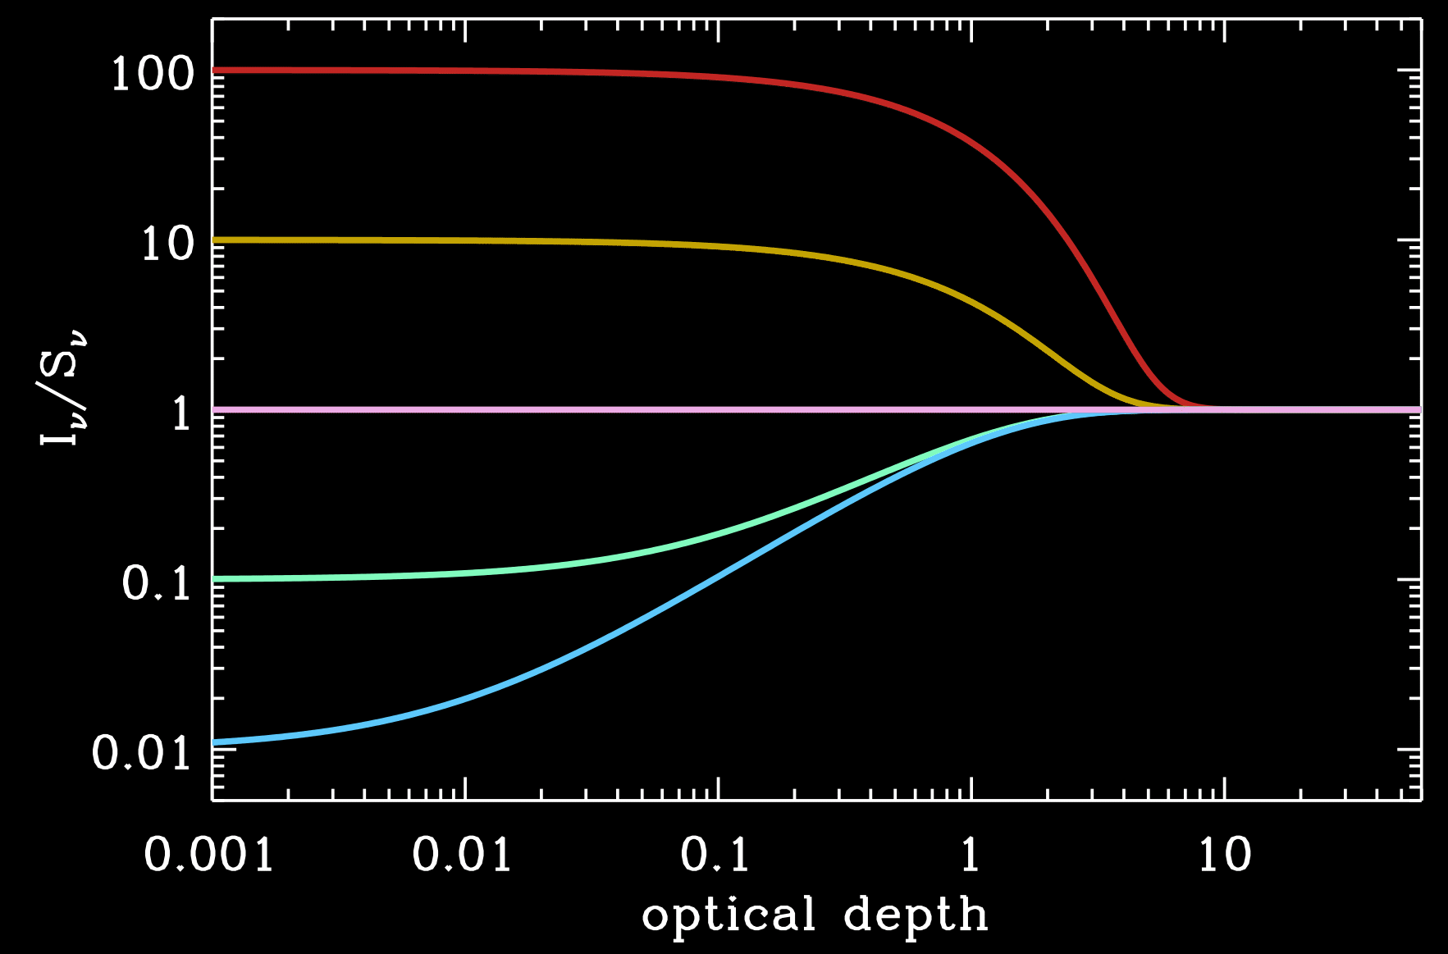
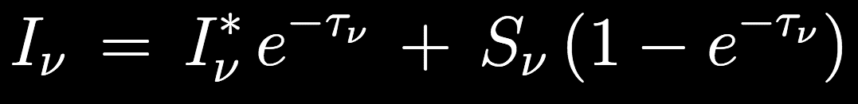
Radiative transfer: the “formal solution”
The source function is like an “attractor” for the intensity.
At every point along a ray, I_{ν} wants to approach S_{ν} and it will get there once the medium becomes optically thick.
Consider the solution if S_{ν} = constant
100
10
1
0.1
0.01
Plot vs τ_{ν} for I_{ν}* = S_{ν}

Slide 11
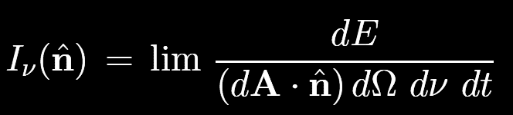
What if the “beam” consists of a superposition of >1 monochromatic plane waves?
with different frequencies?
coming from different directions?
with different phases in time?
with different E┴ orientations in the transverse plane?
Already taken care of!
Polarization

Slide 12
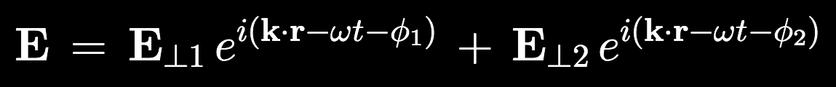
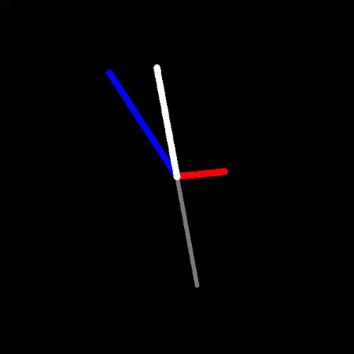
Polarization
Defined as a non-random distribution of electric vectors in an arbitrary beam of electromagnetic radiation.
First consider the superposition of two plane waves:
If ϕ₁ = ϕ₂ , the two waves are in phase with one another → linear polarization
The vector sum between E₁ and E₂ in the transverse plane determines the orientation of linear polarization.

Slide 13
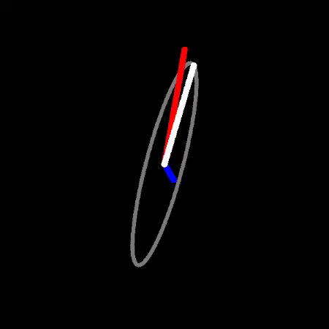
Polarization
If ϕ₁ ≠ ϕ₂ , the two waves are out of phase with one another → elliptical polarization

Slide 14
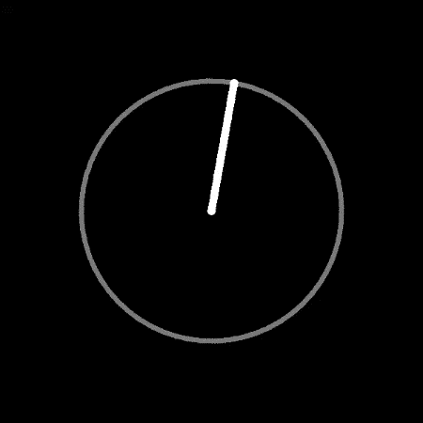
Polarization
If ϕ₁ ≠ ϕ₂ , the two waves are out of phase with one another → elliptical polarization
Special case:
  ϕ₁ = ϕ₂ ± π/2
  magnitudes of E₁ and E₂ are equal
  E₁ and E₂ are separated by ± π/2 in the transverse plane
  → circular polarization

Slide 15
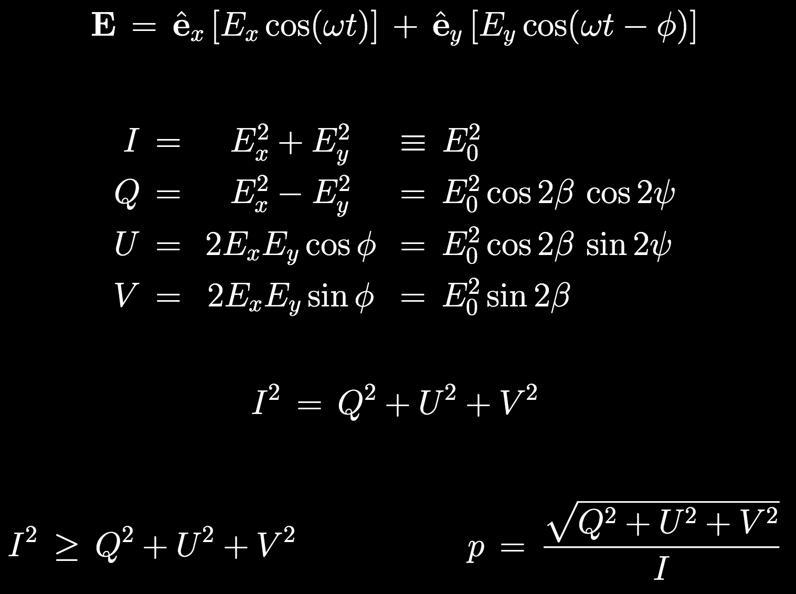
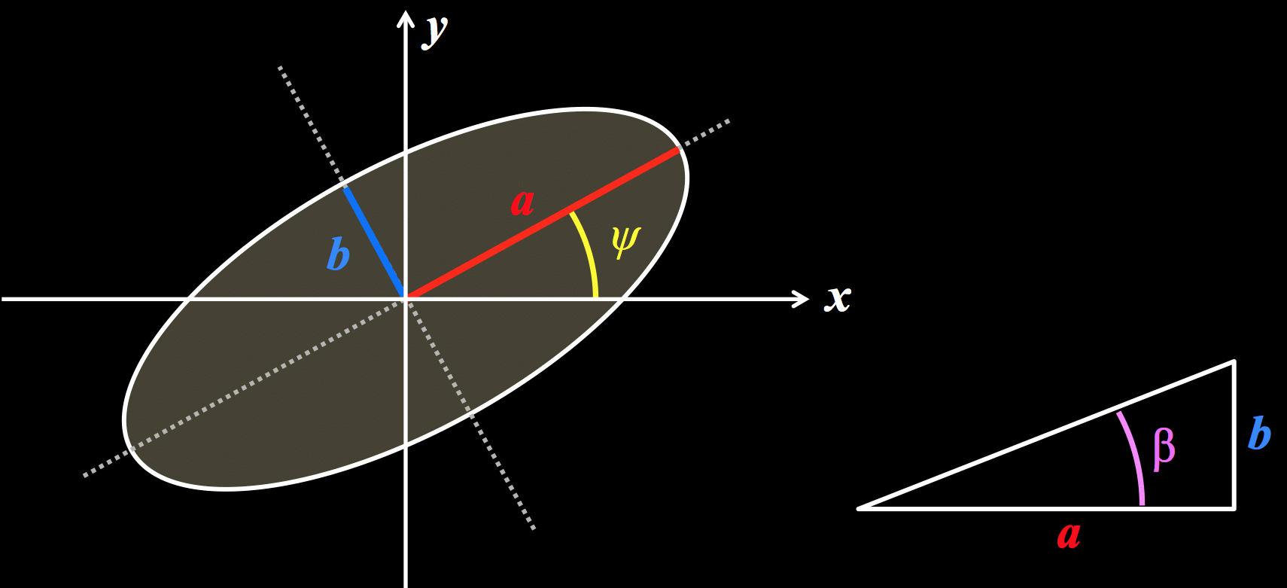
Stokes parameters
How can we quantify all these cases?
Superposition of any two E₁ and E₂ vectors can be transformed into:
Three free parameters (E_{x} , E_{y} , ϕ) are all one needs. Traces out general ellipse:
ψ = ellipse tilt angle
β = tan^{–1} (b/a) = ellipticity angle

Slide 16
Stokes parameters
In 1852 (prior to Maxwell!), Stokes showed that one can describe the same radiation field with 4 intensity-like parameters:
Note: since there were only 3 free parameters,
…for this “completely polarized” sum of two plane waves.

Slide 17
Stokes parameters
Once we start summing N > 2 waves together, we have more free parameters.
In most cases, the time-averaged beam can be broken up into:
a completely un-polarized part
<I> ≠ 0
<Q> = <U> = <V> = 0
a completely polarized part
<I>² = <Q>² + <U>² + <V>²
Total: partial degree of polarization
In solar physics, sometimes I is called B (the unpolarized total brightness),
and the polarized brightness is thus referred to as pB

Slide 18
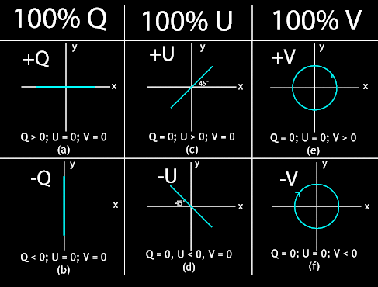
Stokes parameters: what do they mean?
  Linear: b/a = 0 or ∞ … β = 0 or ± π/2 … sin(2β) = 0 … all Q or U
Circular: b/a = 1 … β = ± π/4 … cos(2β) = 0 … all V

Slide 19
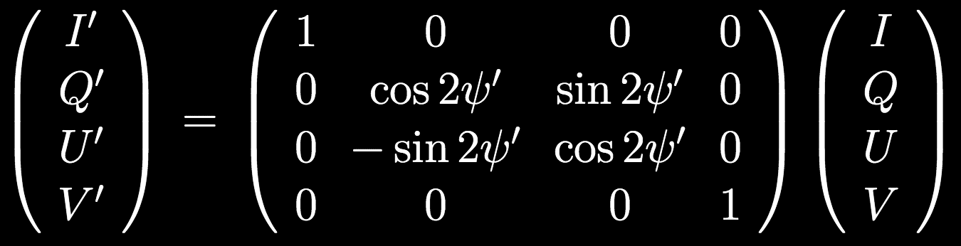
Stokes parameters: a common frame
I and V are invariant under coordinate rotations about axis of propagation.
Q and U depend on the full coordinate system.
When computing Stokes intensities from a complex/extended source of emitters, we need to make sure all 4 components refer to the same set of axes.
Each emitting “parcel” must have its Stokes vector rotated through an angle ψ′
where ψ′ is defined as the angle between the whole system’s Q-axis and the individual axis of each parcel’s intrinsic “scattering plane.”

Slide 20
Later, we’ll investigate what happens to an arbitrarily polarized beam (I,Q,U,V) as it passes through matter… polarized radiative transfer.
Next time
Why is blocking the Sun needed? (quantitative)
How do coronagraphs work?
Physical optics… not just geometric ray tracing

