Slide 1
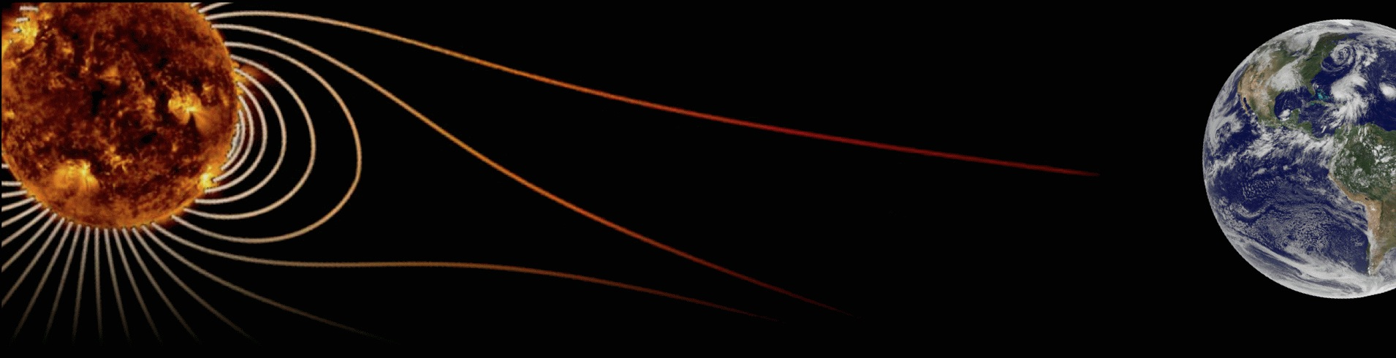








Hale COLLAGE (CU ASTR-7500)
“Topics in Solar Observation Techniques”
Spring 2016, Part 1 of 3: Off-limb coronagraphy & spectroscopy
Lecturer: Prof. Steven R. Cranmer
APS Dept., CU Boulder
steven.cranmer@colorado.edu
http://lasp.colorado.edu/~cranmer/
Lecture 2:
Describing the radiation field

Slide 2
Brief overview
Goals of Lecture 2:
Understand how astronomers define the radiation field
Relate that to how physicists discuss electromagnetic radiation

Slide 3
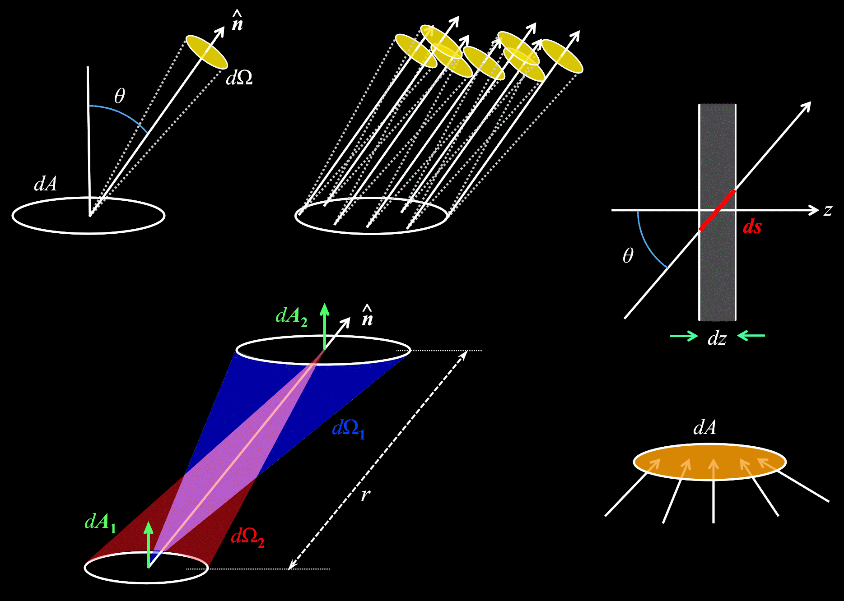
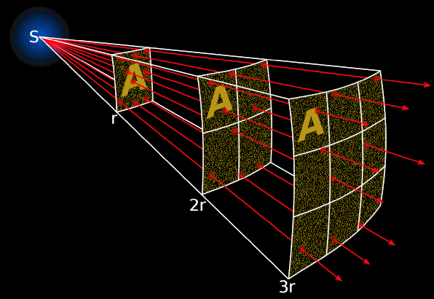
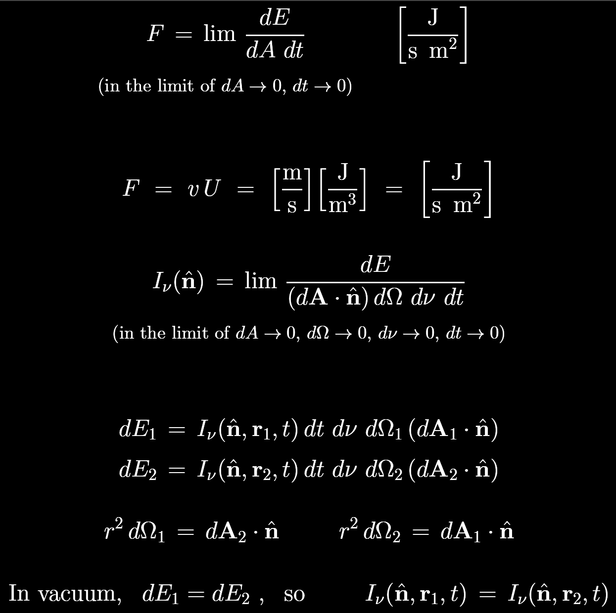
Energy flux
A fundamental concept: how much radiative energy crosses a given area per unit time?
Alternately, if one transports a “parcel” with known energy density U with a velocity v…

Slide 4
Specific intensity
Often we want to know more… the full 3D distribution of photon properties.
Specific intensity describes everything contained in the flux, plus how the photons are arranged in direction… and in frequency…
I_{ν} describes how much photon energy is flowing
through a particular area
in a particular direction (i.e., through a particular sold angle)
per unit frequency (i.e., energy “bin”)
per unit time
Standard units:
J / s / m² / sr / Hz

Slide 5
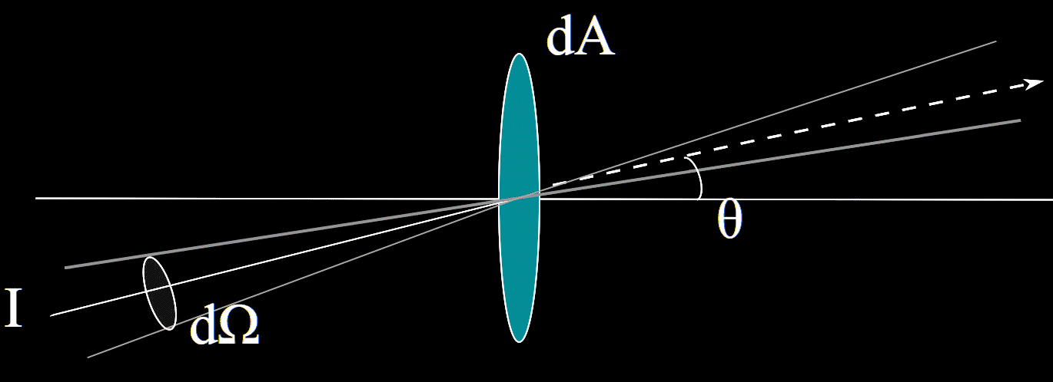
Specific intensity
In vacuum,
  we’re not considering light rays that bend (no GR!)
  specific intensity is constant along a given ray (unlike flux)
  dΩ can mean either “into” or “out of” the projected area
^
dA . n = dA cos θ
μ = cos θ
Alternate units: J / s / m² / sr / Hz
  change Joules to “photons” (divide by E = hν)
  instead of “per unit frequency,” use wavelength or photon energy bins
  (conversion: chain rule)

Slide 6
Specific intensity
In reality, I_{ν} describes the flux of energy flowing from one area dA₁ into another (dA₂).
However, since we prefer to specify I_{ν} locally (all properties at one location), we convert one of the areas into solid angle measured from our location.
Both descriptions are identical!

Slide 7
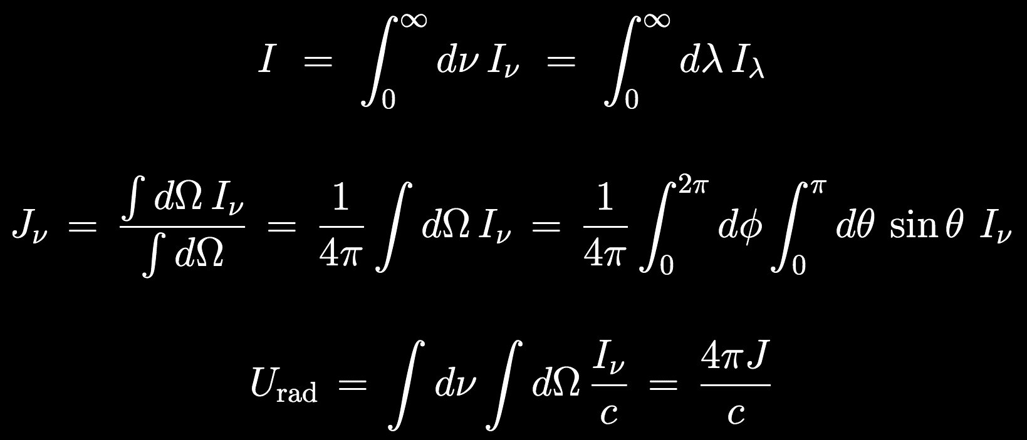
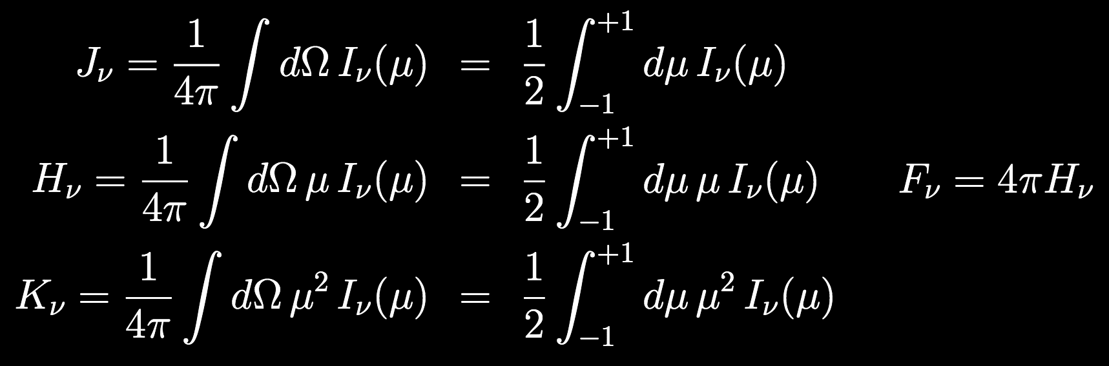
Angle-moments of specific intensity
Sometimes, I_{ν} is too much information…
We can integrate over the spectrum (specific intensity → total intensity)
We can take weighted moments over the solid angle distribution of rays

Slide 8
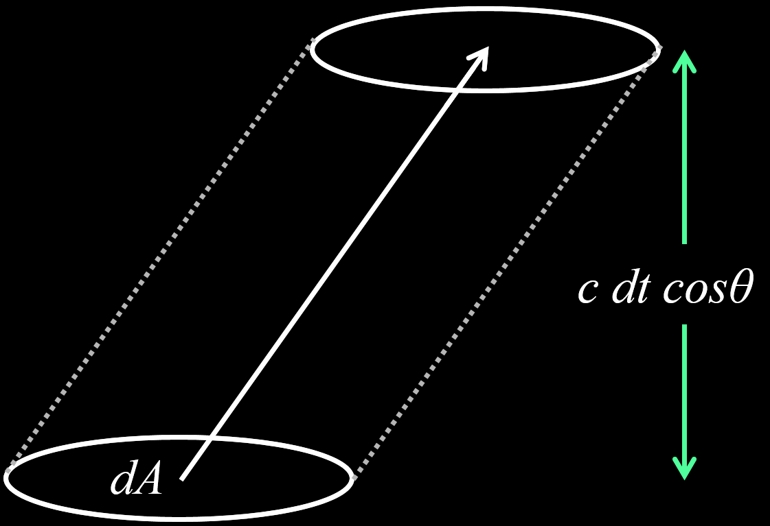
0th Moment: Mean intensity
Just average over all angles:
By noting that (dA dt) times c gives a “volume,” we can compute the mean radiative energy density (i.e., energy per unit volume), and it’s proportional to the mean intensity:

Slide 9
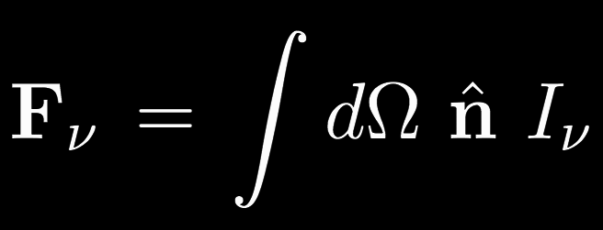
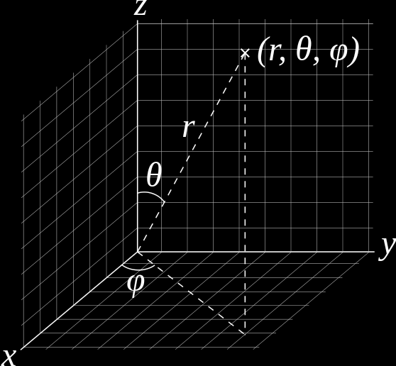
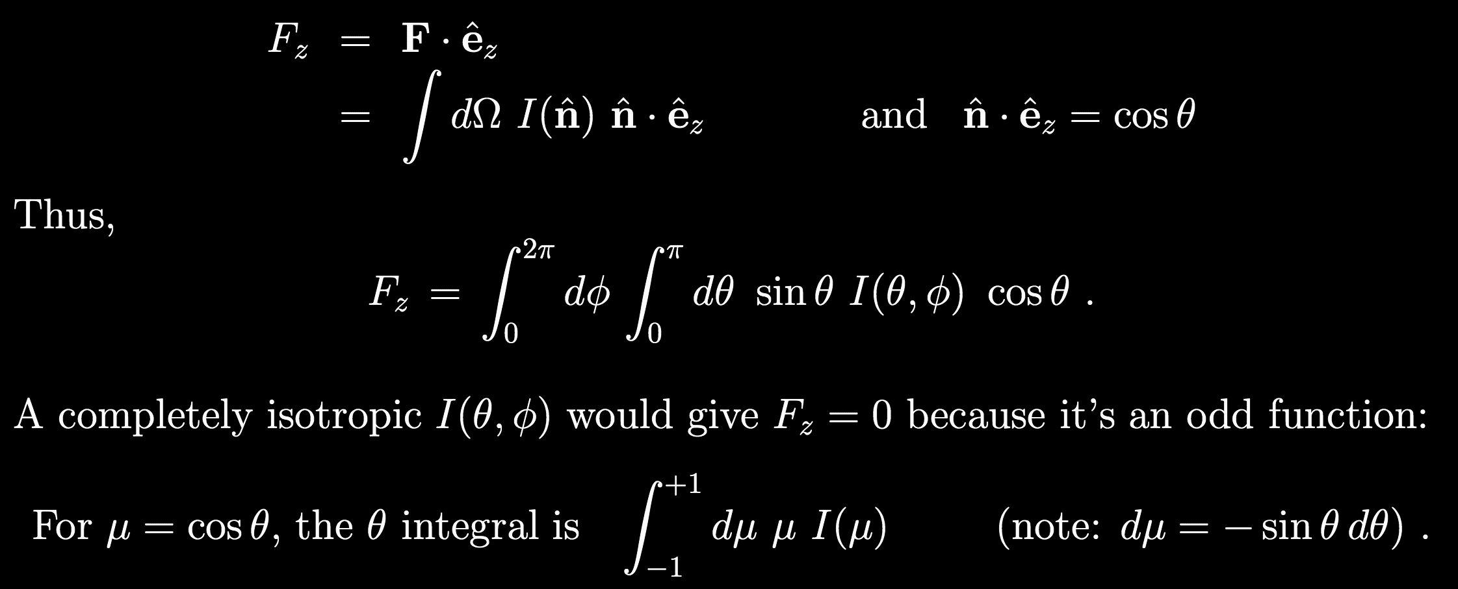
1st Moment: Radiative energy flux
Flux is a vector quantity whose direction gives us the weighted “peak” n of the angular distribution.
^
It’s easiest to think about computing the flux in a particular direction – e.g., the z direction:
Thus,

Slide 10
Higher moments?
Useful for stellar atmospheres, but let’s skip them for now.
We can get a better understanding of all these I’s and J’s by looking at
specific geometries.

Slide 11
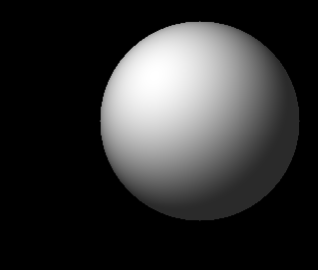
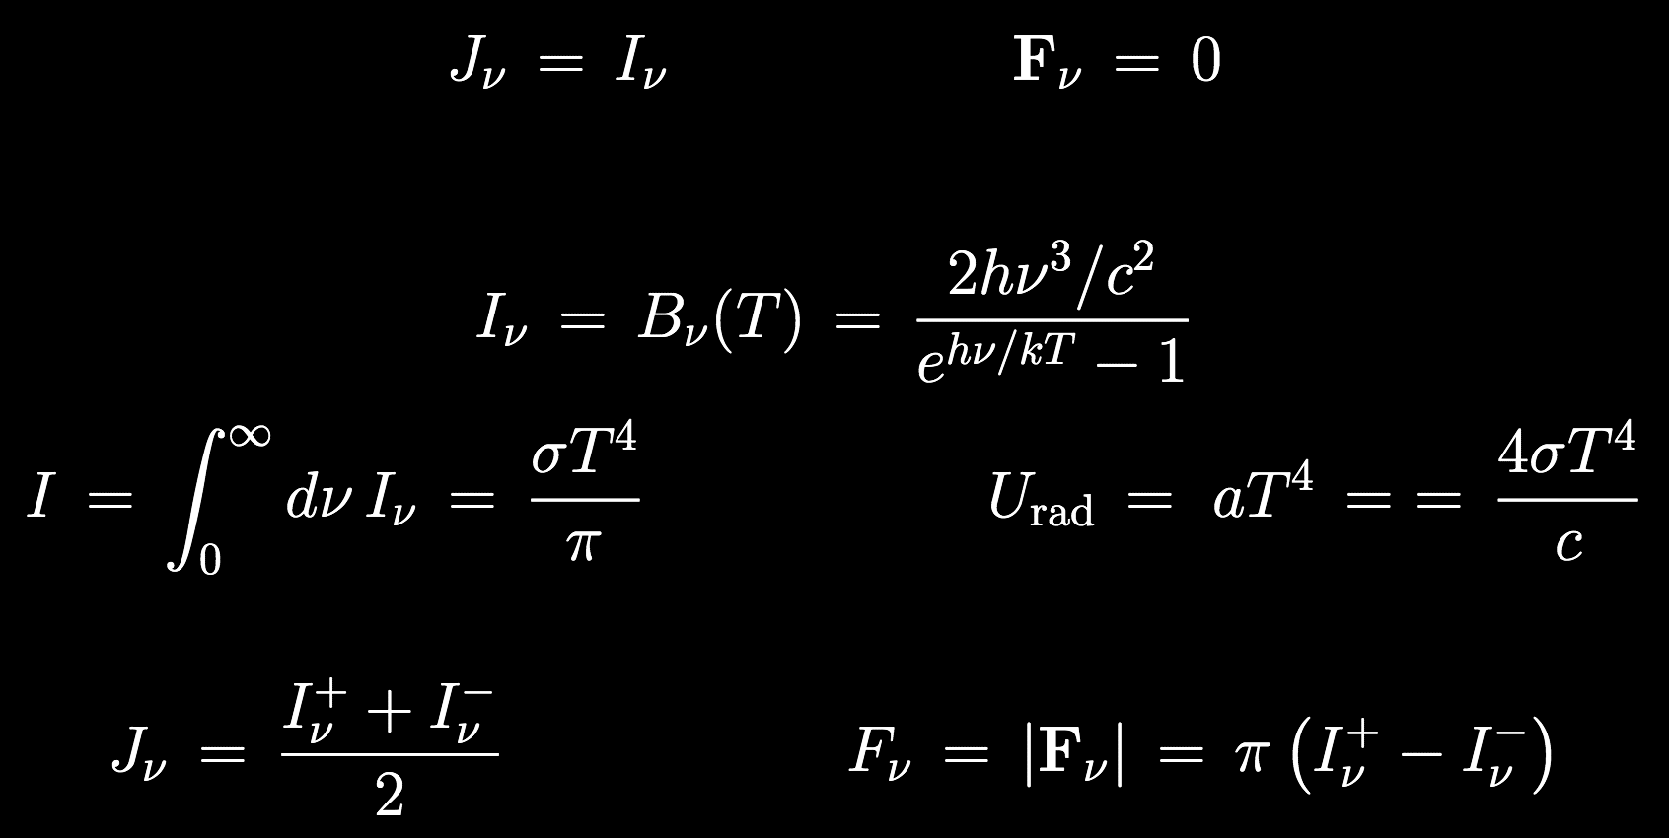
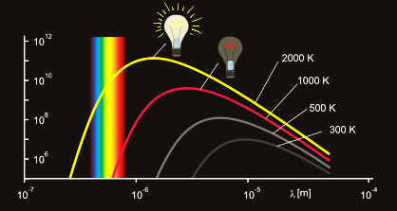
Specific geometry 1/4: Isotropic
I_{ν} is constant, independent of direction:
Example: Planck blackbody equilibrium…

Slide 12
Specific geometry 2/4: Two-stream
I_{ν} is isotropic in both “hemispheres,” but up ≠ down:
I_{ν}⁺
(mean)
I_{ν}–
(“net” flux = difference)
In stars:
deep interior
↓
lower atmosphere
↓
upper atmosphere
…..
…..
…..
isotropic ( I⁺ ≈ I– )
↓
mostly up, some down ( I⁺ > I– )
↓
escaping ( I⁺ >> I– )

Slide 13
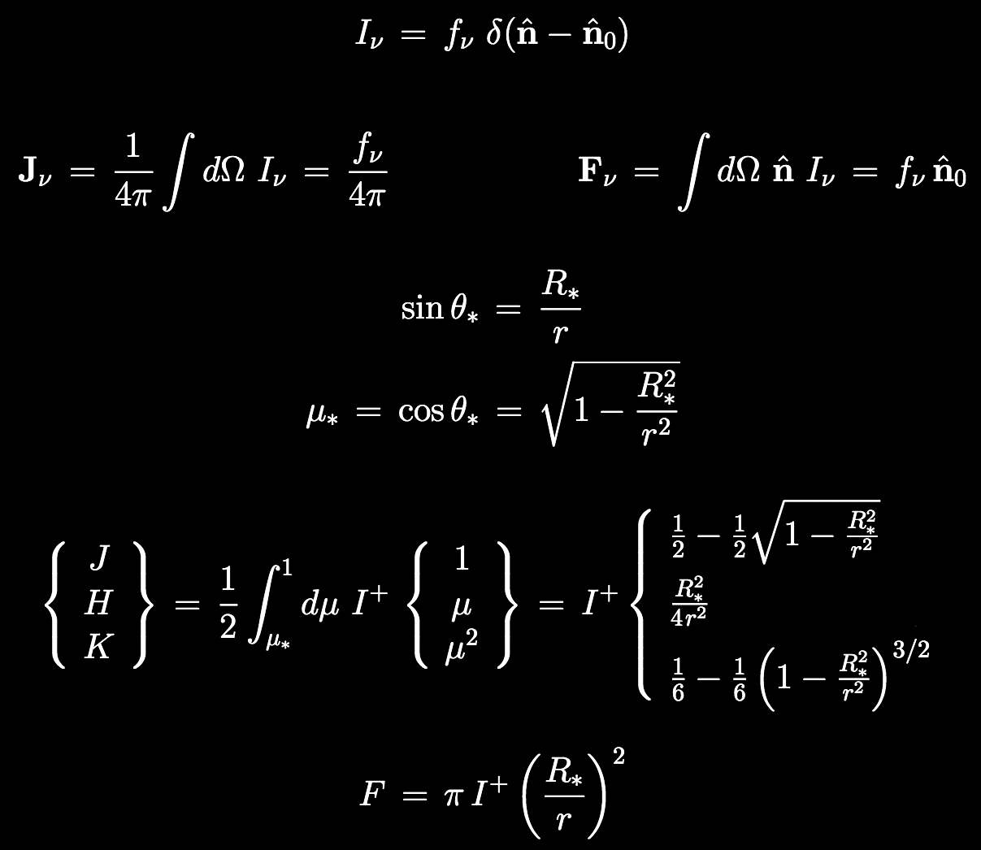
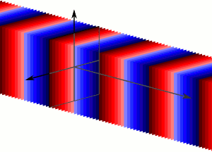
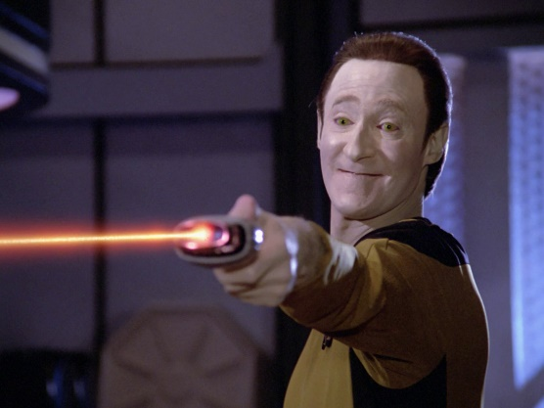
Specific geometry 3/4: Plane waves
In a way, it’s the exact opposite of an isotropic distribution: I_{ν} ≠ 0 only for one specific direction.
In a way, it doesn’t matter whether:
  the radiation field fills all space (like a plane wave),
  or is just a narrow beam from a “point source”
…the angular distribution, measured from some point “inside” the beam, is still peaked at a single point in solid-angle-space.

Slide 14
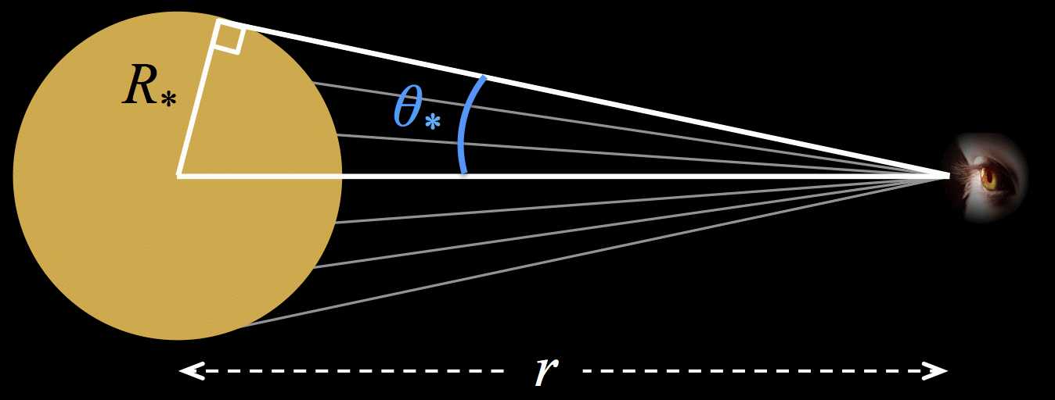
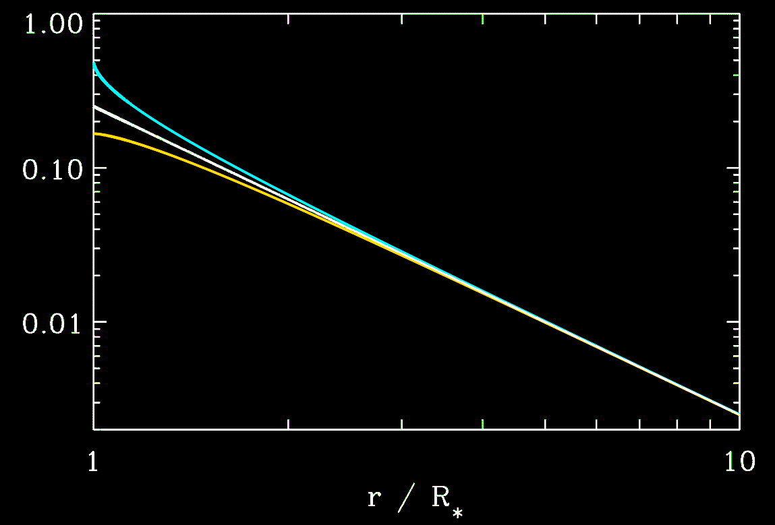

Specific geometry 4/4: Spherical expansion
The usual spherical cartoon focuses on the point of origin:
However, if a central sphere is the source of radiation (assume two-stream, I⁺ ≠ 0, I– = 0), the observer looks back to see a uniform-brightness “disk” on the sky:
J
H
K
Far from the source…

Slide 15
How does classical E&M treat radiation?

Slide 16
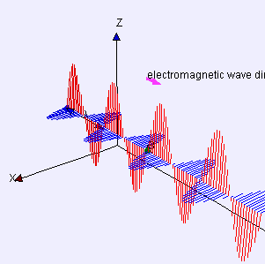
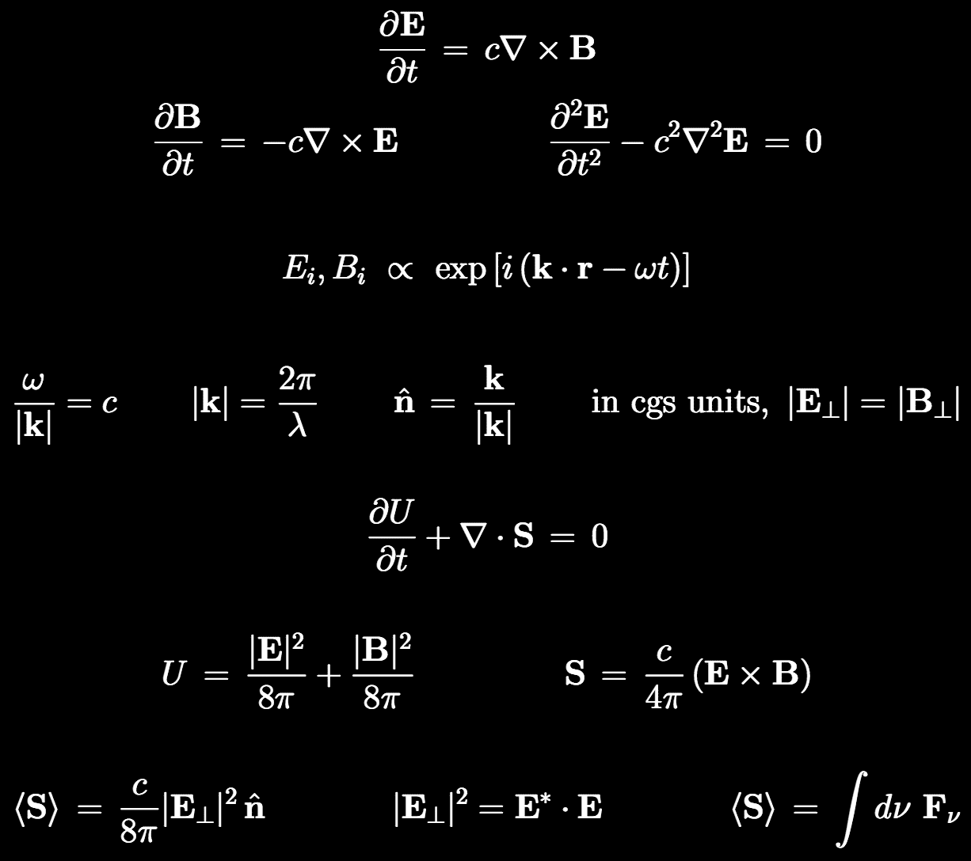
Electromagnetic waves
In vacuum, Maxwell’s equations become a wave equation, with solutions depending on geometry:
Each component of E & B have oscillating solutions, but the only nonzero ones are transverse to k, and to one another:

Slide 17
Poynting flux
Conservation of electromagnetic energy (again, in vacuum) says that if local energy density U changes at one location, it must be due to an energy flux S into our out of that point:
For transverse waves, the time-averaged flux is proportional to the square of the field amplitude… S is a true flux: energy density (U) x speed (c)

Slide 18
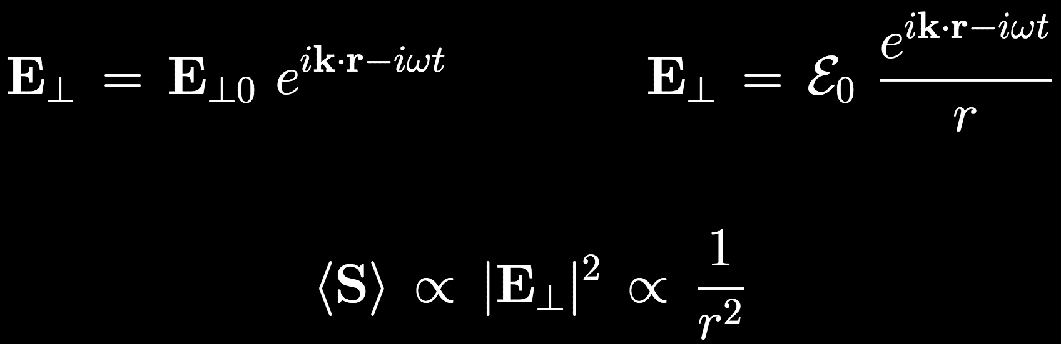
Plane waves vs. spherical waves
Details of the solution depend on the geometry:
Cartesian: plane waves have constant amplitude
Spherical: central source, with amplitude ~ 1/r
In the spherical case, the simplest central source is an oscillating electric dipole.
More complex sources are associated with higher-order E&B multipoles (i.e., antenna theory)
For r >> source size,

Slide 19
Next time
What happens when the “beam” passes through matter: radiative transfer
What if the beam consists of a superposition of >1 plane waves, each with its own phase and transverse electric field direction?

