Slide 1
Observing the Sun

Slide 2
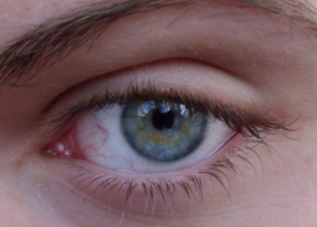
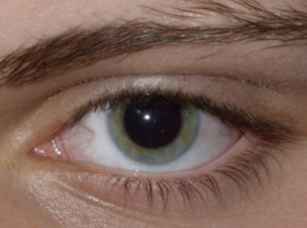
Why do your pupils get bigger in the dark?
vs
Day
Night

Slide 3
See it in Action
vs
Day
Night
Sit in the dark for 2 minutes, then turn to your partner and watch their pupils when the light turns on. What did you see? Why do pupils do that?

Slide 4
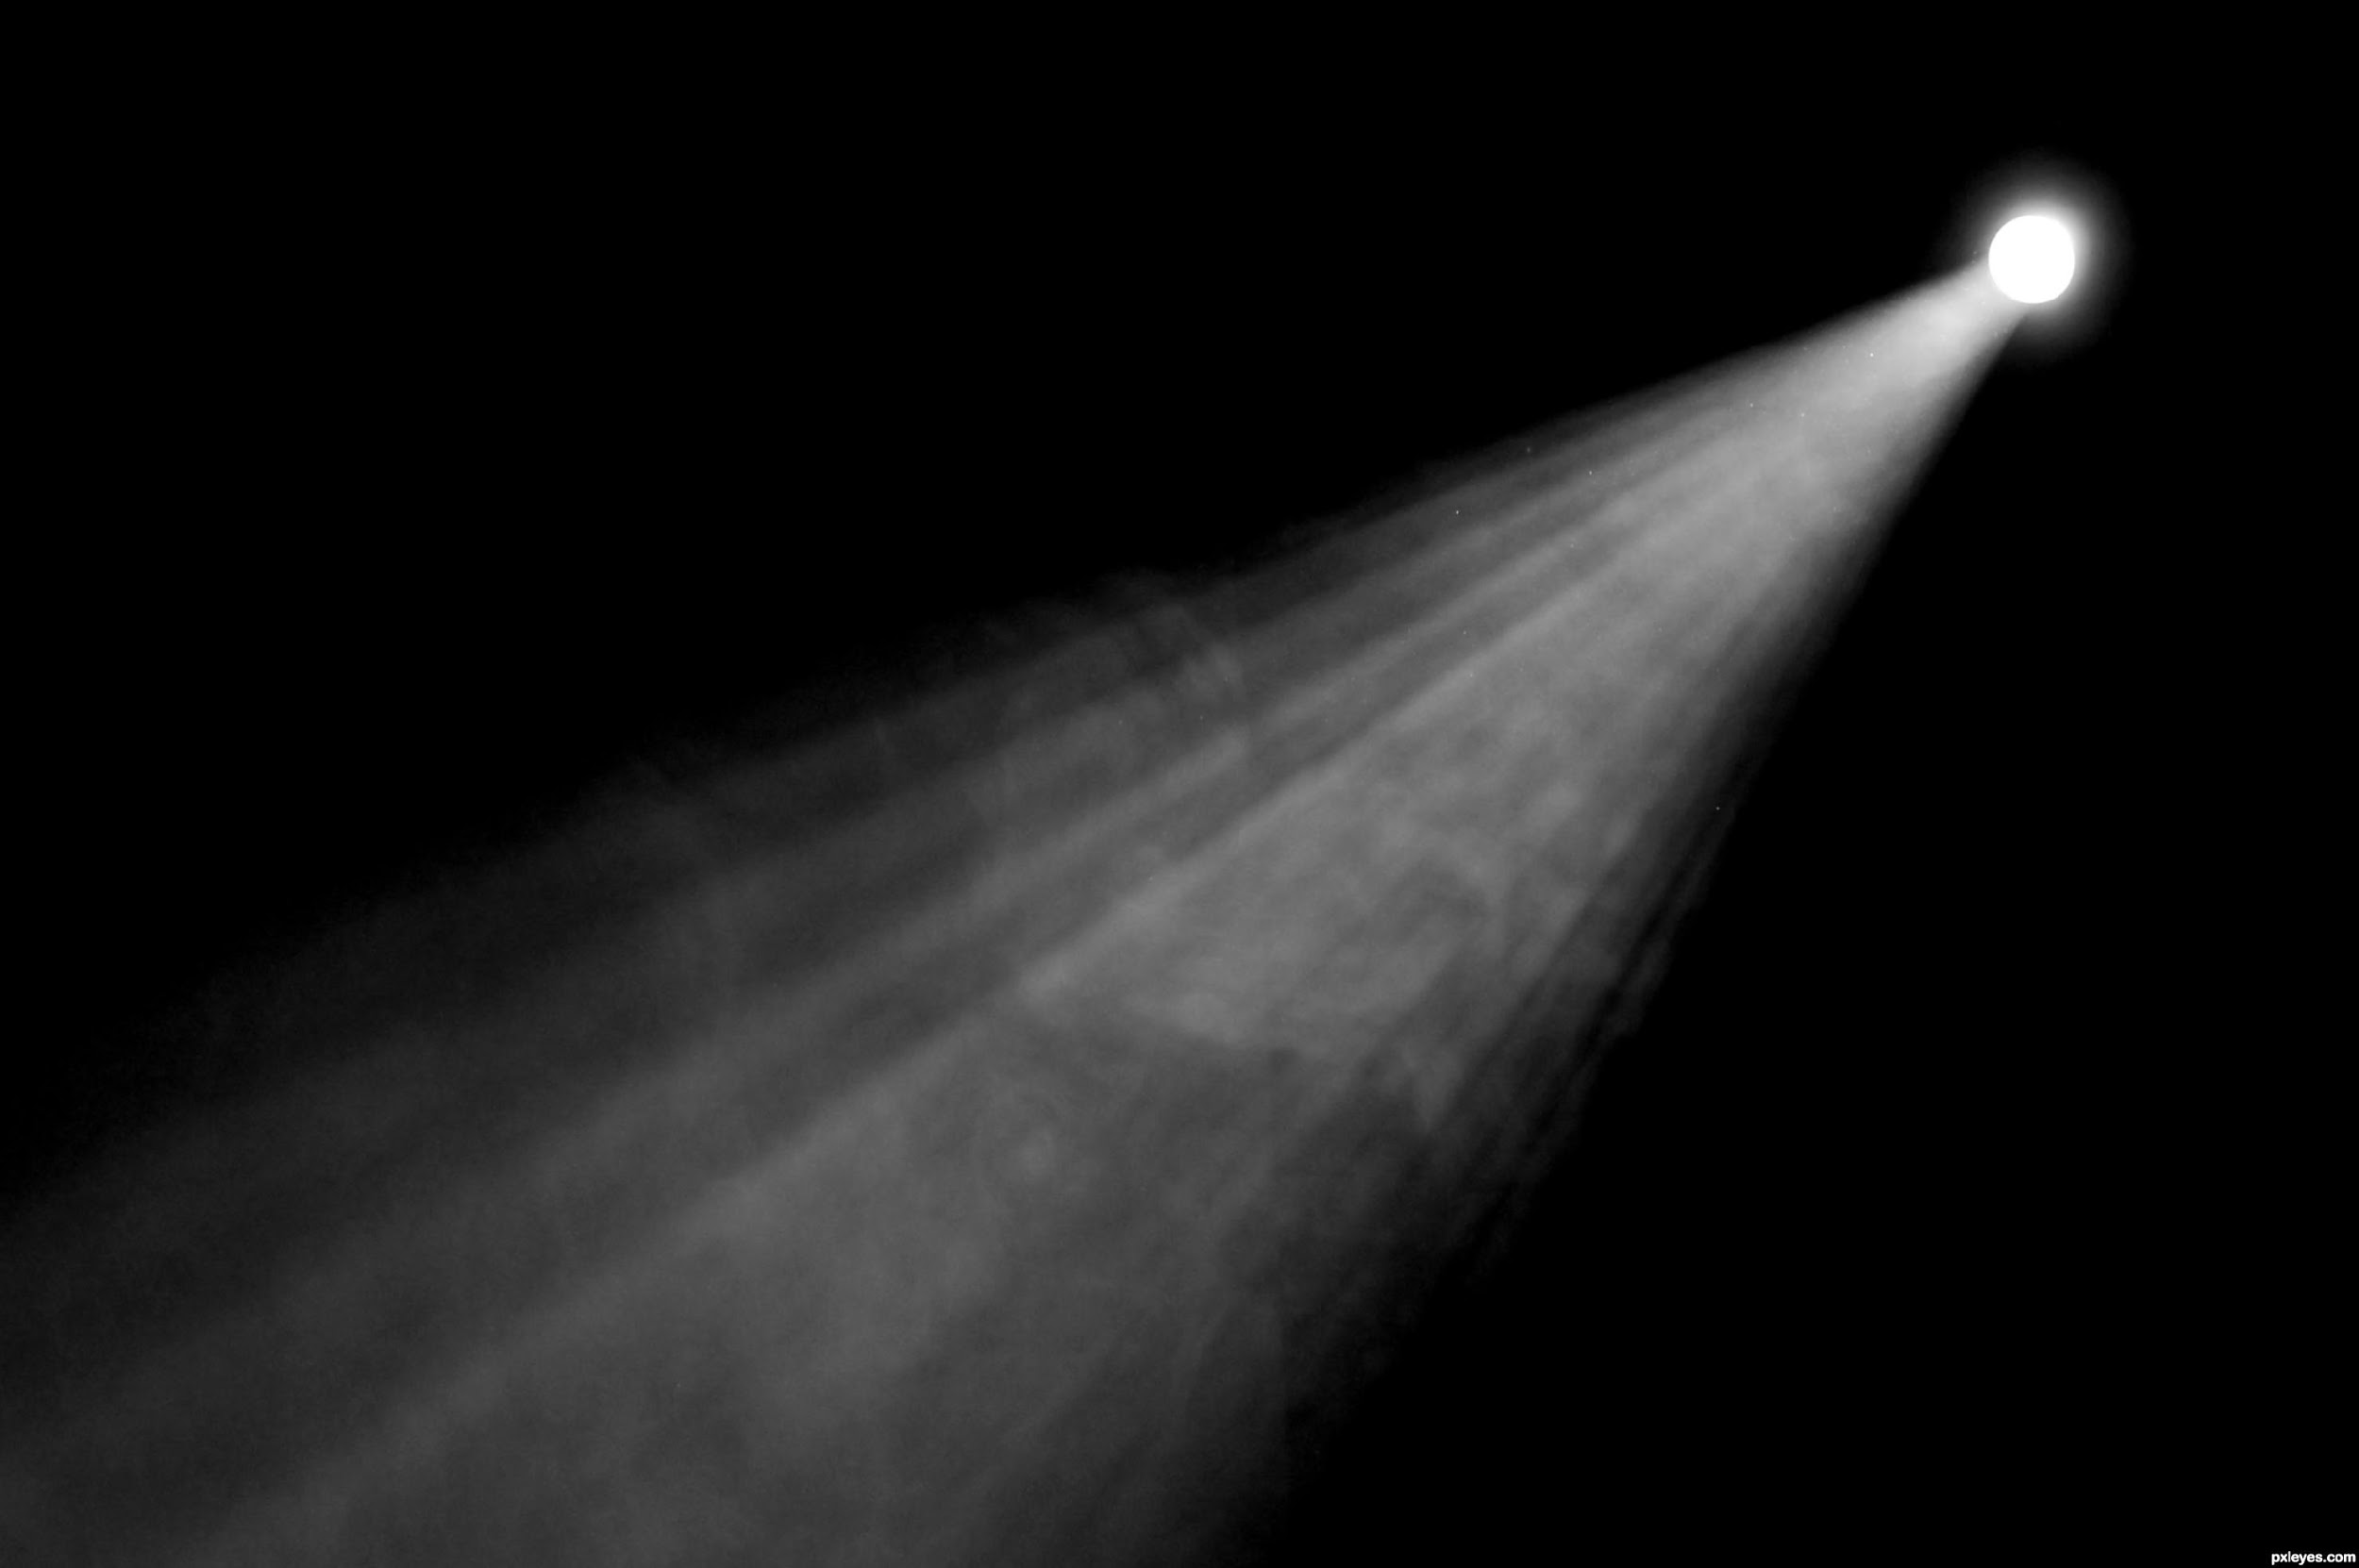
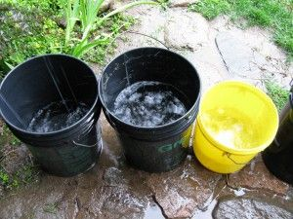
It’s all about catching and focusing light!
The bigger your pupil = The more light photons get captured
Bigger openings, like your eye pupils and telescope apertures, catch more light!
Bigger buckets catch more rain right?

Slide 5
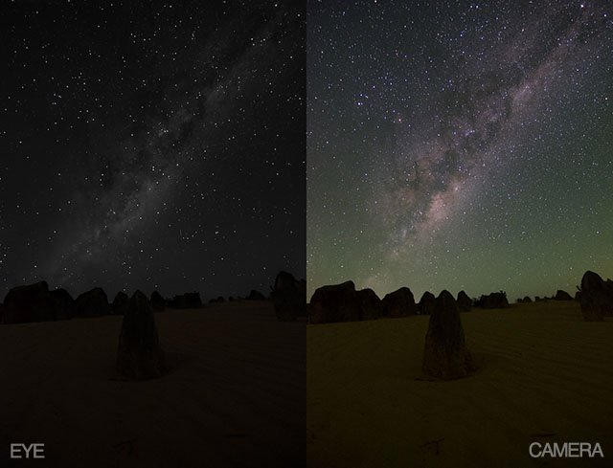
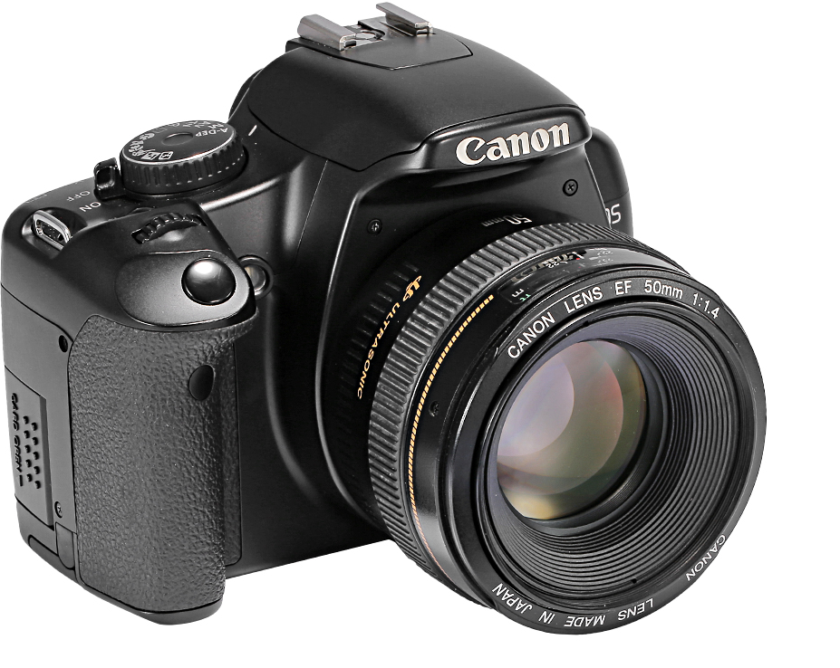
It’s all about catching and focusing light!
The more light photons get captured = Faint images become brighter!
Your eyes are like telescopes or cameras with very small lenses
(the size of your pupil).
Objects in space appear faint to our eyes because they are very far away and our eyes have small lenses.
~6mm
Pupil
52mm
Camera Lens
EYE
CAMERA

Slide 6
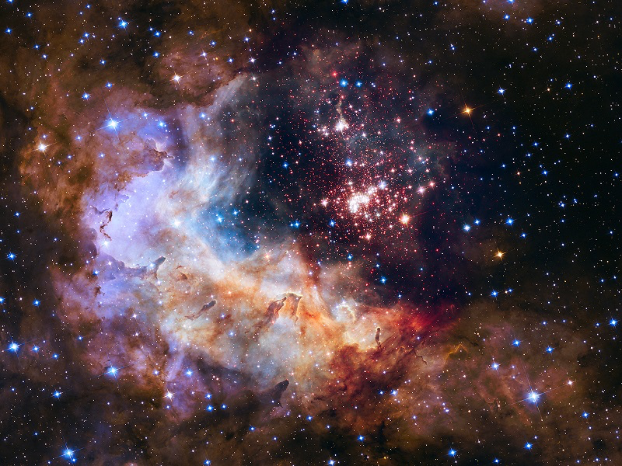
So, What’s the Key to Viewing the Universe?
Telescopes and Cameras with larger lenses can see objects farther away in space.
The larger the lens, the farther away you can see and the more detailed your image will become!

Slide 7
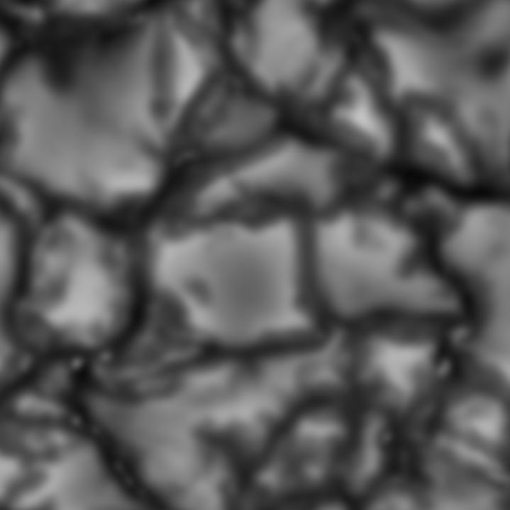
The larger the lens, the farther away you can see and the brighter and more detailed your image will become!
New Solar Telescope (NST)
California
1.56 m lens
Dunn Solar Telescope (DST)
New Mexico
0.76 m lens
Daniel K. Inouye Solar Telescope (DKIST)
Hawaiʻi
4.00 m lens
Match It!
Match each telescope with the image it’s capable of taking ☺

Slide 8
Dunn Solar Telescope (DST)
New Mexico
0.76 m lens
New Solar Telescope (NST)
California
1.56 m lens
Daniel K. Inouye Solar Telescope (DKIST)
Hawaiʻi
4.00 m lens
The larger the lens, the more light you can collect, the farther away you can see and the more detailed your image will become!

Slide 9
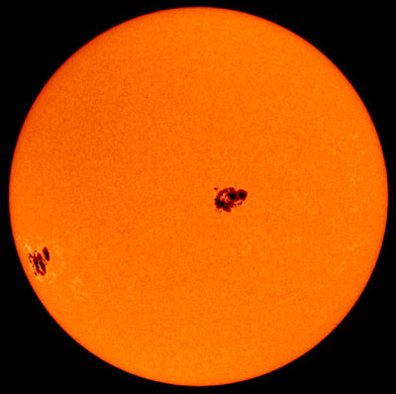
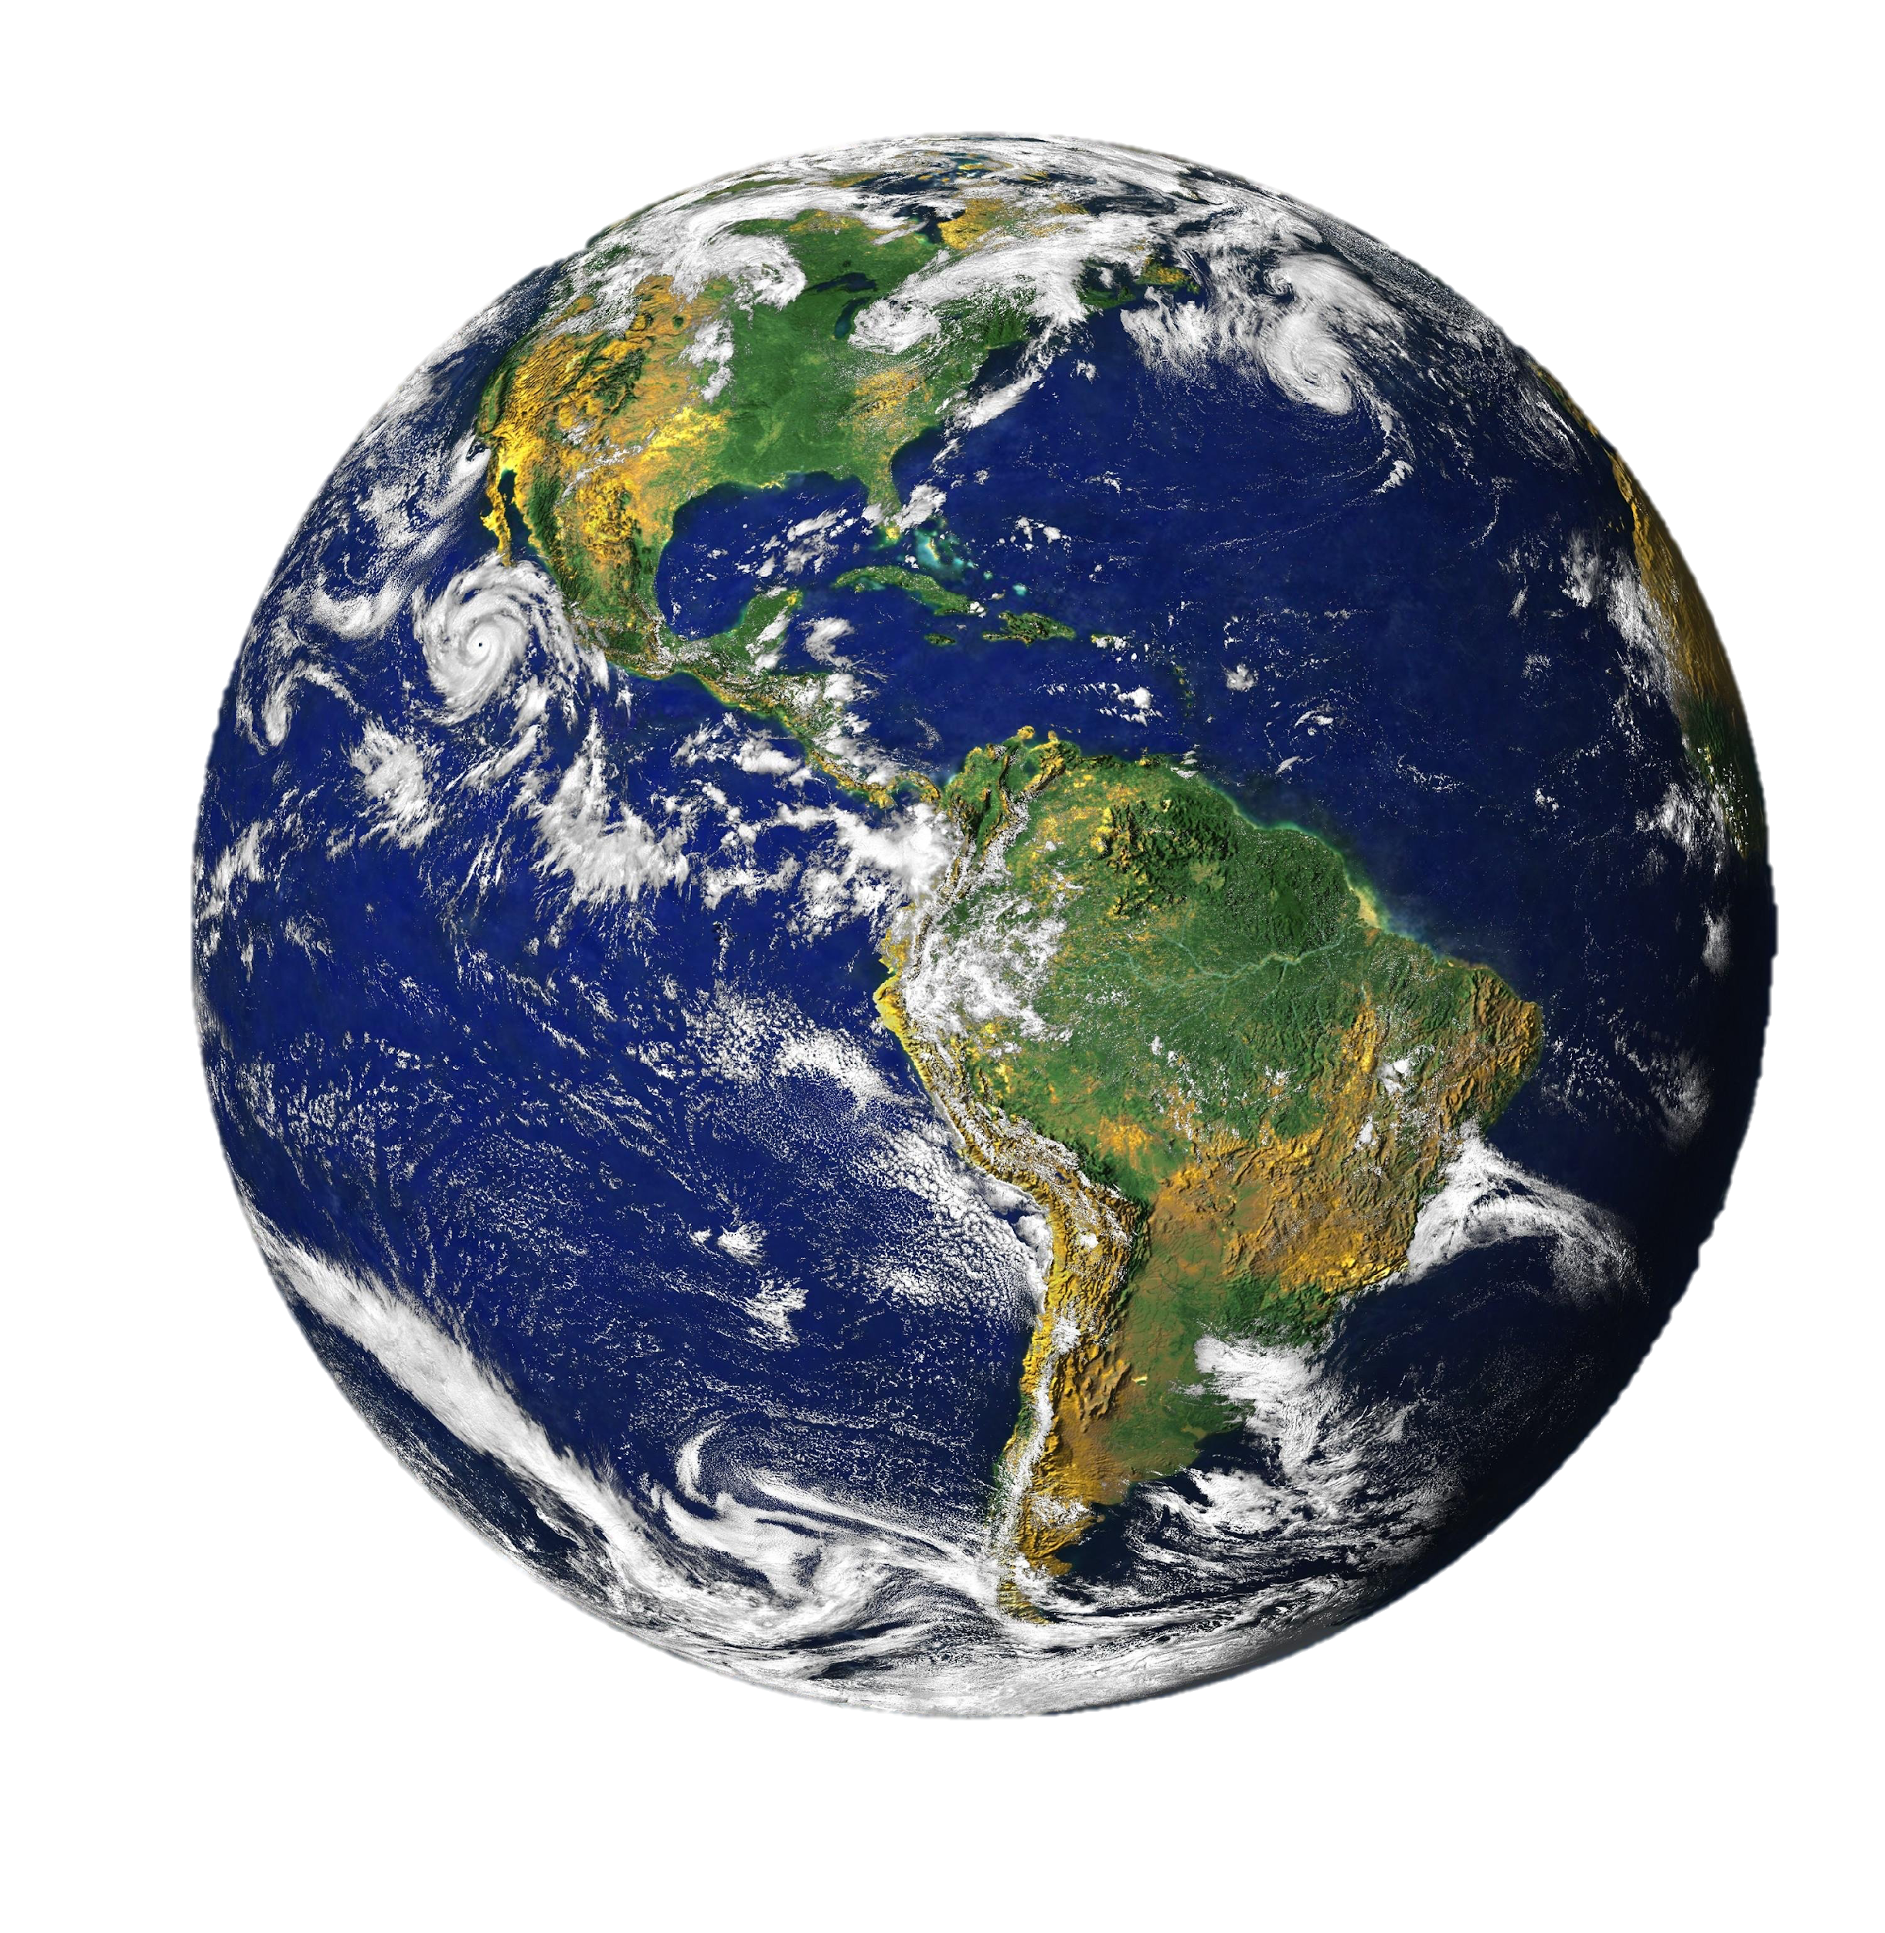
SUN
EARTH
The picture above is the boiling surface of the Sun! The picture is of an area about the same size as Earth!
If the Sun were the size of a beach ball, the Earth would be about the size of a green pea!

Slide 10
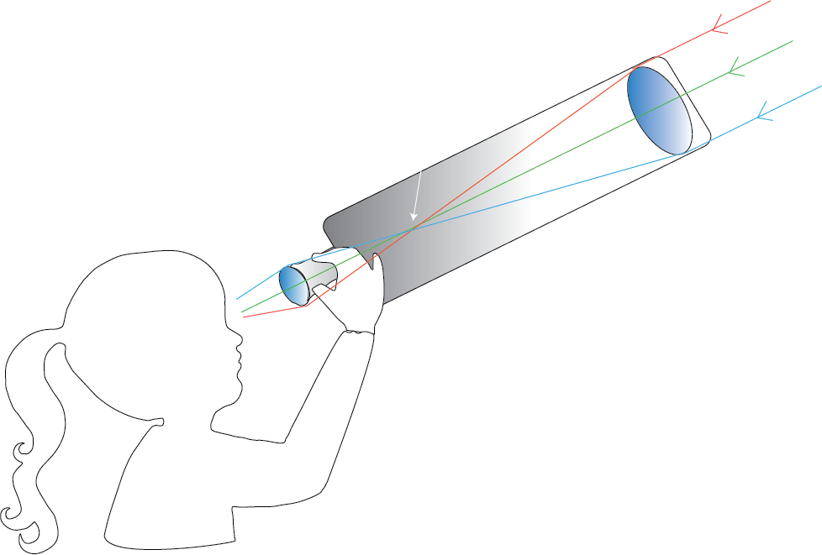
Focal Point
All light is focused onto this point inside the telescope
Incoming Light
Incoming Light
Eyepiece Lens
Magnifies the image from the focus to the size of your eye’s pupil
Refractor
Objective Lens
Bends incoming light into focus
Two Types of Telescopes:
Refractor and Reflector

Slide 11
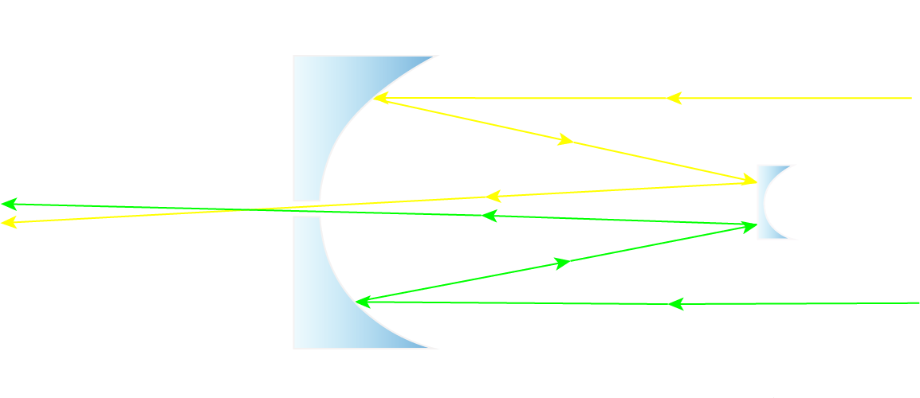
Refractor vs Reflector Telescopes
REFRACTOR
Uses lenses to bend and focus light
Must be long to achieve optimal light path distance
Lenses are see through and can’t be supported from the back, thus they can’t be too large.
Incoming light
Eyepiece lens
Objective lens
Uses mirrors to bend and focus light
Can be short because the light bounces back on itself due to reflection
Mirrors are not see through and can be supported from the back, thus they can be very large.
REFLECTOR
Incoming light
Primary mirror
Secondary Mirror

Slide 12
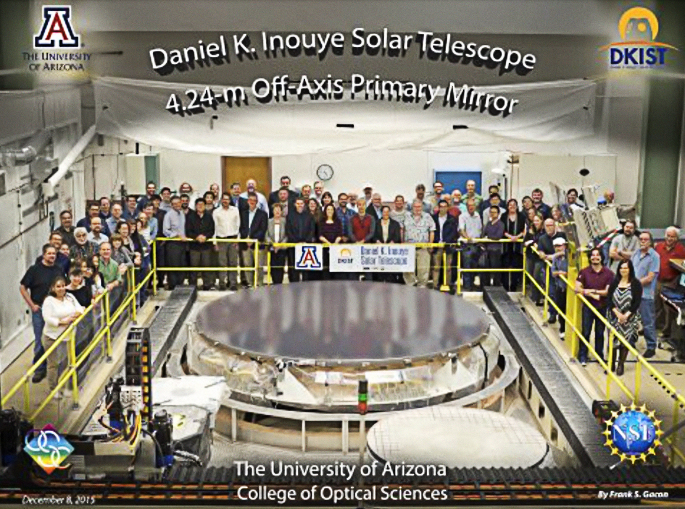
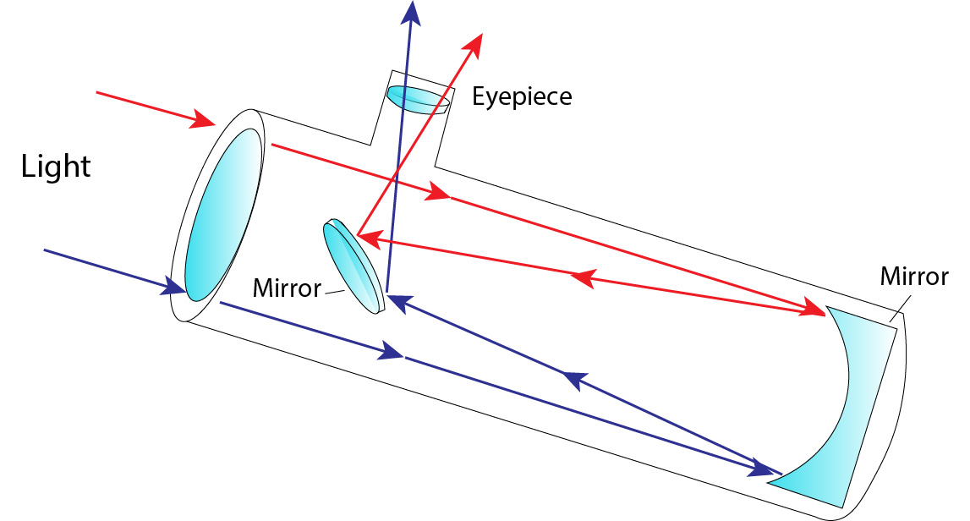
Refractor vs Reflector Telescopes
Most professional telescopes are reflector because the backs of mirrors can be supported and thus, the mirrors can be built very large!
Remember, the larger the mirror the brighter and more clear your images will be
(Very important when viewing objects that are far away, like the Sun!)

Slide 13
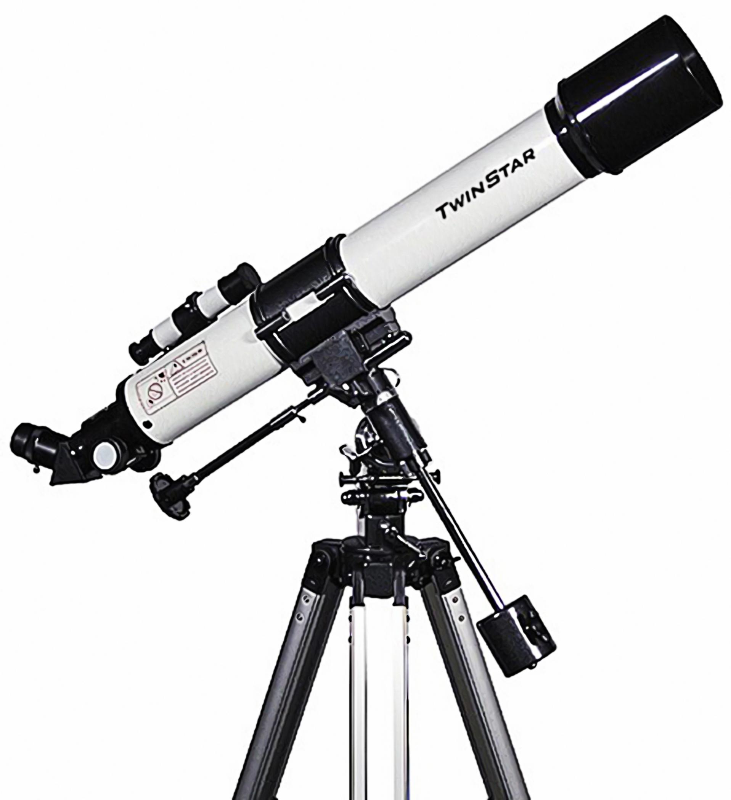
Refractor Telescope or Reflector Telescope?

Slide 14
Refractor Telescope or Reflector Telescope?

Slide 15
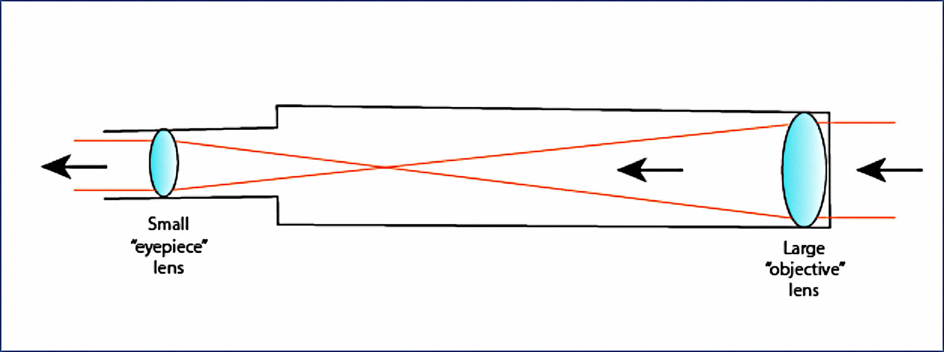
Refractor Telescope or Reflector Telescope?

Slide 16
Refractor Telescope or Reflector Telescope?

Slide 17
Refractor Telescope or Reflector Telescope?

Slide 18
Refractor Telescope or Reflector Telescope?

Slide 19
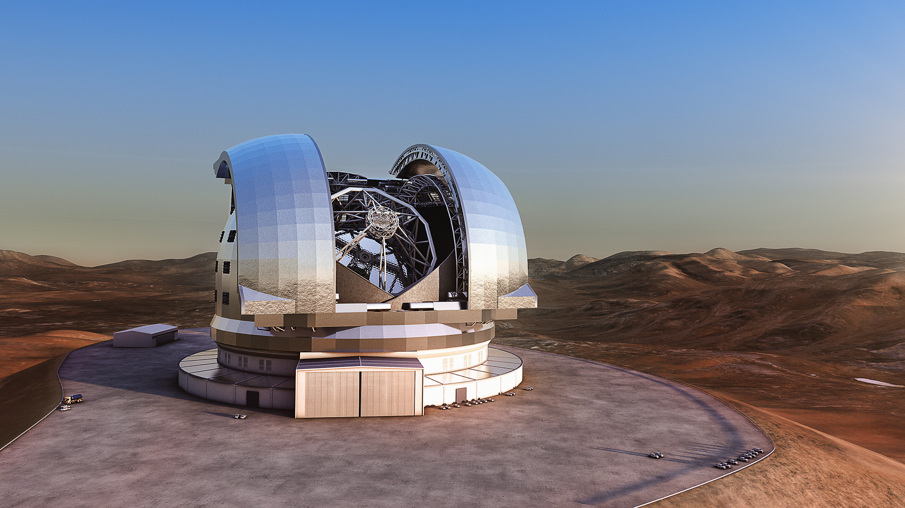
Refractor Telescope or Reflector Telescope?

Slide 20
Refractor Telescope or Reflector Telescope?

Slide 21
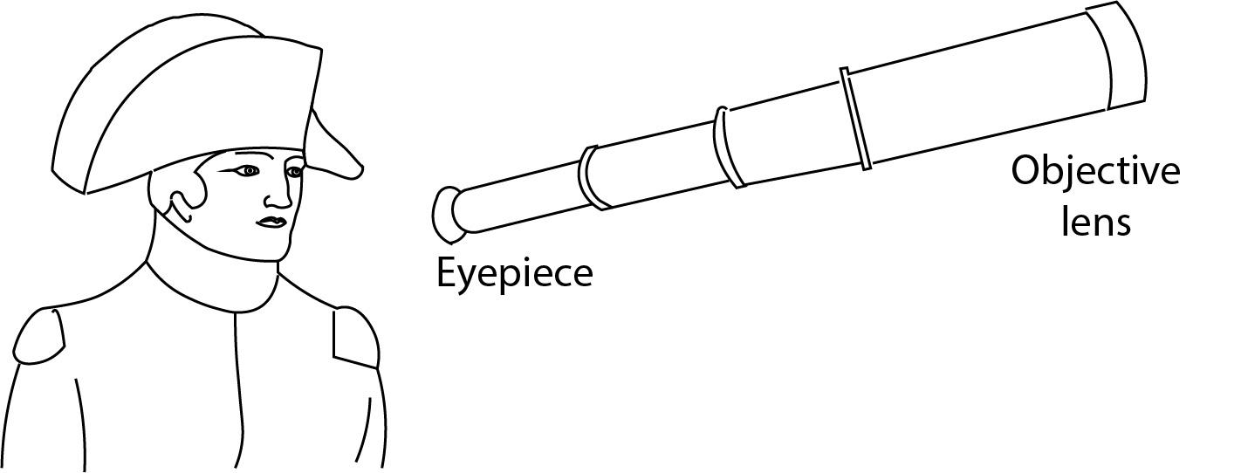
Refractor Telescope or Reflector Telescope?

Slide 22
Refractor Telescope or Reflector Telescope?

Slide 23
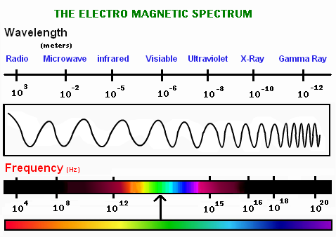
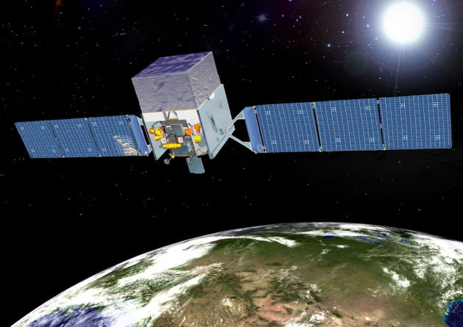
Professional Telescopes
Astronomers use telescopes that can observe across different wavelengths of light.
NASA’s Fermi gamma ray space telescope observes the Sun’s radiation

Slide 24
Professional Telescopes
Astronomers use telescopes that can observe across different wavelengths of light.
NASA’s Fermi gamma ray space telescope observes the Sun’s radiation

Slide 25
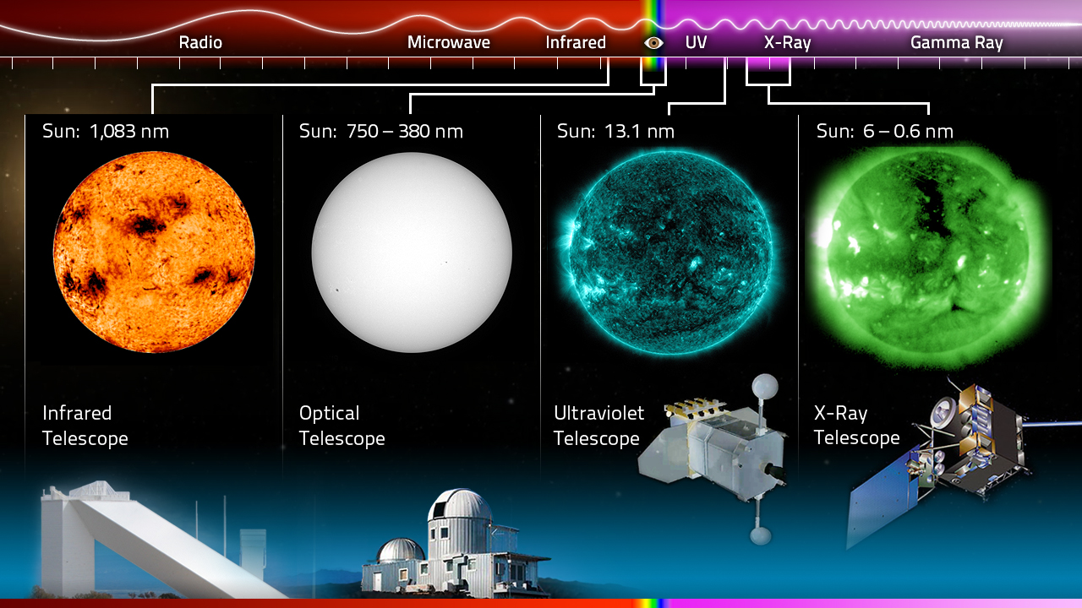
Professional Telescopes
Images of the Sun taken at different wavelengths.
What differences to you see?

Slide 26
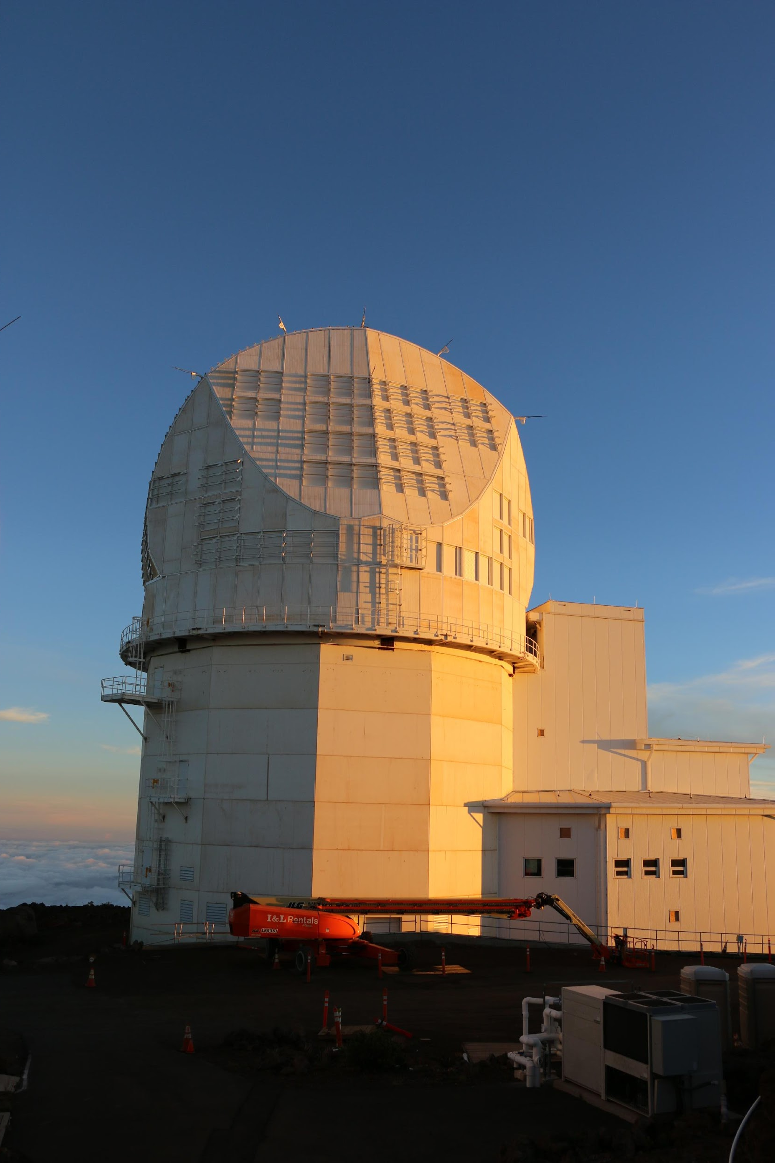
Space-Based vs Ground-based Telescopes

Slide 27
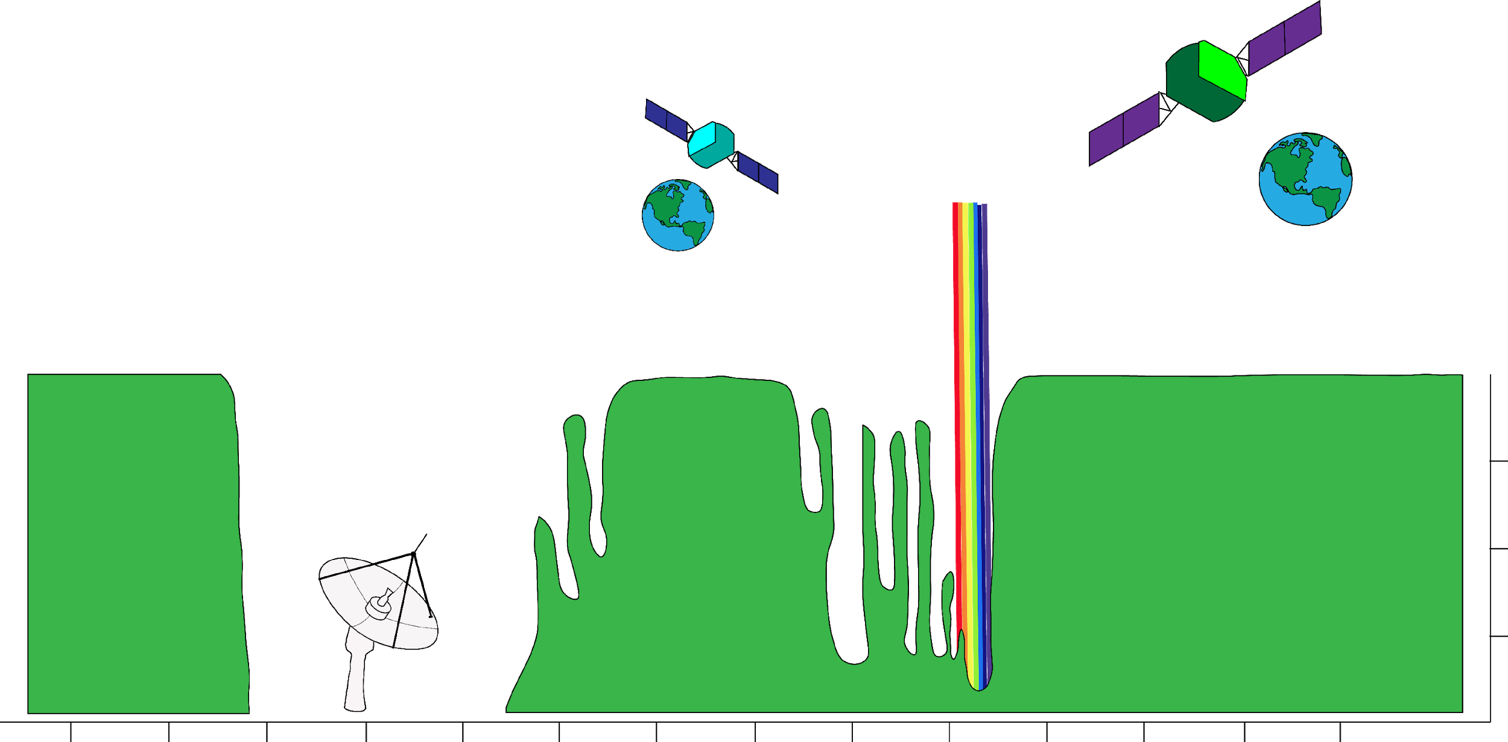
Professional Telescopes
Visible light is somewhat distorted by the atmosphere, but is still observable from Earth
Infrared is best observed from space
Radio waves with longer wavelengths are blocked by the atmosphere
Most infrared waves are absorbed by the atmosphere but some gets to Earth
The upper atmosphere blocks gamma rays, X-rays, and UV light. These are best observed from space
100%
Radio waves in this range are observable from Earth
75%
50%
Atmospheric Opacity
25%
0%
1 km
100 m
10 m
1 m
10 cm
1 cm
1 mm
100 μm
10 μm
1 μm
100 nm
10 nm
1 nm
0.1 nm
Wavelength
Space-Based vs Ground-based Telescopes

Slide 28
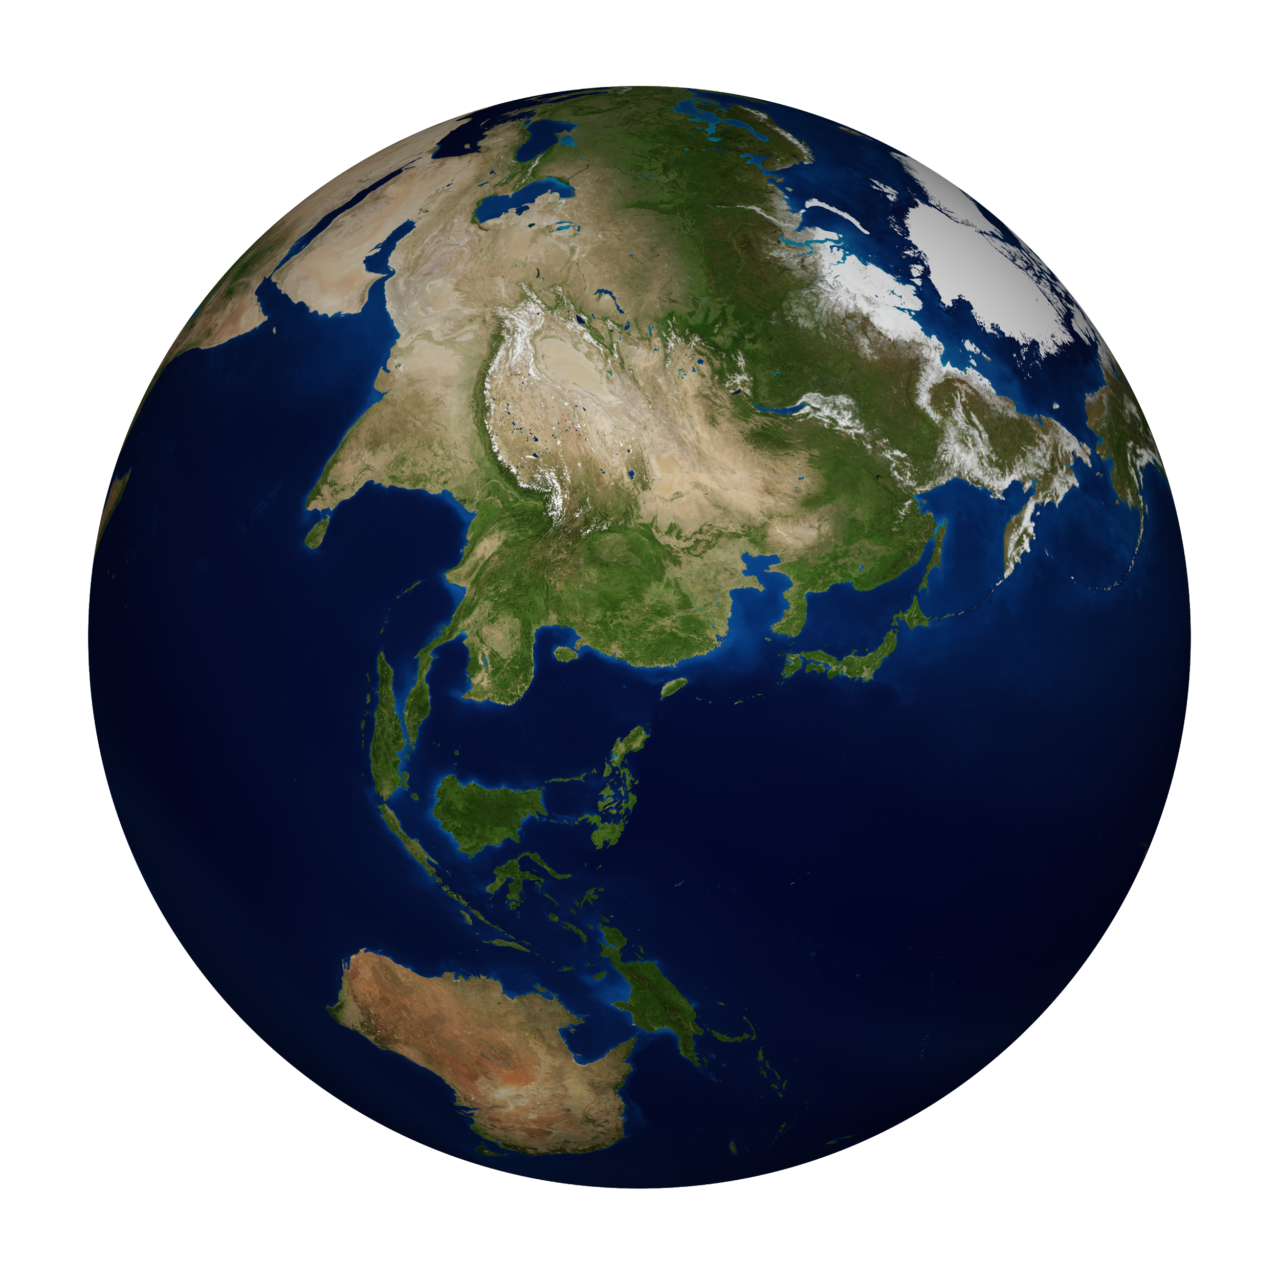
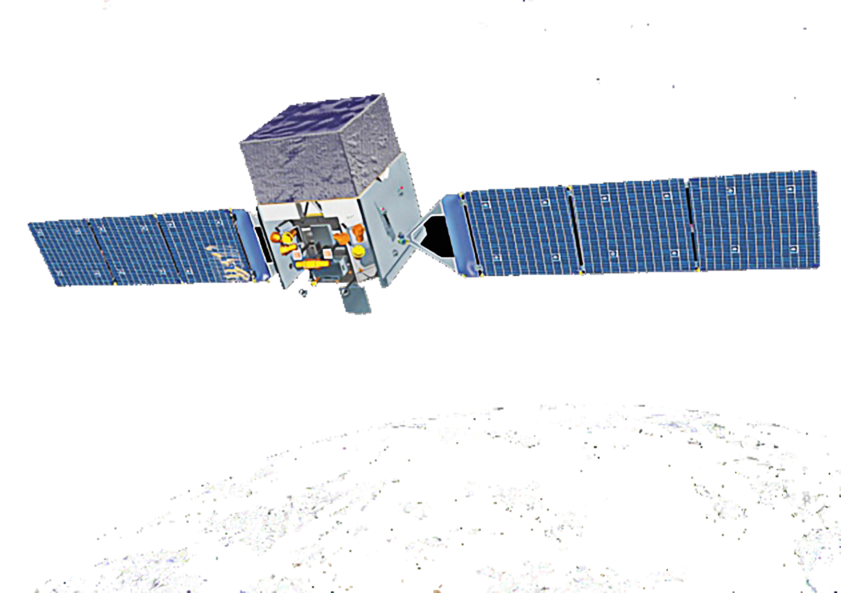
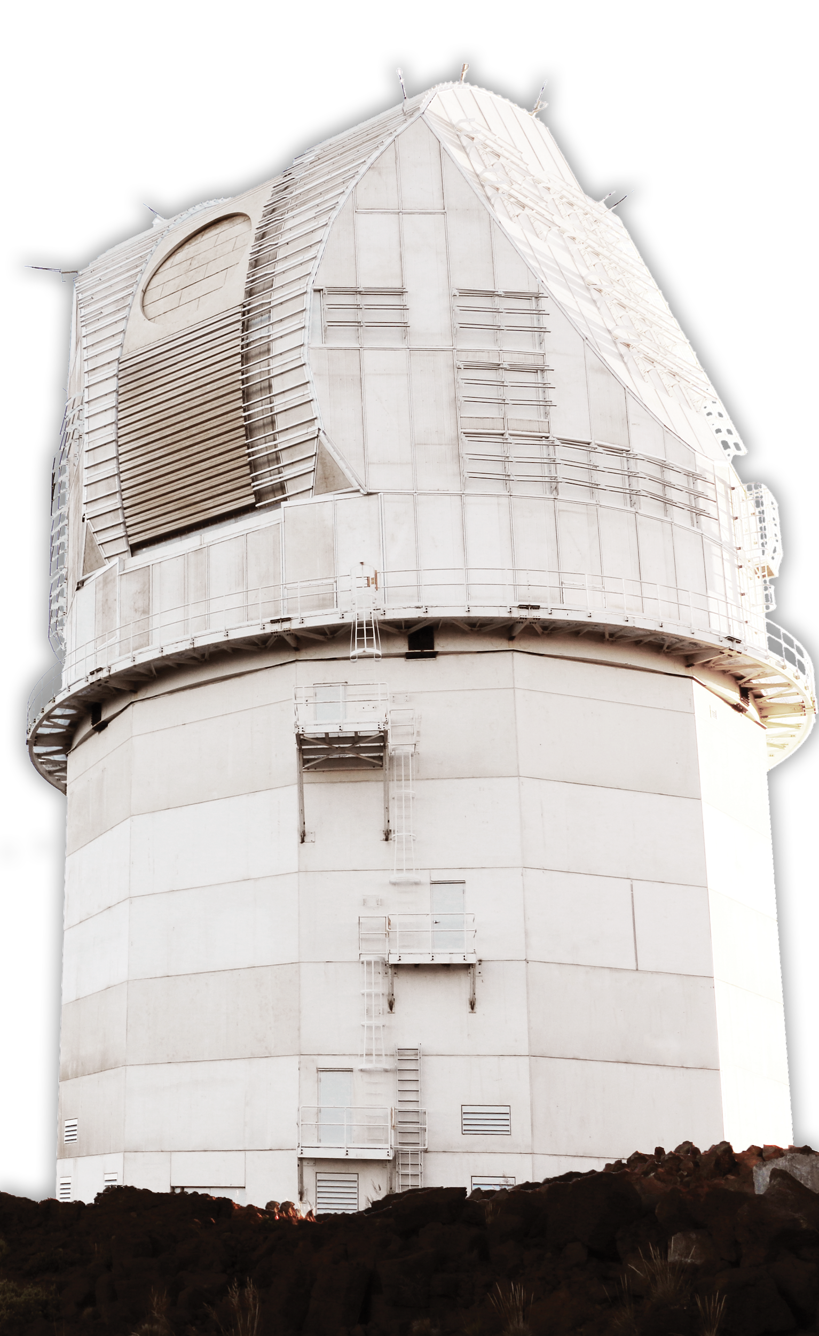
Space-Based vs Ground-based Telescopes
Earth’s Atmosphere

Slide 29
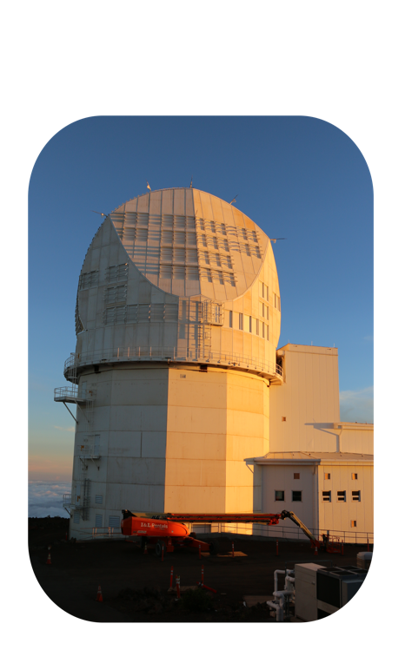
Space-Based Telescopes
Pros:
Cons:
Earth’s atmosphere does not distort images
Can observe X-ray and gamma rays that are blocked by Earth’s atmosphere
Closer to objects in space
More expensive
Difficult to repair in space
Must be small enough to put in a rocket
Once it’s launched, it can’t be improved
Earth’s Atmosphere

Slide 30
Ground-Based Telescopes
Pros:
Cons:
Less expensive than space-based
Easier to fix (don’t have to send people into space)
Can be improved over time
Size is not a limitation (does not need to be launched in to space) e.g we couldn’t launch a 4 meter mirror like DKIST into space!
Requires specific site conditions
(must be located away from light & dust, above the clouds)
Images are not always as clear as space-based, due to blurring caused by Earth’s atmosphere

Slide 31
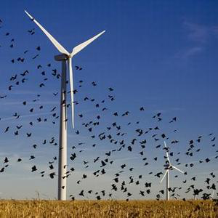
Trade-Offs
Trade off: “If one thing increases, some other thing must decrease”
(A compromise)
Example:
Wind Turbines – Converts the wind’s kinetic energy to electrical energy
Sustainable in terms of energy, but…
Trade Off: Sometimes birds are harmed

Slide 32
Trade-Offs
Trade off: “If one thing increases, some other thing must decrease”
(A compromise)
Can you think of any examples of trade-offs?

Slide 33
Belief Circles
When I show you the statement, hold up a sign.
Thumbs up means you agree
Thumbs down means you disagree
These are your beliefs, there are no
“right” or “wrong” answers

Slide 34
“We don’t need to worry about what’s happening in space because it doesn’t affect us here on Earth”
Thumbs up students pair with a thumbs down student and quickly discuss up

Slide 35
“It is important to study the Sun”
Thumbs up students pair with a thumbs down student and quickly discuss up

Slide 36
“Telescopes are a useful tool for Science”
Thumbs up students pair with a thumbs down student and quickly discuss up

Slide 37
“Advancements in technology are bad for the environment”
Thumbs up students pair with a thumbs down student and quickly discuss up

Slide 38
“Humans would not be able to survive in today’s society without modern technology”
Thumbs up students pair with a thumbs down student and quickly discuss up

Slide 39
“Scientists have a responsibility to help society”
Thumbs up students pair with a thumbs down student and quickly discuss up

Slide 40
Analyzing Real Telescope Data
Complete the following activities to analyze data obtained by real, professional, telescopes and observatories:
“Sunspot Tracking”
“Sunspot Graphing Practice”
Complete the following activity to gather, record, and analyze your own data using the Coronado Personal Solar Telescope!:
“Student Solar Observations”

Slide 41
References:
eGFI-Dream Up the Future. 2010. Lesson: How Telescopes Work. http://www.egfi-k12.org/index_noflash.php. / Retrieved: 07/26/17
Images/media
Digital Image (slides 1&2): Eyes - http://blog.targethealth.com/wp-content/uploads/2011/11/20111104-1.jpg. / Retrieved: 07/27/17
Digital Image (slide 4): Buckets - https://s-media-cache-ak0.pinimg.com/736x/a5/39/9c/a5399c692a2f8fb262a1e2338e942919--buckets-rain.jpg. / Retrieved: 07/27/17
Digital Image (side 4): Light path - http://www.pxleyes.com/images/contests/light-rays-2/fullsize/Spotlight-4d9ab27bcd1e7_hires.jpg / Retrieved: 07/27/17
Digital Image (slide 5): Camera vs Eye - https://petapixel.com/2015/04/04/what-the-naked-eye-sees-in-the-night-sky-compared-to-what-the-camera-can-capture/ Retrieved: 07/28/17
Digital Image (slide 6): Universe - https://playmoss.com/en/music/universe /Retrieved: 07/28/17
Digital Image (slide 9): Orange Sun - https://borntoscience.com/2014/01/01/a-brief-tour-of-the-solar-system-the-sun/ Retrieved: 07/28/17
Digital Image (slide 13): Telescope - http://protelescope.com/astroventure-70mm-refractor-telescope-silver. /Retrieved: 07/28/17
Digital Image (slide 15): Telescope Diagram - http://www.stormthecastle.com/telescopes/difference-between-a-reflector-and-a-refractor.htm. /Retrieved: 07/28/17
Digital Image (slide 17): Telescope Diagram - http://www.derbyastronomy.org/TelescopeBuyingAdvice.htm. /Retrieved: 07/28/17
Digital Image (slide 19): Europe’s Giant Telescope - http://www.skyandtelescope.com/astronomy-news/groundbreaking-europes-next-big-telescope/ Retrieved: 07/28/17
Digital Image (slide 21): Telescope Diagram - http://www.derbyastronomy.org/TelescopeBuyingAdvice.htm /Retrieved: 07/28/17
Digital Image (slide 23): Light Spectrum - http://chemistry.tutorvista.com/organic-chemistry/ir-spectroscopy.html /Retrieved: 07/31/17
Digital Image (slide 23): X-ray Telescope - https://www.space.com/17075-pictures-chandra-x-ray-observatory-space-telescope.html /Retrieved: 07/31/17
Digital Image (slide 25): Sun in Different Wavelengths - http://ecuip.lib.uchicago.edu/multiwavelength-astronomy/astrophysics/02.html /Retrieved: 07/31/17
Digital Image (slide 26): https://en.wikipedia.org/wiki/Telescope /Retrieved: 07/31/17

