Slide 1
Interactive Electromagnetic Spectrum Quiz

Slide 2
Quiz Time!
Electromagnetic Spectrum

Slide 3
Ready?!?
Name the type of Electromagnetic Radiation represented in the photos on each slide

Slide 4
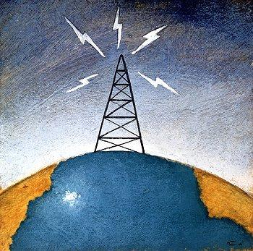
1

Slide 5
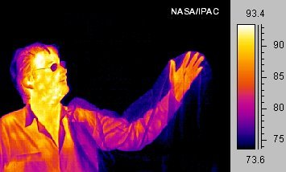
2

Slide 6
3

Slide 7
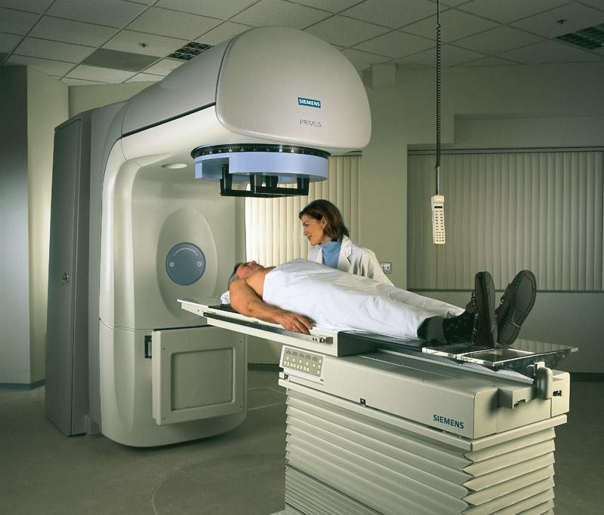
These rays are used in cancer treatment radiation
4

Slide 8
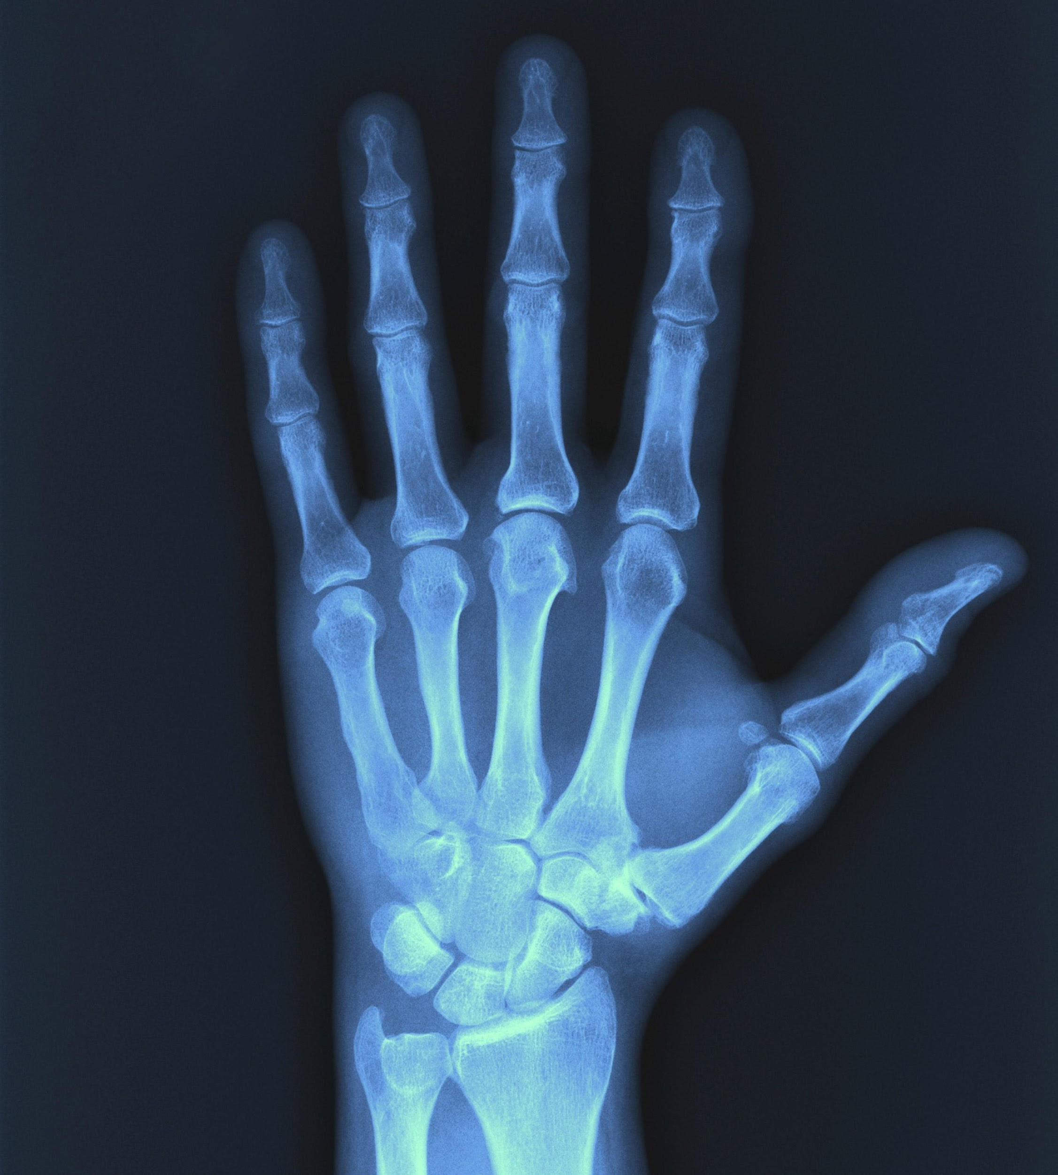
5

Slide 9
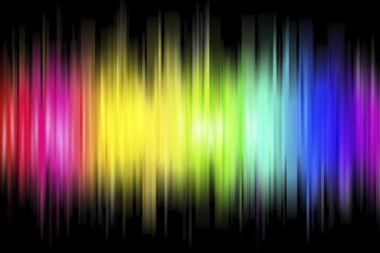
6

Slide 10
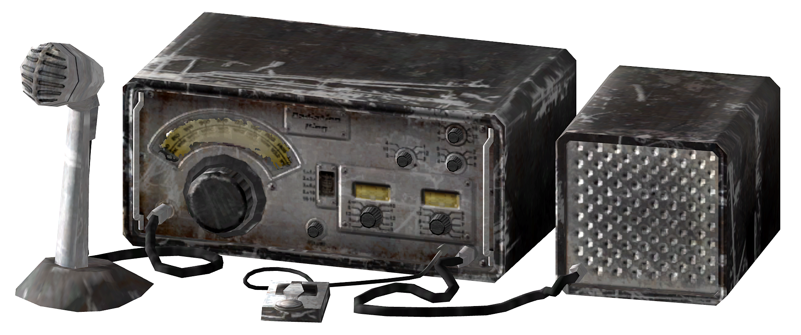
7

Slide 11
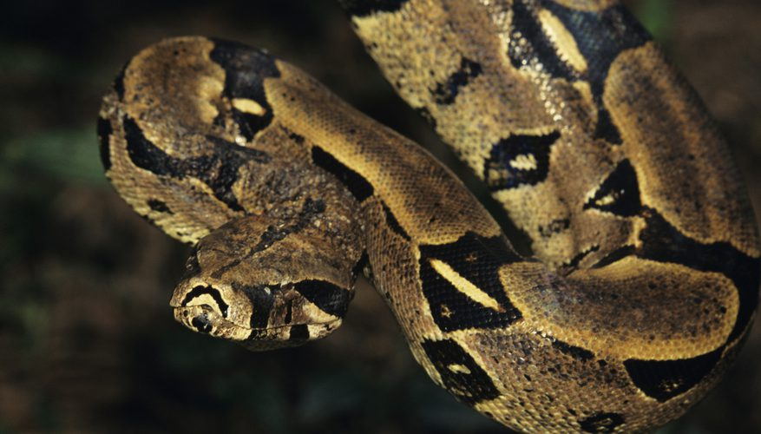
Some species can see in this wavelength of the Electromagnetic Spectrum. They can sense the body heat of their prey
8

Slide 12
9
Which type of radiation is made of wavelengths between 10⁻⁷ and 10⁻⁹ cm?
10³
10
10⁻¹
10⁻³
10⁻⁵
10⁻⁷
10⁻⁹
10⁻¹¹
Wavelength (cm)

Slide 13
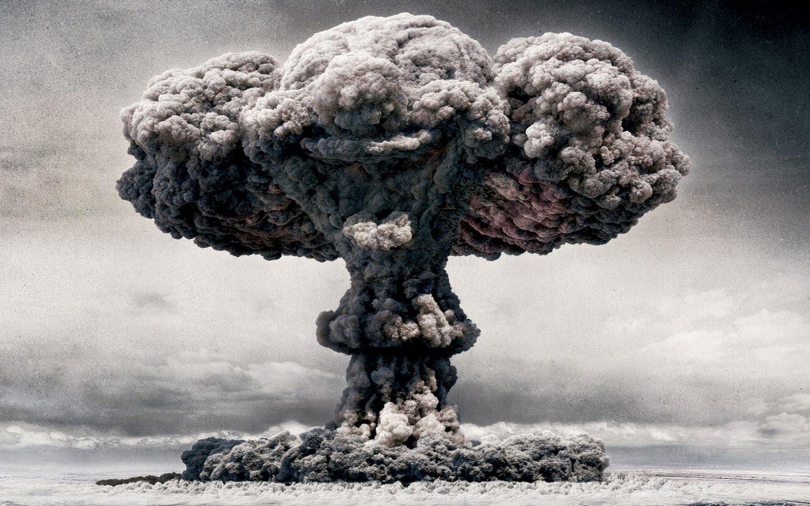
These rays are present in atomic bomb explosions
10

Slide 14
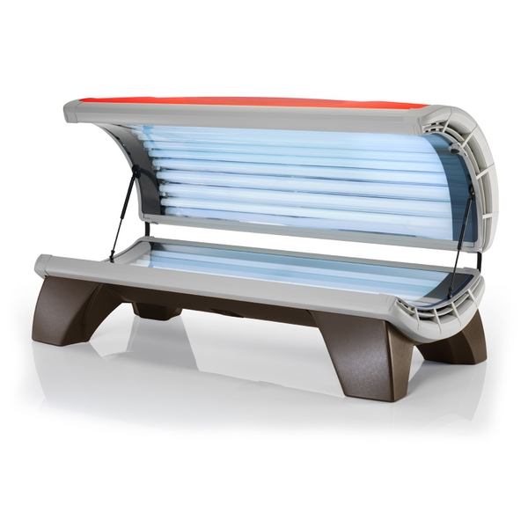
Tanning beds use this type of radiation, which is widely known to cause skin cancer
11

Slide 15
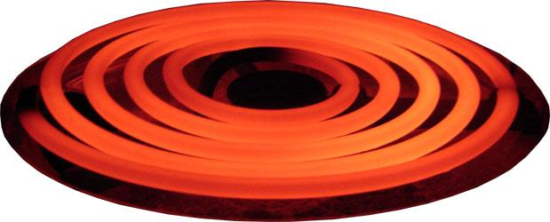
12

Slide 16
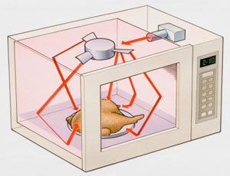
13

Slide 17
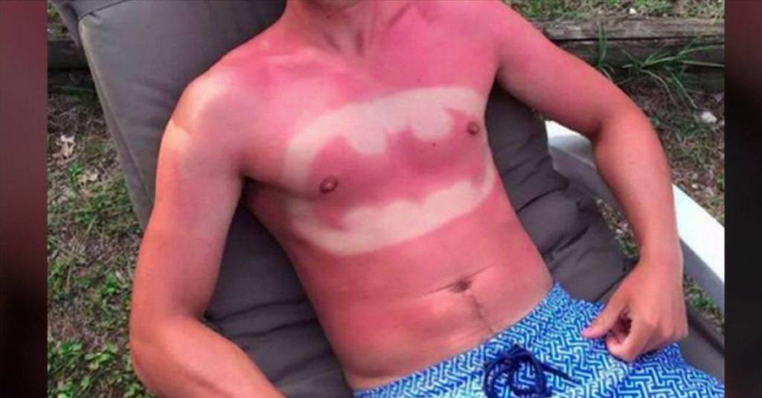
Wear sunscreen to protect your skin from these harmful rays
14

Slide 18
15

Slide 19
Answers

Slide 20
1

Slide 21
Radio
1

Slide 22
2

Slide 23
Infrared
2

Slide 24
3

Slide 25
Radio
3

Slide 26
These rays are used in cancer treatment radiation
4

Slide 27
Gamma
4
These rays are used in cancer treatment radiation

Slide 28
5

Slide 29
X-Ray
5

Slide 30
6

Slide 31
Visible
6

Slide 32
7

Slide 33
Radio
7

Slide 34
Some species can see in this wavelength of the Electromagnetic Spectrum. They can sense the body heat of their prey
8

Slide 35
Some species can see in this wavelength of the Electromagnetic Spectrum. They can sense the body heat of their prey
8
Infrared

Slide 36
Which type of radiation is made of wavelengths between 10⁻⁷ and 10⁻⁹ cm?
9
10³
10
10⁻¹
10⁻³
10⁻⁵
10⁻⁷
10⁻⁹
10⁻¹¹
Wavelength (cm)

Slide 37
X-Ray
9
Which type of radiation is made of wavelengths between 10⁻⁷ and 10⁻⁹ cm?
10³
10
10⁻¹
10⁻³
10⁻⁵
10⁻⁷
10⁻⁹
10⁻¹¹
Wavelength (cm)

Slide 38
These rays are present in atomic bomb explosions
10

Slide 39
These rays are present in atomic bomb explosions
10
Gamma

Slide 40
Tanning beds use this type of radiation, which is widely known to cause skin cancer
11

Slide 41
Ultraviolet
11
Tanning beds use this type of radiation, which is widely known to cause skin cancer

Slide 42
12

Slide 43
Infrared
12

Slide 44
13

Slide 45
Microwave
13

Slide 46
Wear sunscreen to protect your skin from these harmful rays
14

Slide 47
Ultraviolet
14
Wear sunscreen to protect your skin from these harmful rays

Slide 48
15

Slide 49
Visible
15

Slide 50
References
Boardman, R. 2017. Animals that see in infrared. Sciencing.com. http://sciencing.com/animals-can-see-infrared-light-6910261.html.
National Cancer Institute. Radiation Therapy for Cancer. https://www.cancer.gov/about-cancer/treatment/types/radiation-therapy/radiation-fact-sheet / Retrieved on 8/2/17
Images/Media:
Digital Image (slides 4,20,21 ): Radio tower – Corbisimages.com: https://www.pinterest.com/pin/526639750146192384/ Retrieved 8/2/17
Digital Image (slides 5,22,23 ): Human Infrared - http://www.wikiwand.com/en/Infrared /Retrieved 8/2/17
Digital Image (slides 6,24,25 ): Cell Phone - http://www.clipartpanda.com/categories/no-cell-phone-clipart /Retrieved 8/2/17
Digital Image (slides 7,26,27 ): Cancer Treatment - http://www.xxszxyy.com.cn/ Retrieved 8/2/17
Digital Image (slides 8,28,29 ): X-Ray - http://pulsemedicalimaging.com.au/x-ray/ / Retrieved 8/2/17
Digital Image (slide 9,30,31 ): Visible Colors - https://www.thoughtco.com/the-visible-light-spectrum-2699036 /Retrieved 8/2/17
Digital Image (slides 10,32,33 ): Radio - http://fallout.wikia.com/wiki/Ham_radio /Retrieved 8/2/17
Digital Image (slides 11,34,35): Snake - http://sciencing.com/animals-can-see-infrared-light-6910261.html /Retrieved 8/2/17
Digital Image (slides 13,38,39 ): Atomic Bomb Explosion – Wallpapercave.com: https://www.pinterest.com/pin/572449802619043813/ /Retrieved 8/2/17
Digital Image (slides 14,40,41 ): Tanning Bed - https://www.familyleisure.com/Blog/Tanning-Beds-Electrical-Requirements /Retrieved 8/2/17
Digital Image (slides 15,42,43 ): Stove Coil - http://zenstoves.net/StoveSystems.htm /Retrieved 8/2/17
Digital Image (slides 16,44,45 ): Microwave - https://www.maryvancenc.com/is-your-microwave-destroying-your-health/ Retrieved 8/2/17
Digital Image (slides 17, 46, 47 ): Sunburn - http://www.wccbcharlotte.com/2016/05/31/bad-cases-of-sunburn-photos/ / Retrieved 8/2/17

