Slide 1
How Do Solar Events Affect Life on Earth?

Slide 2
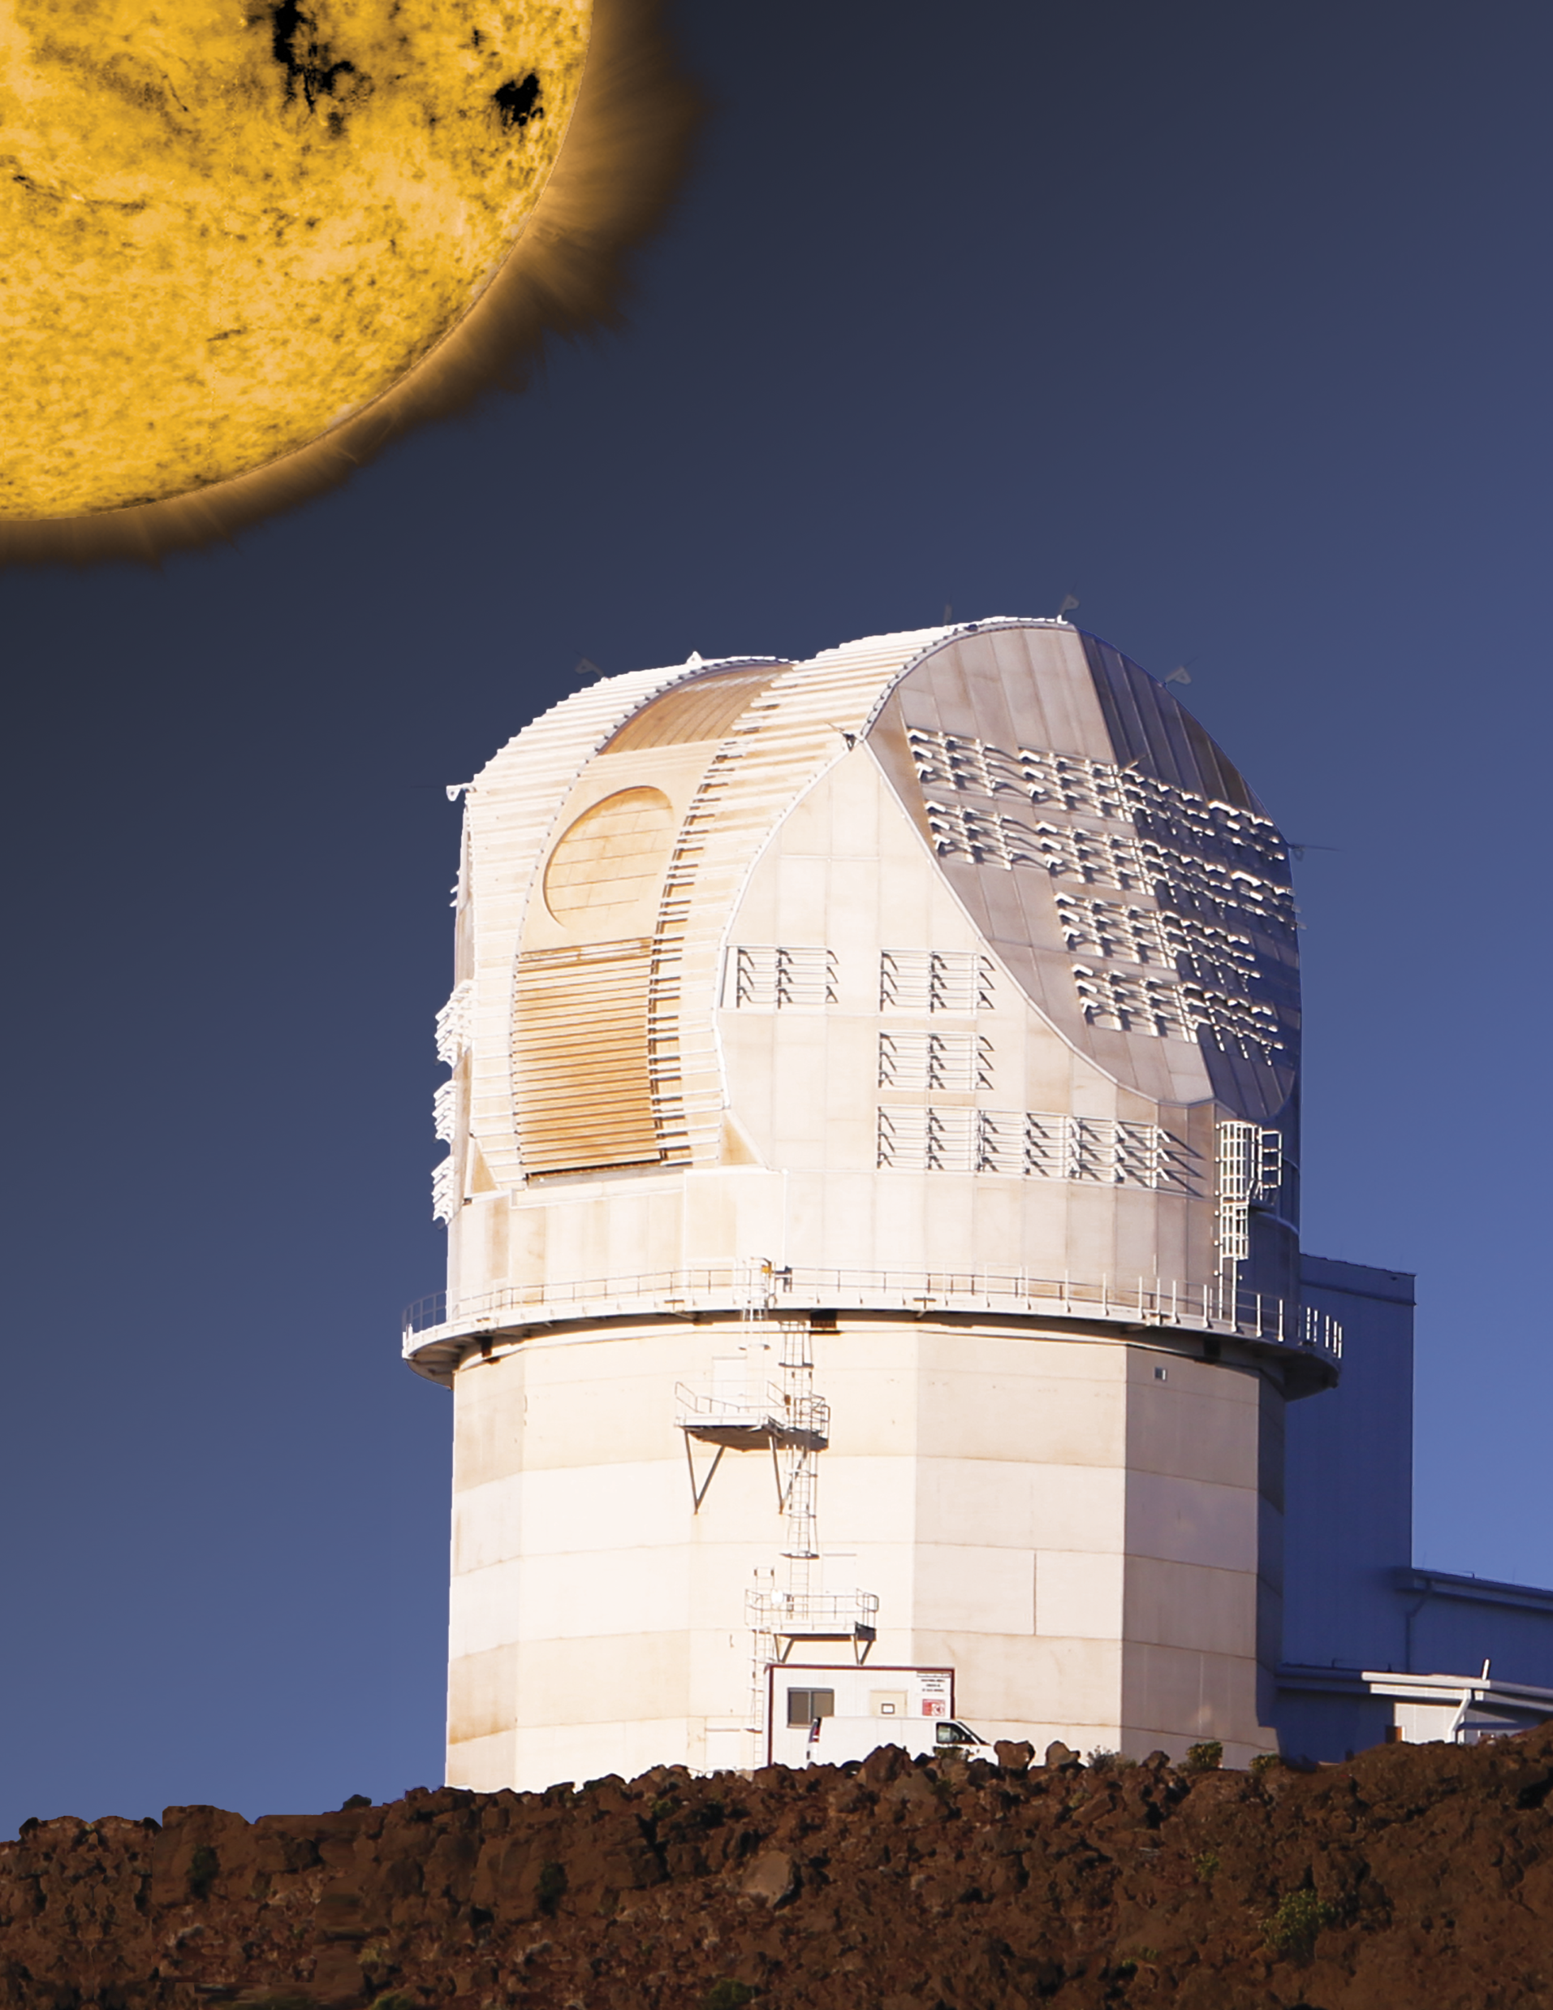
Why is it important for Solar Scientists to know about how the Sun “works”?

Slide 3
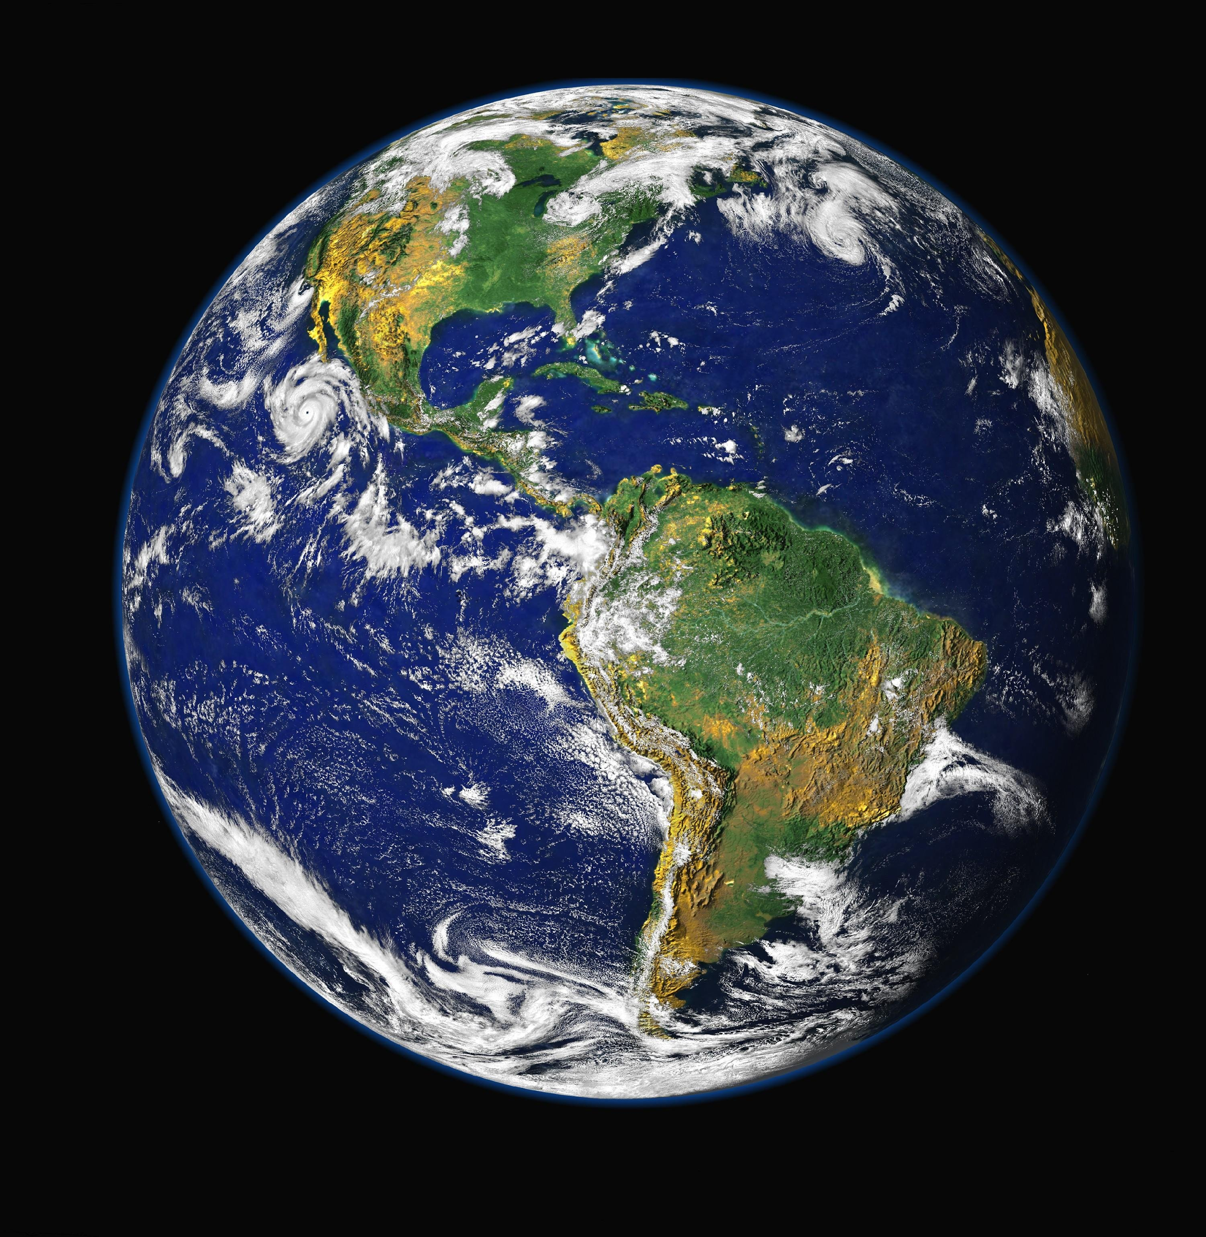
We Rely on the Sun!
Sunspots
Filaments
Prominences
Solar Flares
Coronal Mass Ejections (CMEs)
All these solar events can affect the people living on EARTH!
Notes:
https://www.youtube.com/watch?v=6lfm1FpX--E.

Slide 4
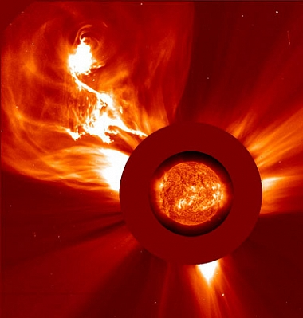
Coronal Mass Ejections | Solar Flares
Release explosions of magnetic field, protons and electrons (matter) | Release electromagnetic radiation (light / energy)
Particles take 2-3 days to reach Earth | Travels at the speed of light, takes 8 minutes to reach Earth
Carries a magnetic field that can interact with Earth’s magnetic fields (can make technologies “screwy”) | Increase in EM radiation can cause disruptions in radio communications and GPS.

Slide 5
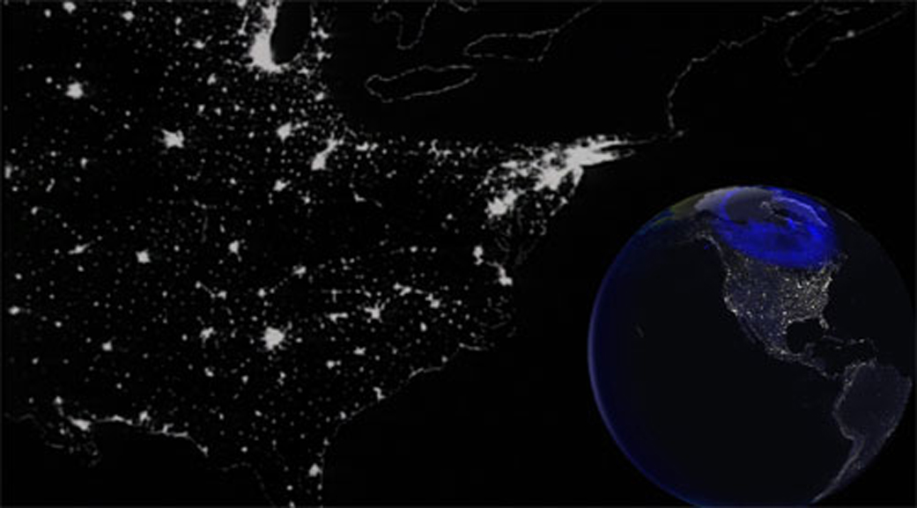
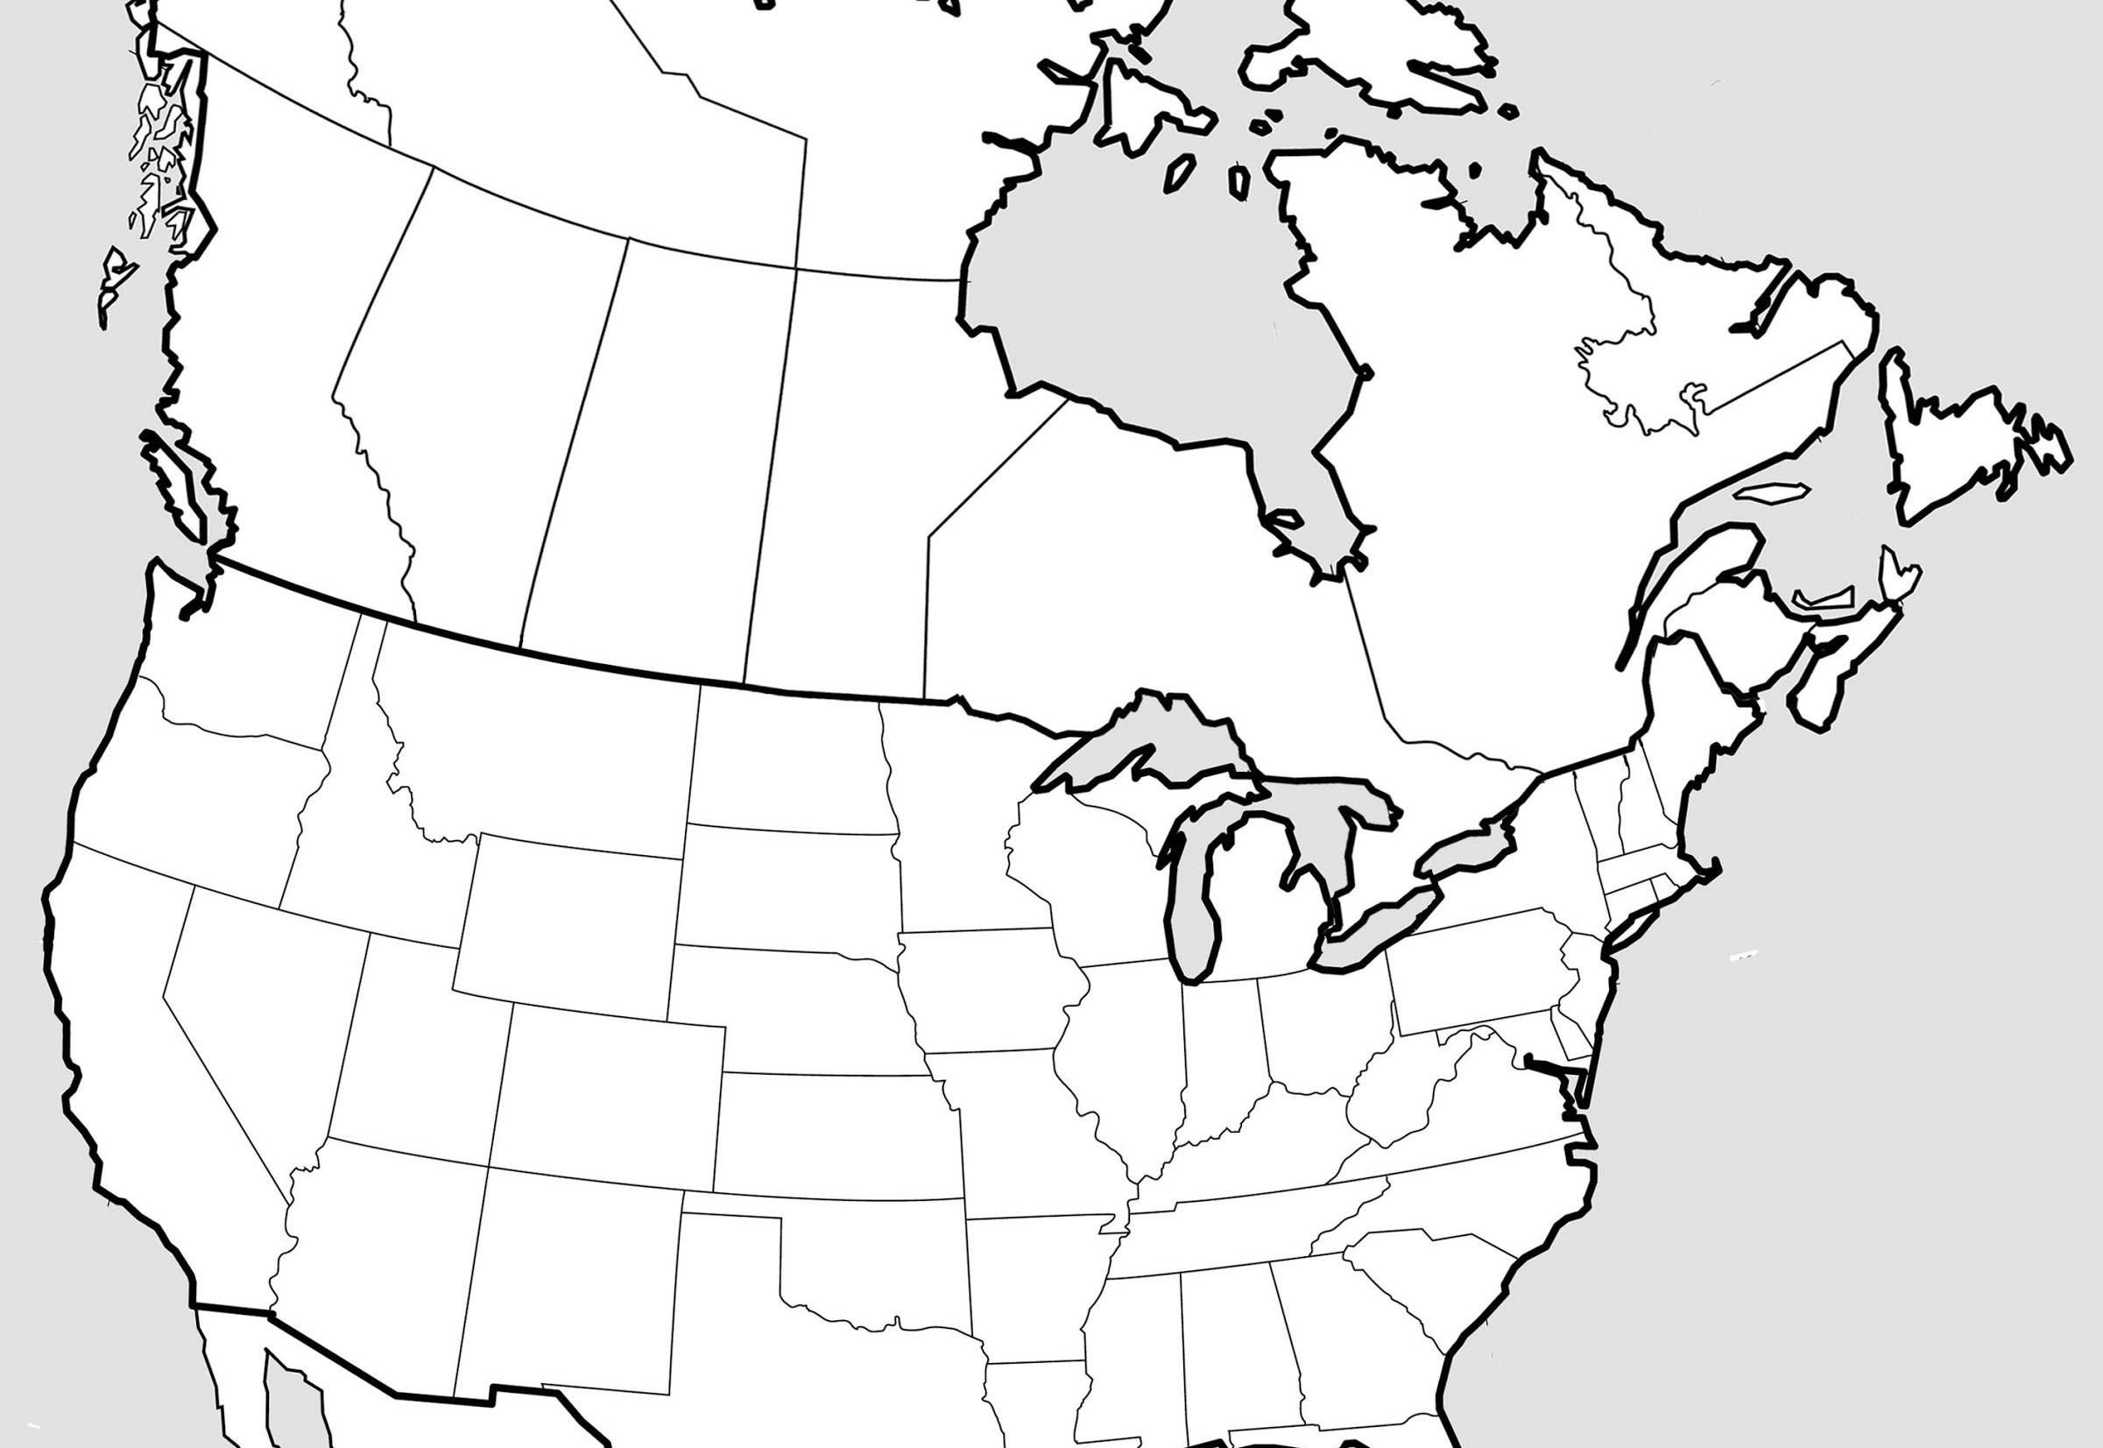
Real-World Example of Coronal Mass Ejection (CME) Impacts
March 13, 1989 – Collapse of the Hydro-Quebec power network
Occurred due to a March 10th, 1989 CME and associated magnetic field, which caused variations in Earth’s magnetic fields and tripped power-grid circuit breakers.
https://www.nasa.gov/topics/earth/features/sun_darkness.html

Slide 6
The Big CME that Missed Earth
One of the largest, fastest, Coronal Mass Ejections on record occurred on July 23, 2012.
If this CME had hit Earth, it could have seriously disrupted electrical power grids, causing widespread power outages and possibly permanent damage to electrical infrastructure.
The economic impact of such a hit, is estimated to be around $2,000,000,000,000 (2 trillion dollars)
In the video, note Earth’s location in its orbit, and how close of a shave this event really was! (large CME seen at 0:09)
Notes:
Green represents particle density, usually protons and other ions. Red represents particles at high temperatures and shows the CME is hotter than the usual solar wind flow. Large changes in density are represented in blue.

Slide 7
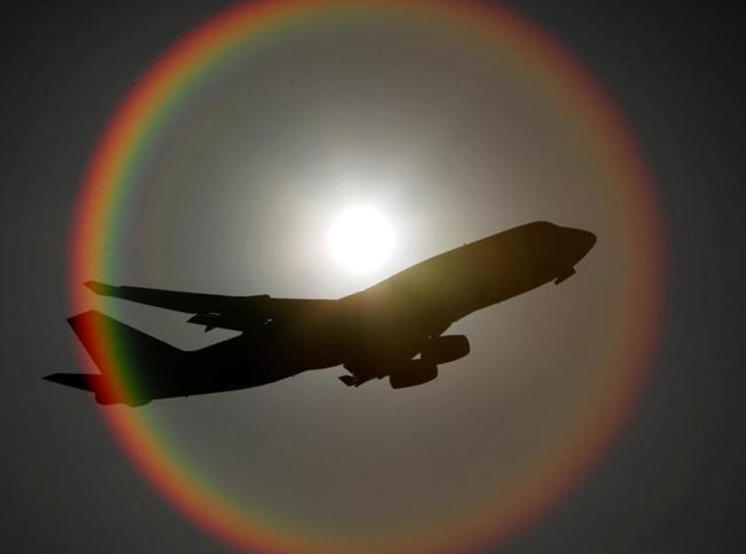
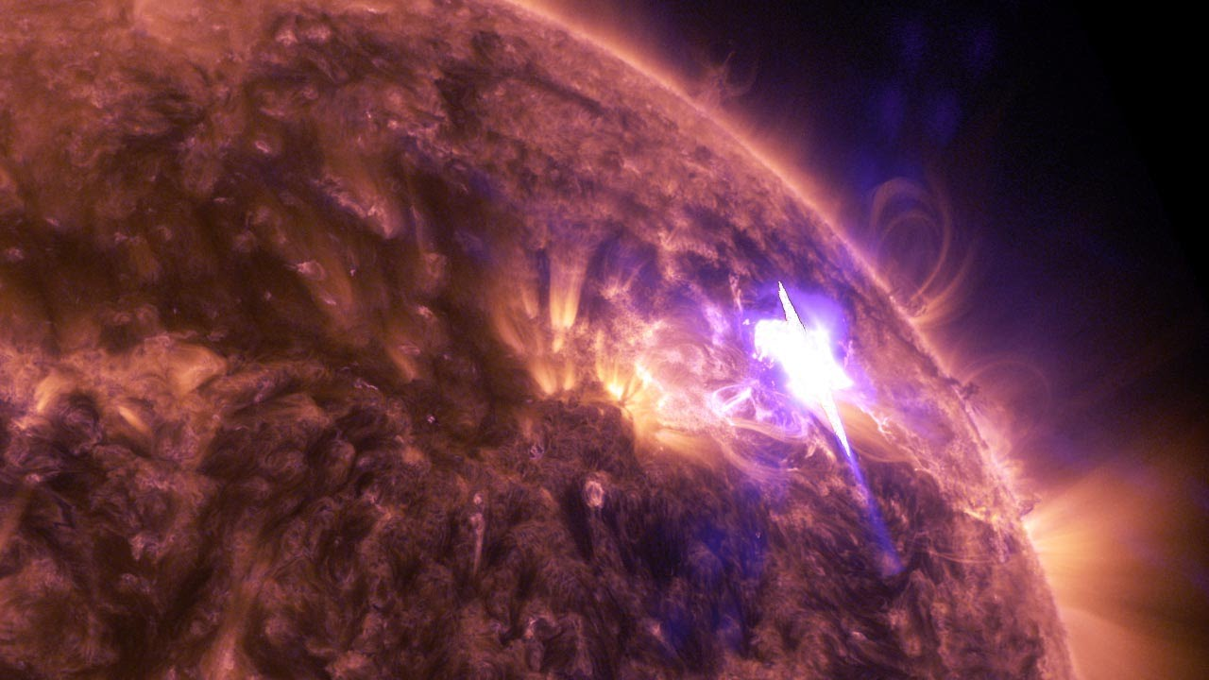
Real-World Example of Solar Flare Impacts
Pilots and aircrew are classified as radiation workers due to the extra exposure to radiation that they receive from the Sun. This exposure comes from flying at high altitudes where the atmosphere is thinner and thus there is less protection from solar radiation.
Additionally,
Due to solar flare impacts, the FAA requires planes to be in communication with the ground at all time. During a solar storm, changes in Earth’s upper atmosphere make long-wave radio communications unreliable near the poles, so planes are not allowed to take polar routes.

Slide 8
Calling All Hawaiʻi Solar Scientists!
Investigate mysterious events by gathering evidence to determine their source.

Slide 9
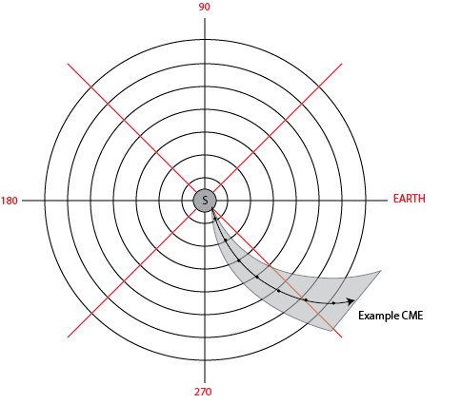
CME Plotting Activity
Plot CME locations over time, as they emerge from the Sun. Map their paths and determine how likely they are to hit Earth.

Slide 10
References:
NASA. 2003. Living with a Star-GEMS Teacher’s Guide for Grades 6-8. University of California, Berkley, CA.
Raftery, Claire. Pers.comm. 2017. National Solar Observatory.
Sun-Earth. NASA. https://www.nasa.gov/mission_pages/sunearth/spaceweather/index.html#q14 . Retrieved 07/26/2017
Solar Flares (Radio Blackouts) - https://www.swpc.noaa.gov/phenomena/solar-flares-radio-blackouts Retrieved 02/06/18
The day the sun brought darkness - https://www.sciencedaily.com/releases/2009/03/090316144521.htm Retrieved 02/06/18
What Aircrews should know about their occupational exposure to ionizing radiation. https://www.faa.gov/data_research/research/med_humanfacs/oamtechreports/2000s/media/0316.pdf /Retrieved 09/06/17
Images/Media:
Seinfield Gif (slide 2):– https://media.giphy.com/media/bkKvvzE9PEcTK/giphy.mp4. Retrieved 09/06/2017
Digital Image (slide 2): Question Mark - http://www.northlandinspections.com/assets/img/Home/Question.png. Retrieved 07/26/2017
Digital Image (slide 2): DKIST - NSO Staff / National Science Foundation Funded
Digital Image(slide 3): Sun – SWAP/PROBA2 imager - http://proba2.sidc.be/about/SWAP. Retrieved 7/24/17
Digital Image (slide 3): Earth - https://www.pexels.com/photo/sky-earth-galaxy-universe-2422/ Retrieved 3/1/18
Digital Image (slide 5): Quebec Hydro - https://www.nasa.gov/topics/earth/features/sun_darkness.html / Retrieved 3/1/18
Digital Image (slide 5): Quebec Map - http://thempfa.org/outline-map-us-and-canada/outline-map-us-and-canada-uscanadapoliticalblank/ Retrieved 3/1/18
Digital Image (slide 6): Airplane Solar Flare - http://www.bbc.com/future/story/20131113-the-supernova-inside-your-plane. / Retrieved 09/06/17

